Slide 1
FIRST LEGO League
Project
Notes:
Welcome to FIRST LEGO League Judge training.

Slide 2
Inspiration for Presentation
FLL Project Resources
https://www.firstlegoleague.org/season#resources
VA-DC FLL Organization Project Resources
https://va-dcfll.org/fll-c/teams/project-resources/
Of particular use:
FLL Challenge Innovation Project Worksheets
Multimedia Resources
Team Meeting Guide
Engineering Notebook

Slide 3
Topics
Review Challenge Text & Key Words/Requirements
Review Project Rubric
Suggested Schedule
Brainstorming Prompts
Project Sparks
Project Ideas
Project Resources and STEAM Resources

Slide 4
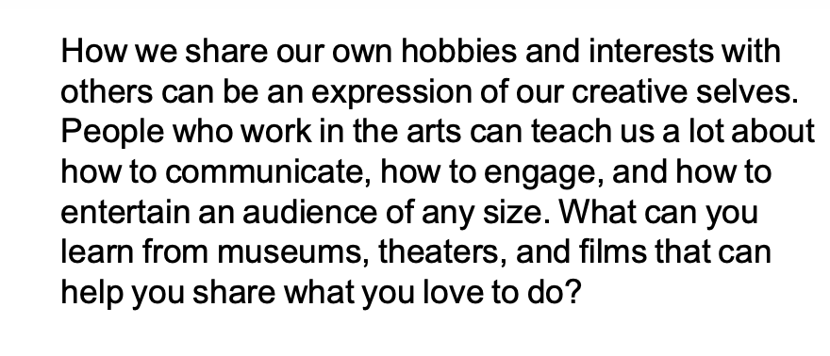
Welcome to the Project!

Slide 5
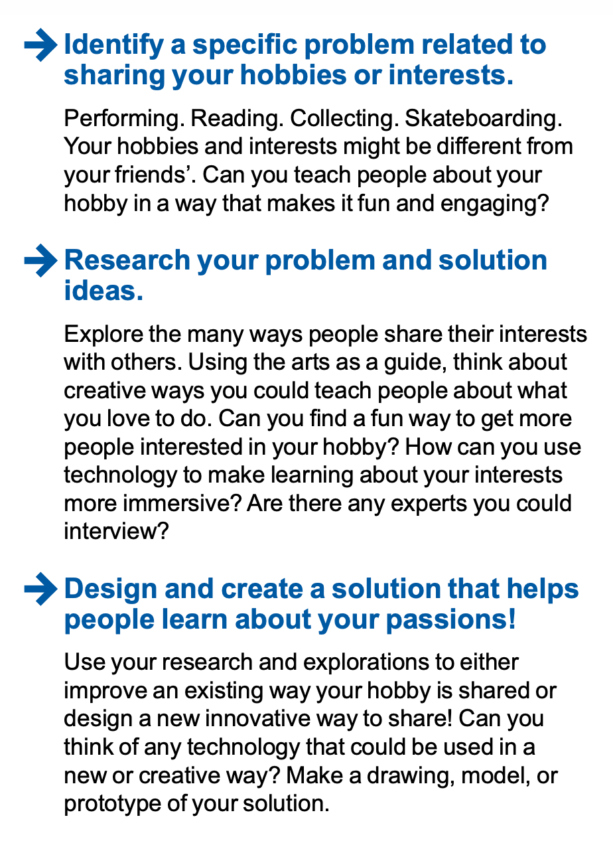
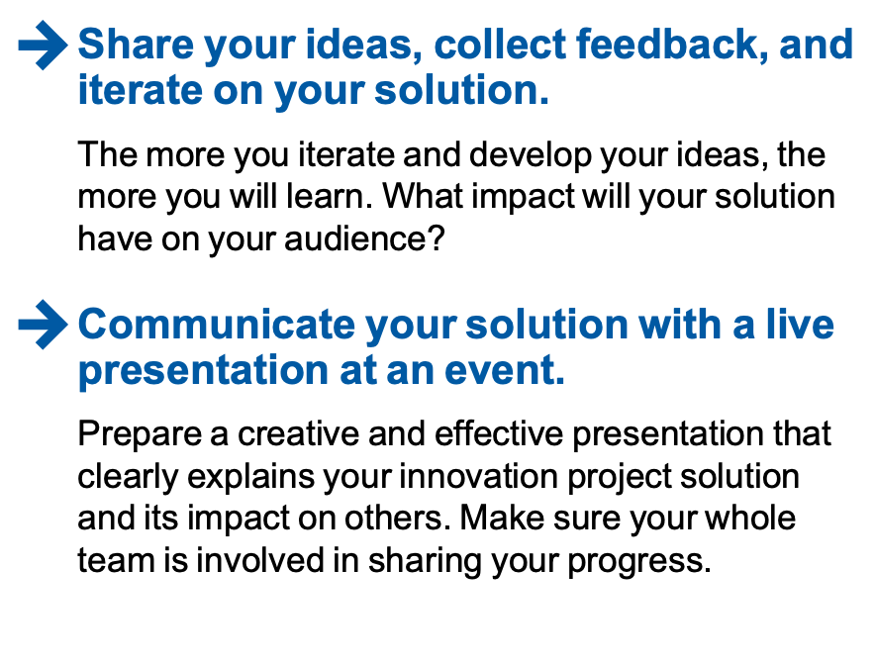
Challenge Statement (con’t)

Slide 6
Key Words & Requirements
“sharing your hobbies or interests”
“explore ways people share interests…teach people…learning about interests”
“improve an existing way…design a new innovative way”
“use arts as a guide”
“think of technology”
“create a model, drawing or prototype”
“share your ideas, collect feedback…iterate”
“impact…on your audience”
“live presentation”
“whole team is involved”

Slide 7
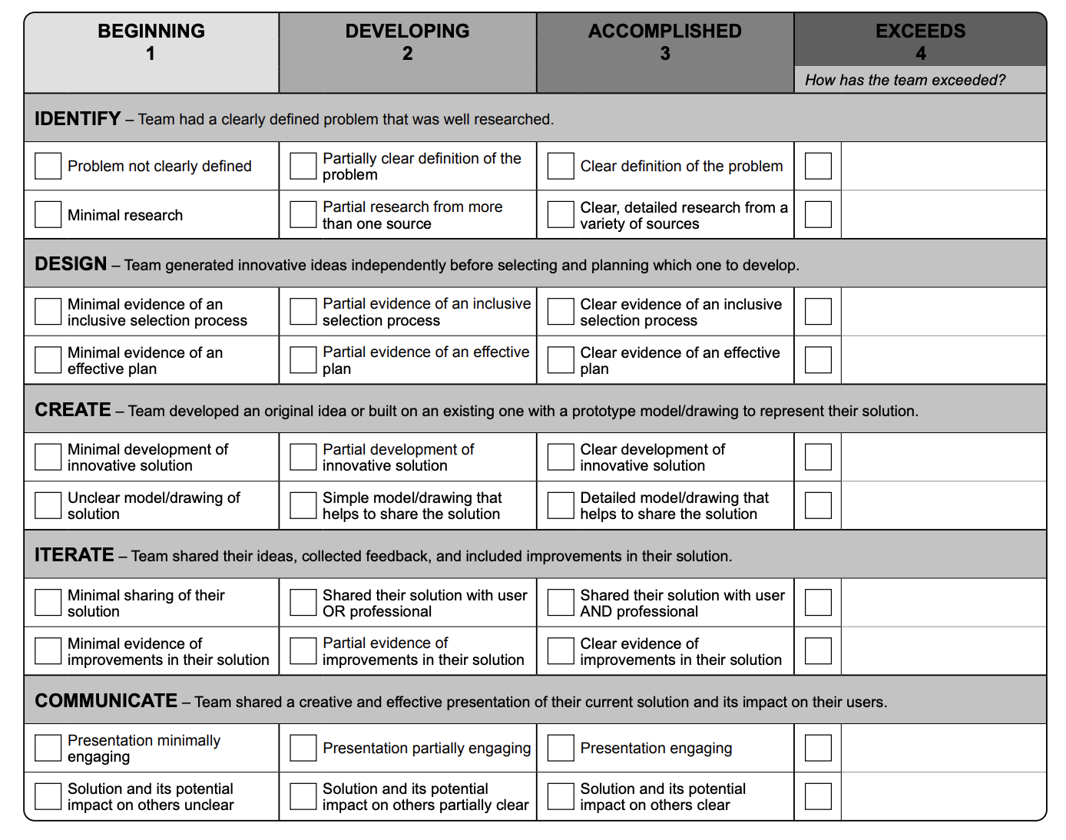
Create a Plan – Study Rubric

Slide 8
Suggested Focus: 12 weeks
Weeks 1-5: Identify & Design
Tasks: Everyone Research Problems and Existing Solutions
Weeks 5-7: Design & Create
Tasks: Select team problem; Everyone to come up with solutions; Select team solution
Weeks 8-10 : Create & Iterate
Tasks: Develop solution; Create Model/prototype;
Share with users/experts; Use feedback to improve solution
Weeks 11-12: Communicate
Tasks: Select skit/method of communication as a team;
Write Script; Practice as a team

Slide 9
Brainstorming Prompts
How can you use technology and the arts to help engage others or increase participation in what you love to do?
Identify hobbies/interests/what you love to do. This can be any hobby or interest (not just arts-related). What do your team members love to do?
“Identify a specific problem related to sharing your hobbies or interests.” Who currently participates in the activity? Why do some people not participate in that activity? How do you learn or even view (spectate) the activity? Are there limitations? What problem has our team identified?
“Can you teach people about your hobby in a way that makes it fun and engaging?” How can we solve the problem we identified while making it more fun and engaging to learn more about the hobby we picked?
“How can you use technology and the arts to help engage others or increase participation in what you love to do?" How are we incorporating technology and the arts in our solution?
“Design and create a solution that helps people learn about your passions!” What type of diagram, model, or prototype can we make for our solution? How can we test it out?
“Share your ideas, collect feedback, and iterate on your solution.” Who can we share our solution with to get feedback?

Slide 10
Project Spark – Museum Curator

Slide 11
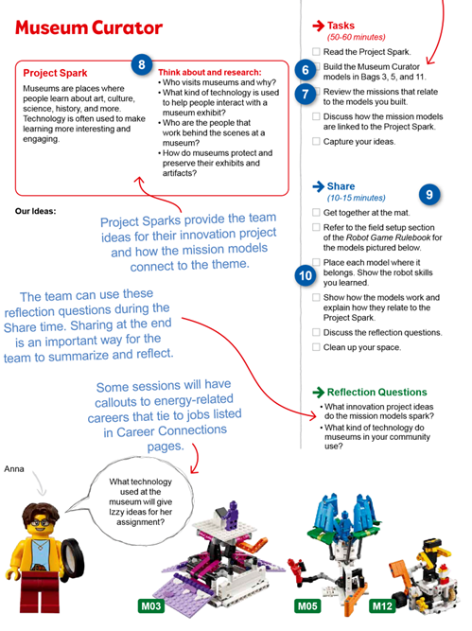
Project Sparks – Museum Curator
M03: Immersive Experience; M05: Augmented Reality Statue; M12: Virtual Reality Artist

Slide 12
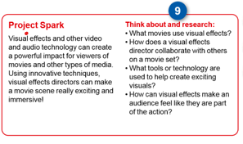
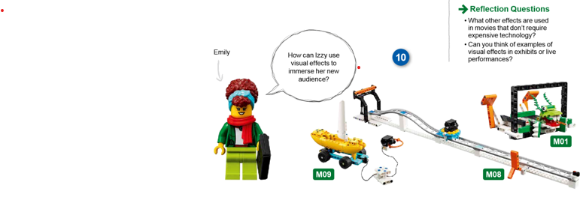
Project Sparks – Visual Effects Dir.
M01: 3D Cinema; M08: Rolling Camera on Truck; M09: Movie Set

Slide 13
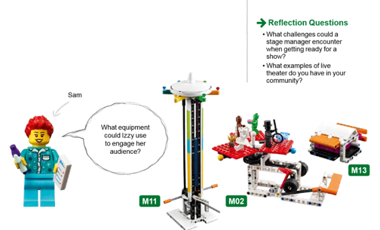
Project Spark: Stage Manager
M02:Theater Scene; M11: Light Show Worm Gear Tech; M13: Craft Creator

Slide 14
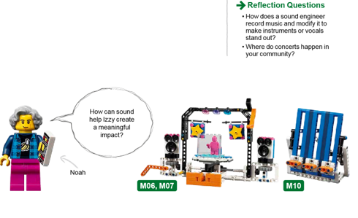
Project Spark: Sound Engineer
M06: Lights & Sound; M07: Hologram Performer; M10: Sound Mixer

Slide 15
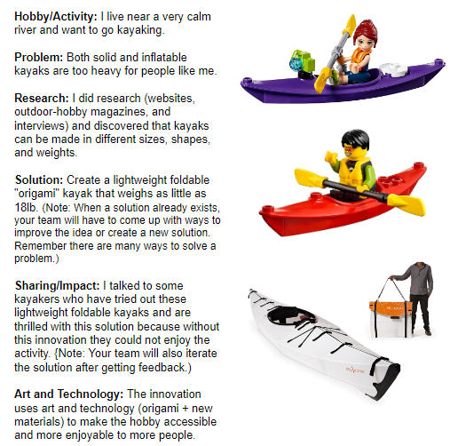
Project Idea: Kayaking

Slide 16
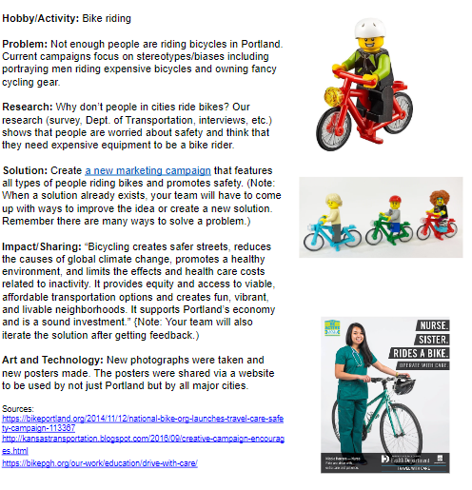
Project Idea: Bike Riding

Slide 17
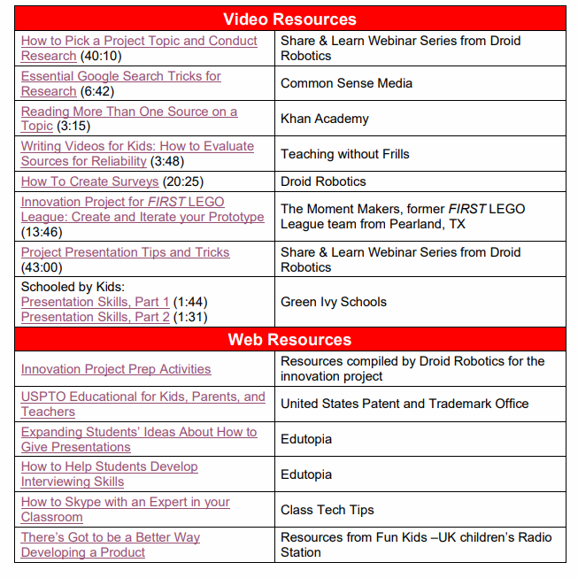
Project Resources

Slide 18
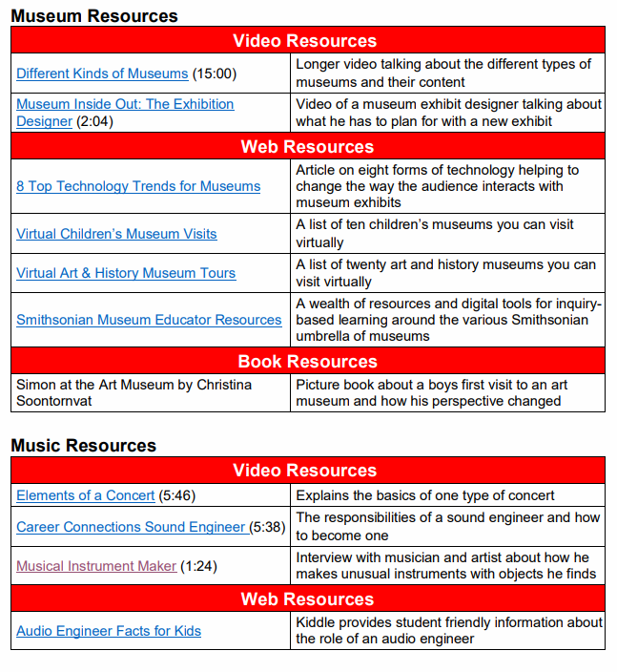
STEAM Resources

Slide 19
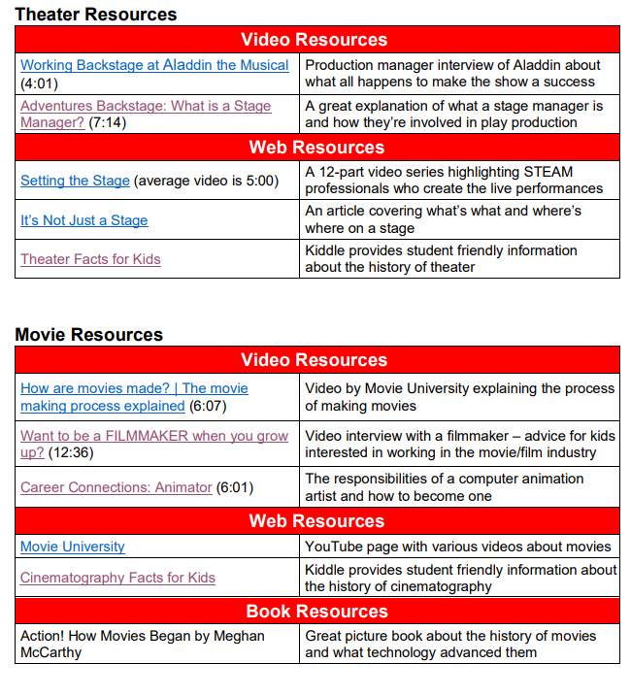
STEAM Resources

Slide 20
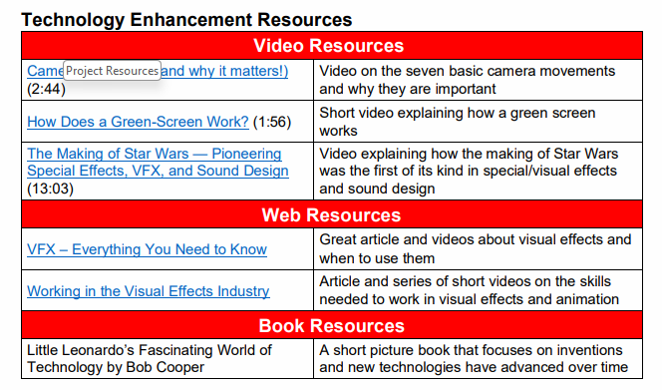
STEAM Resources

