Slide 1
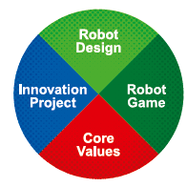

Innovation Project Approach
Notes:
Welcome to FIRST LEGO League Judge training.

Slide 2
Topics
Review Challenge Text & Key Words/Requirements
Review Project Rubric
Suggested Schedule
Innovation Project Considerations
Resources
Reference Material

Slide 3
Review the Challenge Topic and Understand the Process

Slide 4
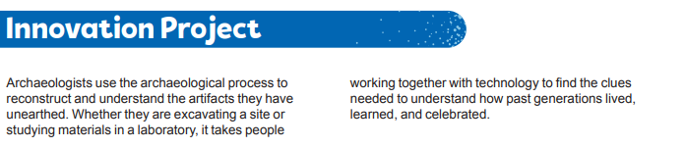
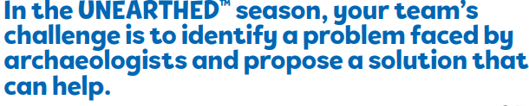
Welcome to the Project!

Slide 5
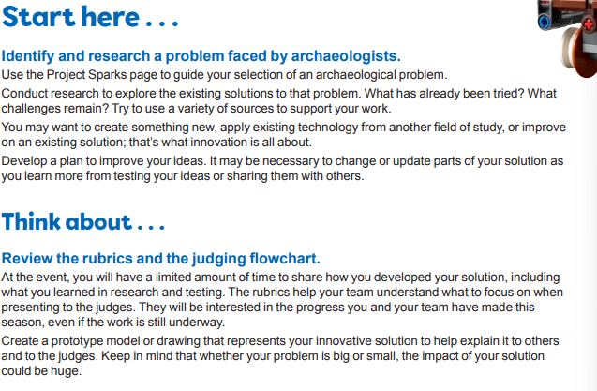
Innovation Project - What is Involved
improve an existing way
Research – use various resources
design a new innovative way
share your ideas, collect feedback…iterate
Understand what impact your solution has
create a model, drawing or prototype

Slide 6
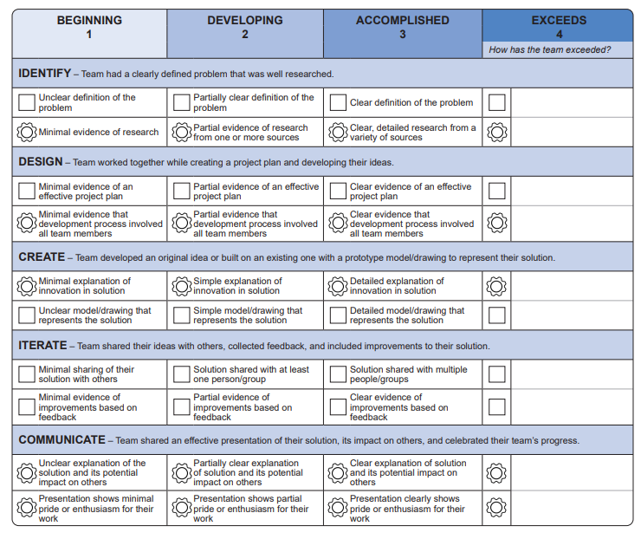
Understand Rubric Before You Start
Remember: Core Values are inbuilt

Slide 7
Suggested Plan

Slide 8
Suggested Focus: 12 Sessions
Sessions
1-5
Sessions
5-7
Sessions
8-10
Sessions
11-12
Identify and Design
Everyone Research Problems and Existing Solutions
Design and Create
Select Team Problem
Everyone to Come up with Solutions
Create and Iterate
Develop
Solution
Create Model/prototype
Communicate
Select method of Communication /delivery as a Team
Select Team Solution
Share with Users/Experts
Iterate and Improve
Practice and Deliver as a Team
Use all Available Resources

Slide 9
Innovation Project Considerations

Slide 10
Innovation Project Considerations
Identify and Design
Divide and conquer – everyone contributes
Let the team learn – there are no bad ideas
Widen the search, topics, and research (full freedom at this stage)
Topic can be narrow or wide (large); finding a topic that is applicable locally can be quite powerful (Judges will be able to relate faster)
Talk to experts in the field (in person or remote). It may validate ideas or give new direction
If possible, take a fieldtrip (make it fun)
Design and Create
Narrow down selection and problem topics or areas
What topic your team is passionate about? This is important
Enjoy the process – if possible agree, with the team how team will narrow the topics
Identify solution (perhaps a draft)

Slide 11
Innovation Project Considerations
Create and Iterate
Build and solidify solution
Review with at least one (more is better) expert; seek feedback and iterate
Improve model/prototype/diagram (depending on the solution)
Model does not have to be expensive (be creative)
Communicate
Build Project Board
What to cover on the project board:
Problem Statement and Solution
Research summary/finding and what the team learned
What other topics were considered
Pictures such as fieldtrip
Present your research and solution to others – community, friends, other FLL teams
Have script/skit – fund fun way to deliver with enthusiasm

Slide 12
Innovation Project Considerations
Help with obstacles and provide guidance don’t do the work for them
Take help from a parent/mentor or co-coach to maintain progress/schedule
Judges do look for signs that team/kids did the work
Look for tangible/physical solution not just an idea
What does core value in innovation project mean?
Don’t forget core values!
Have Fun
Learn
Solution evolution
Celebrate Your Success

Slide 13
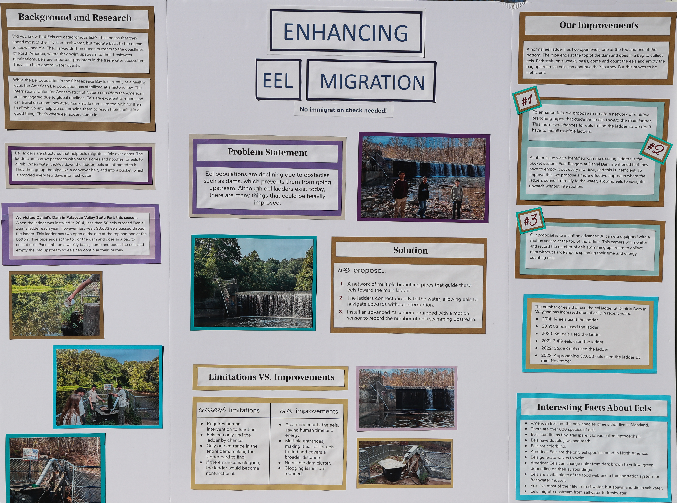
Sample Project Trifold by “Over Coded”

Slide 14
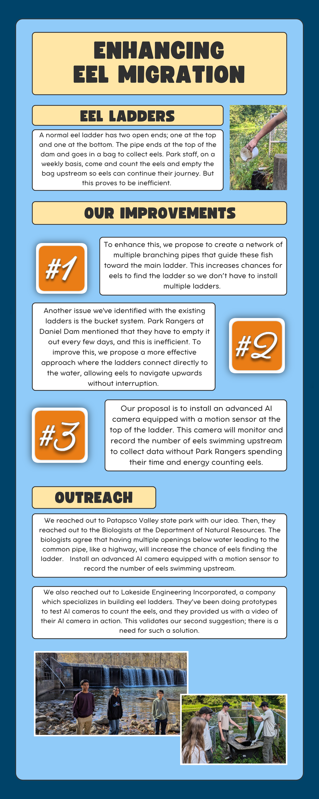
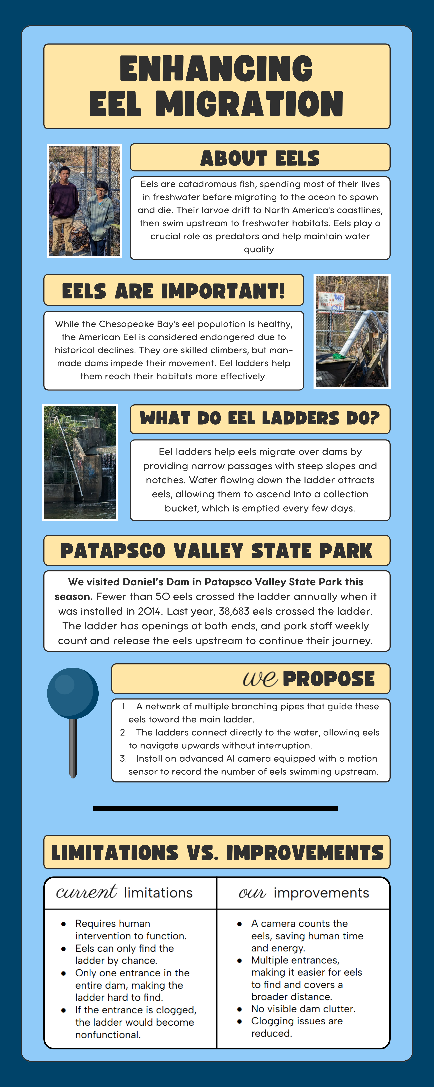

Sample Project Banner by “Over Coded”

Slide 15
Helpful Questions to Stay on Track
“Identify” Read the project sparks, review the challenge story, and explore the different careers that archeologists choose. Which careers do the members of the team find most interesting?
“Research” What issues do your favorite 2 or 3 careers face? Are any of them problems that your team finds interesting?
3. “Design and create a solution” What type of diagram, model, or prototype can we make for our solution? How can we test it out?
4. “Share your ideas, collect feedback, and iterate on your solution.” Who can we share our solution with to get feedback? How can we improve our solution based on this feedback? Can we develop an improved prototype, diagram, or model? Who can we ask to give us feedback on the new model?
5. “Review rubrics and judging process” What do we have to tell the judges? What is the best approach to explaining what we’ve done? How can our diagram, model, or prototype help us explain the project? What impact could our solution could have on the

Slide 16
Helpful Resources

Slide 17
Resources
1 | Home page for the season resources | https://www.firstlegoleague.org/season#resources
2 | Excellent collection of references and links to resources for project selection and Archaeology knowledge | https://firstinspires.blob.core.windows.net/fll/challenge/2025-26/fll-challenge-unearthed-multimedia-resources.pdf
3 | Archaeological Institute of America’s outreach to FLL community including Q/A | https://www.archaeological.org/programs/educators/first-lego-league-challenge-2025-2026/
4 | VA-DC FLL Organization Project Resources | https://va-dcfll.org/fll-c/teams/project-resources/
5 | Innovation project judging rubric | https://firstinspires.blob.core.windows.net/fll/challenge/2025-26/fll-challenge-unearthed-rubrics-color.pdf
6 | Maryland FLL | https://MarylandFLL.com

Slide 18
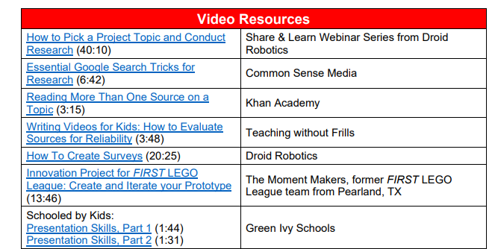
Project Resources

Slide 19
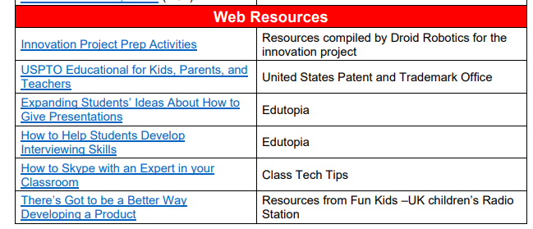

Slide 20
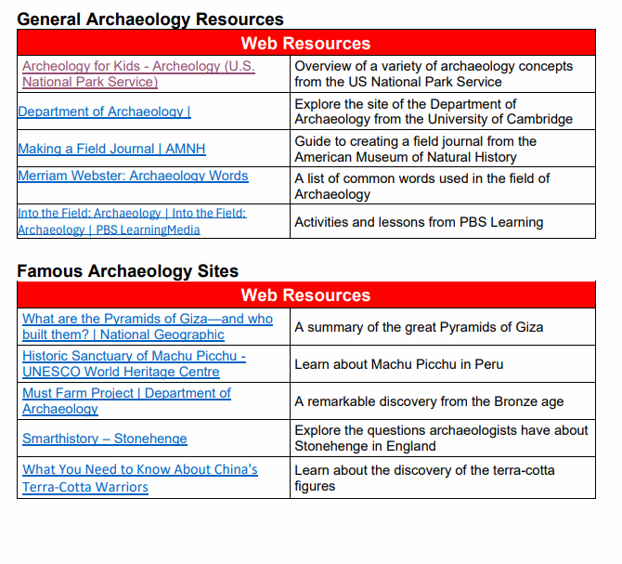
UNEARTHED Resources

Slide 21
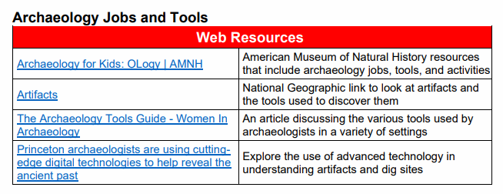
UNEARTHED Resources

Slide 22
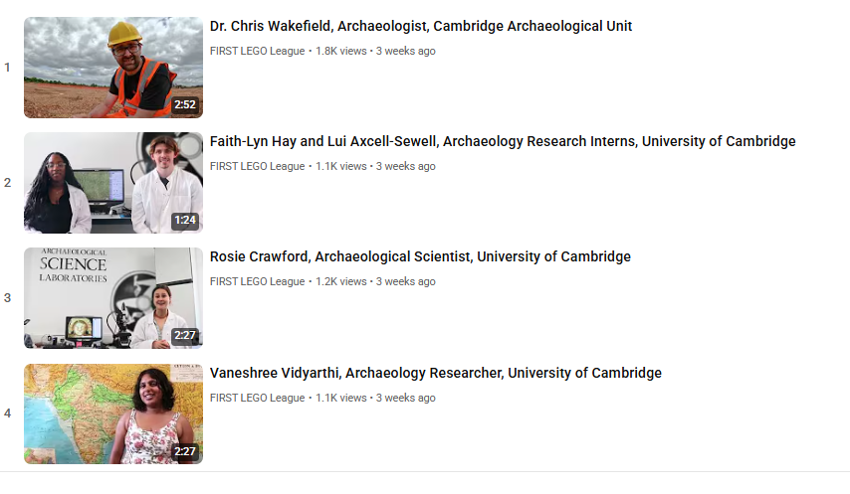
Career Connections Playlist
FLL website: career connections playlist: https://www.youtube.com/playlist?list=PLpaPRqT711tjlOEveikQG1IKM2AdcA7-d

Slide 23
Reference Material (available in the Team Meeting Guide and Engineering Notebooks provided by FIRST)

Slide 24
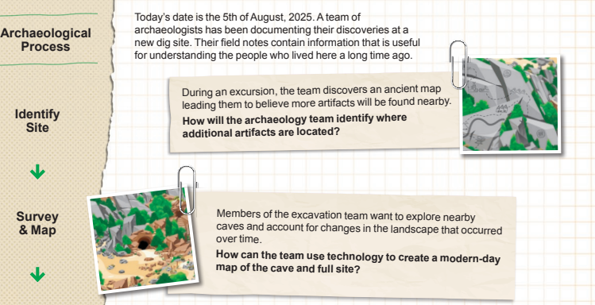
Project Sparks – Generate Ideas

Slide 25
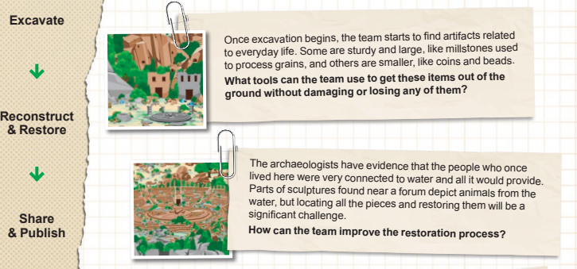
Project Sparks – Generate Ideas

Slide 26
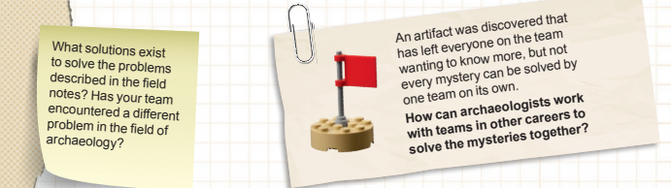
Project Sparks – Generate Ideas

Slide 27
Challenge Stories - Pictures
Use to help the students arrive at a specific problem and solution.
Have the teams explore the challenge story and see if they can discover what the problem and solution that the story depicts.
Relate the problem to a specific models and careers illustrated. See which is most interesting to the team.
Have different students or groups of students research the problem and solutions and have the team pick one to develop.

Slide 28
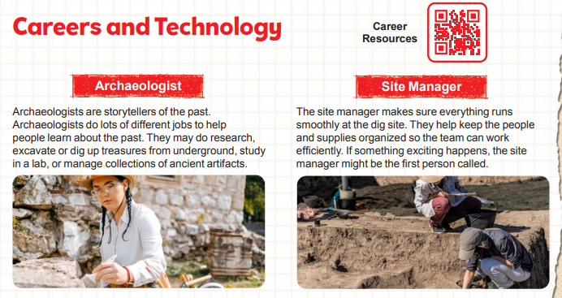
Careers and Technology

Slide 29
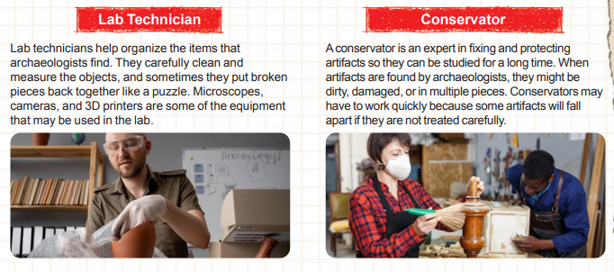
Careers and Technology

Slide 30
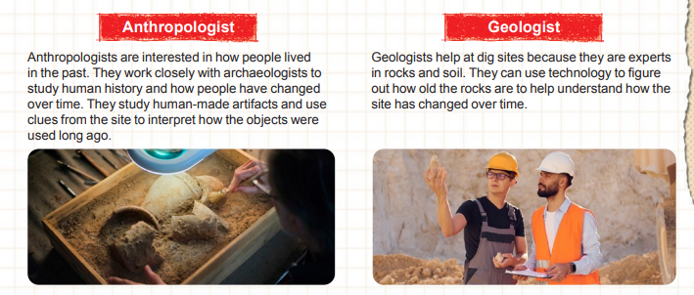
Careers and Technology

