Slide 1
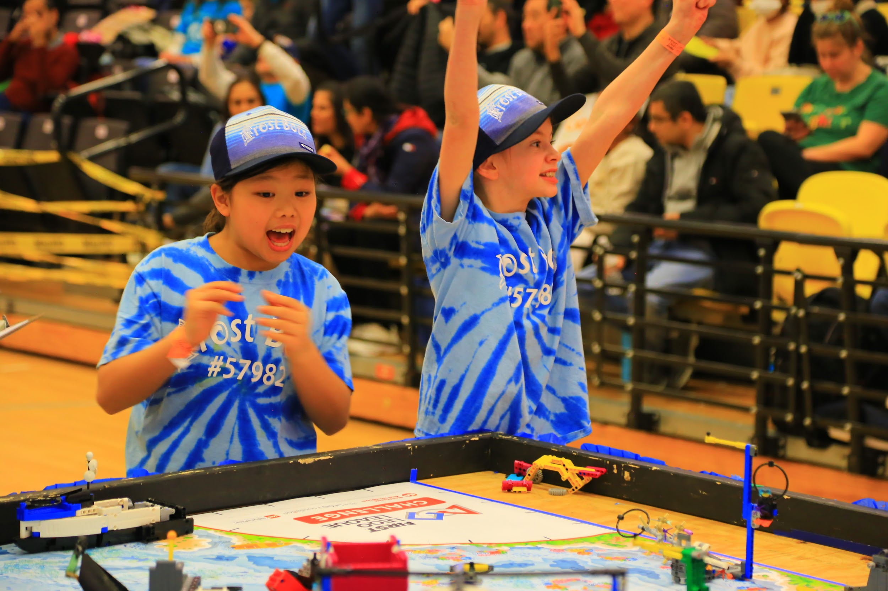
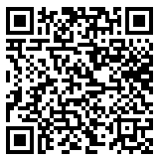
Maryland FLL Challenge Coaches’ Conference
Welcome and Overview
Have you signed in?
September 27, 2025

Slide 2
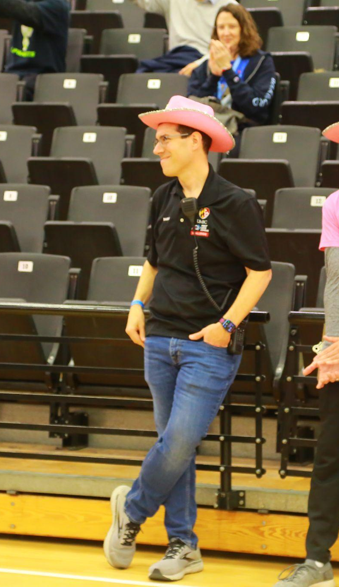
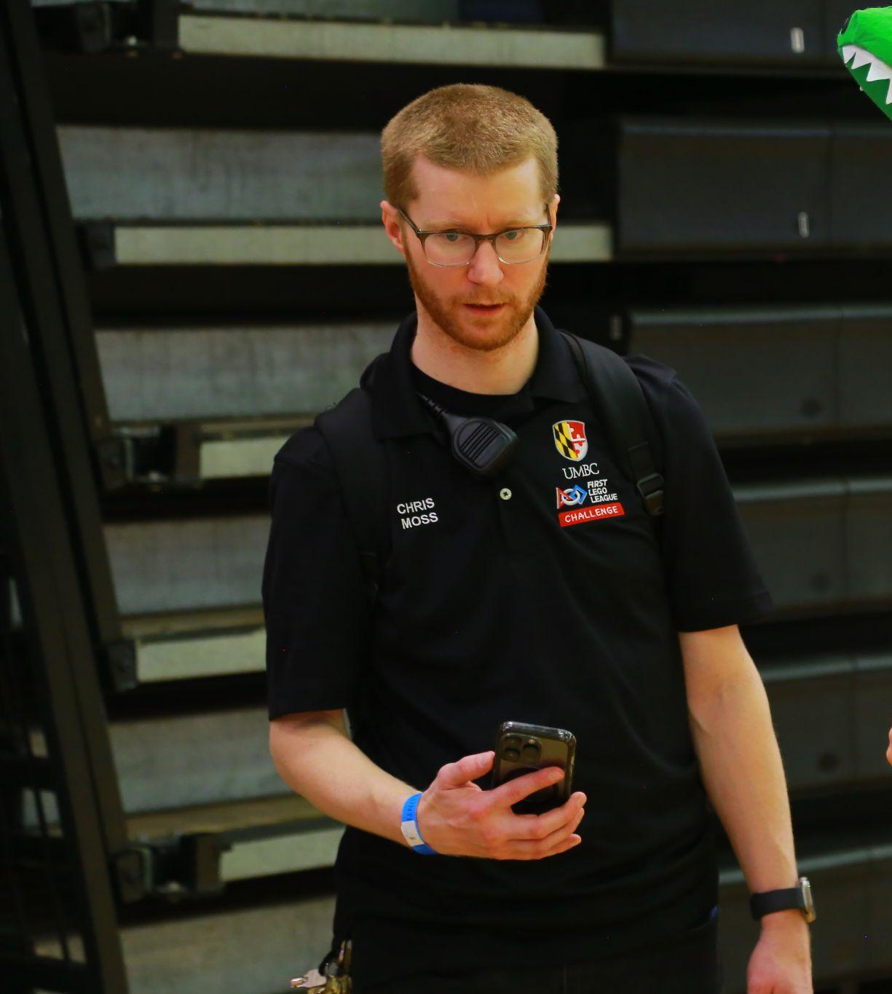
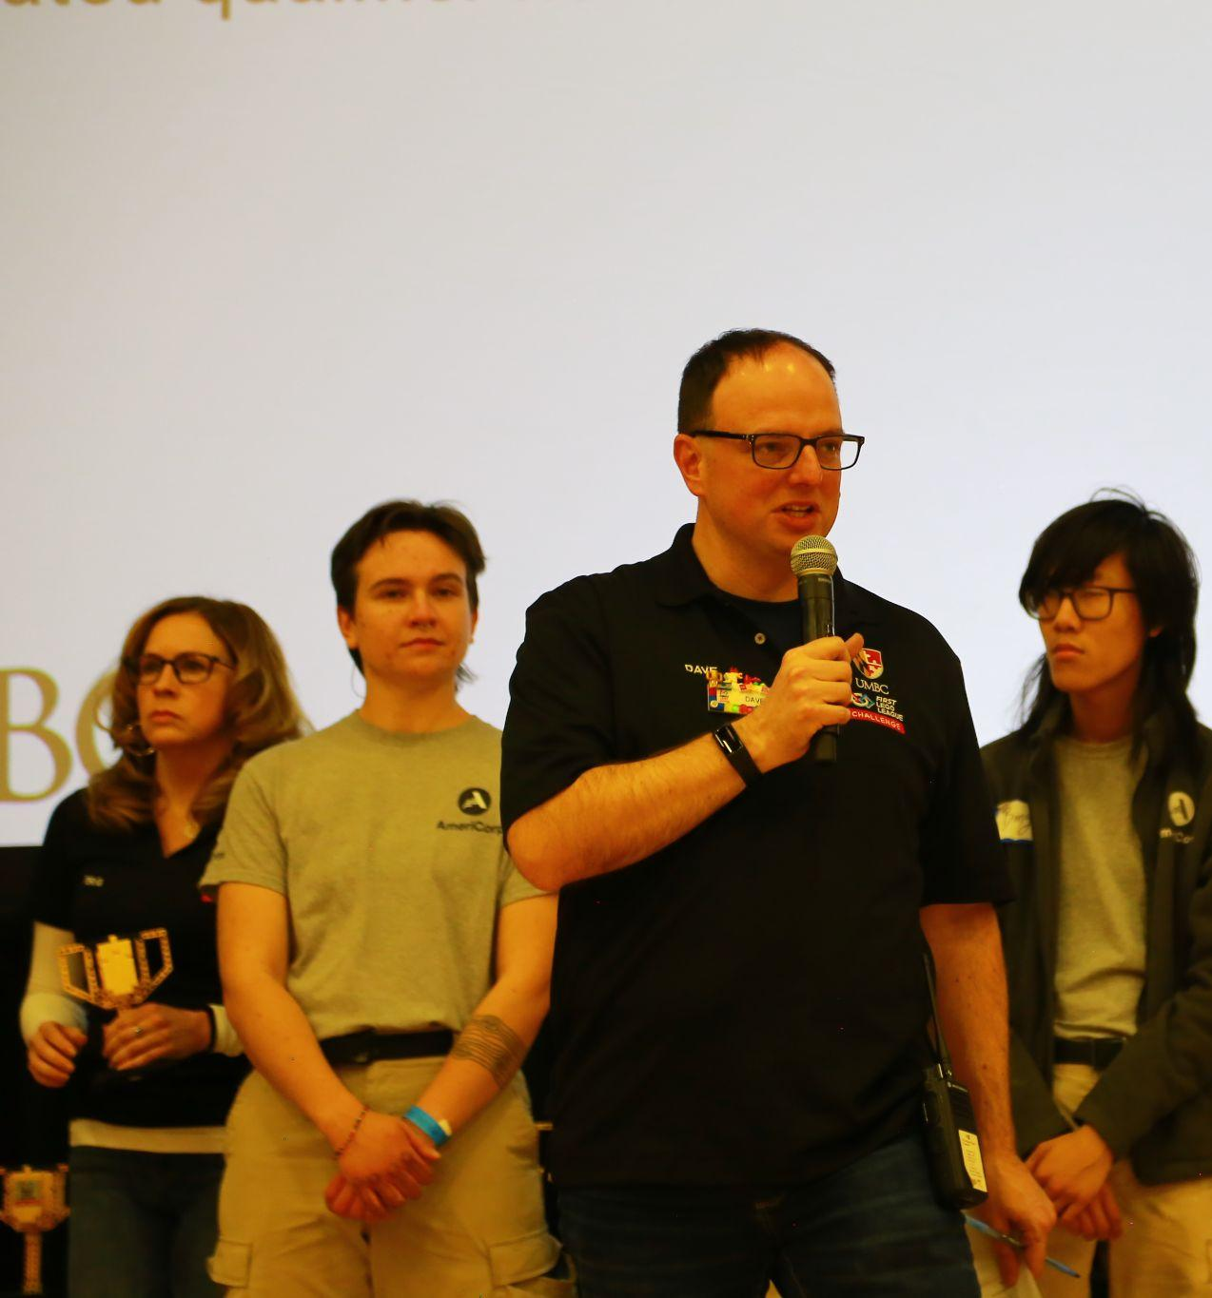
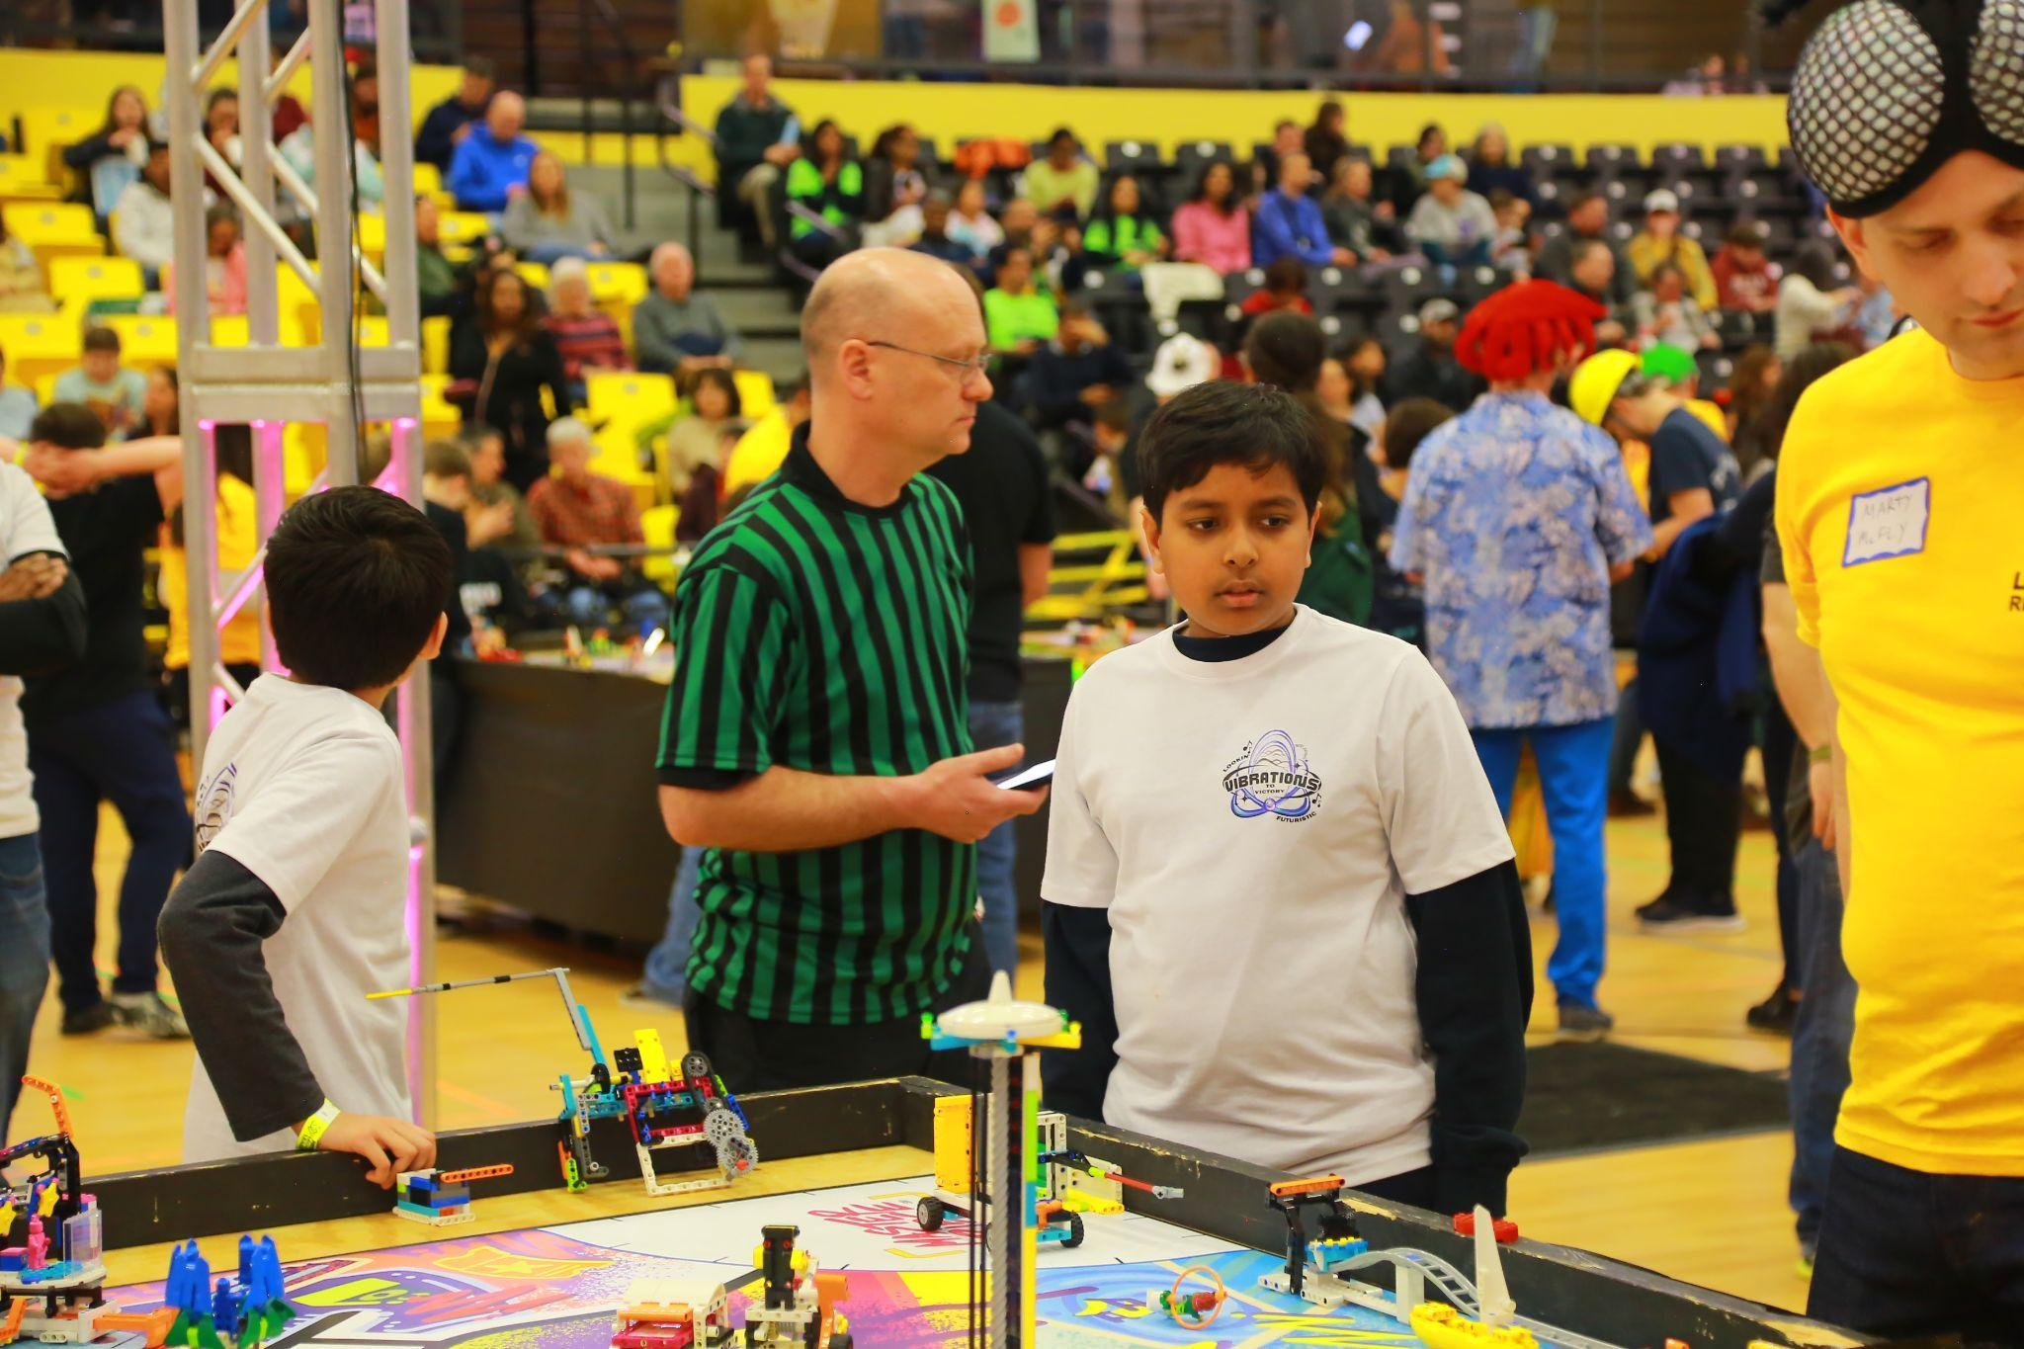
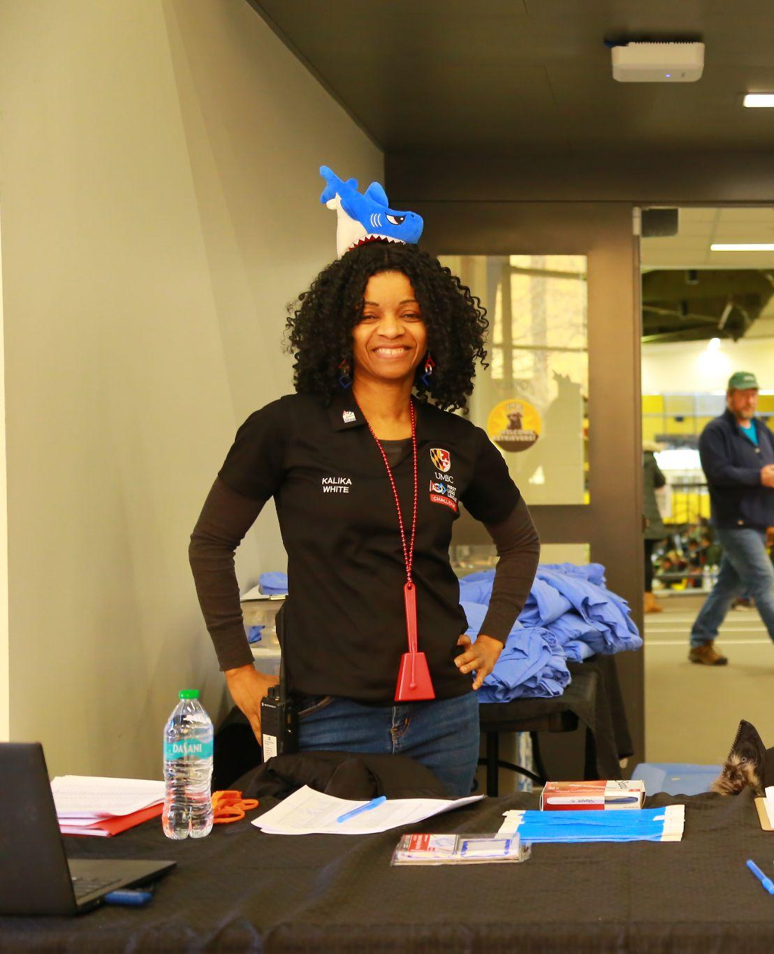
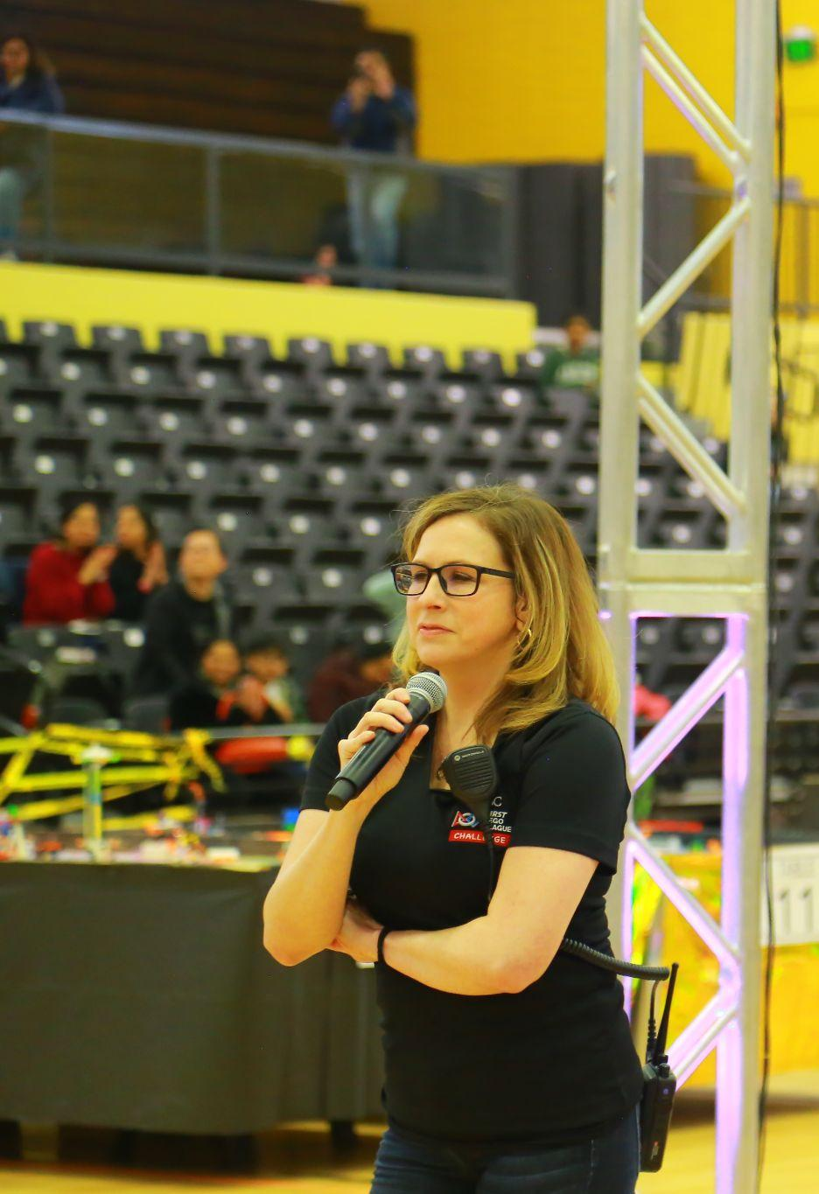
FLL Planning Committee
Program Delivery Partner and Tournament Liaison - Rose Young
Program Delivery Partner - Dr. Jamie Gurganus
Committee Chair - Damian Doyle
Head Judge Advisor - Dave Baran
Head Referee - Joe Cunningham
State Volunteer Coordinator - Kalika White
Judge Advisors - Theresa Jahng, Rob Laura, Glenn Speights, John Mrowka, Bobby Brinkley, Amanda Porter
Head Referees - Andy Leeds, Keaton Taliaferro, Dr. Thomas Murphy, Ken Schreihofer
Communications and PR - Ally Hepp
Operations and State Championship Manager- Robert Oehrli
Planning Logistics and Technology - Ken Schreihofer and Chris Moss
UMBC/NSBE Liaison and Volunteer support - Asantewaa Nyanteh

Slide 3
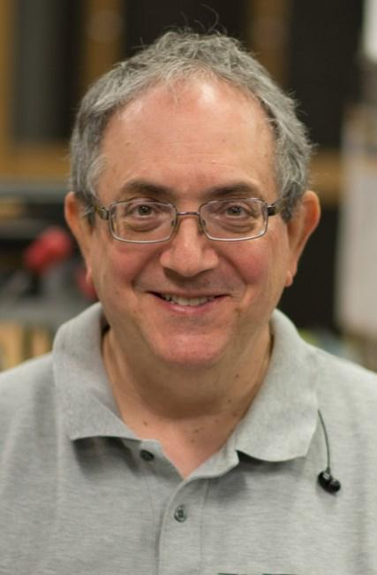
Marco Ciavolino Coach Mentor Program
Mentor Contributions
PyBricks and FLL Info at FIRST CHS Mentor Conference
Sessions for this Conference
Regular small group meetings, Coach input to Committee Meetings
Coming up
Virtual Coach Help Sessions (Fall)
Team Support In Person
Committee activity support
Volunteering at events
Open to ALL Coaches!
2025-2026 Cohort
First Name | Last Name
Chirag | Sanghani
Boyd | Fletcher
Marcus | Scheiterle
Matt | Phillips
Abhijit | Mahato
Ankit | Vachhani
John | Mann
Jie | Zhang
Jonathan | Bennett
Ryan | Rich
Parasuram | Iyer
Tom | Kozikowski

Slide 4

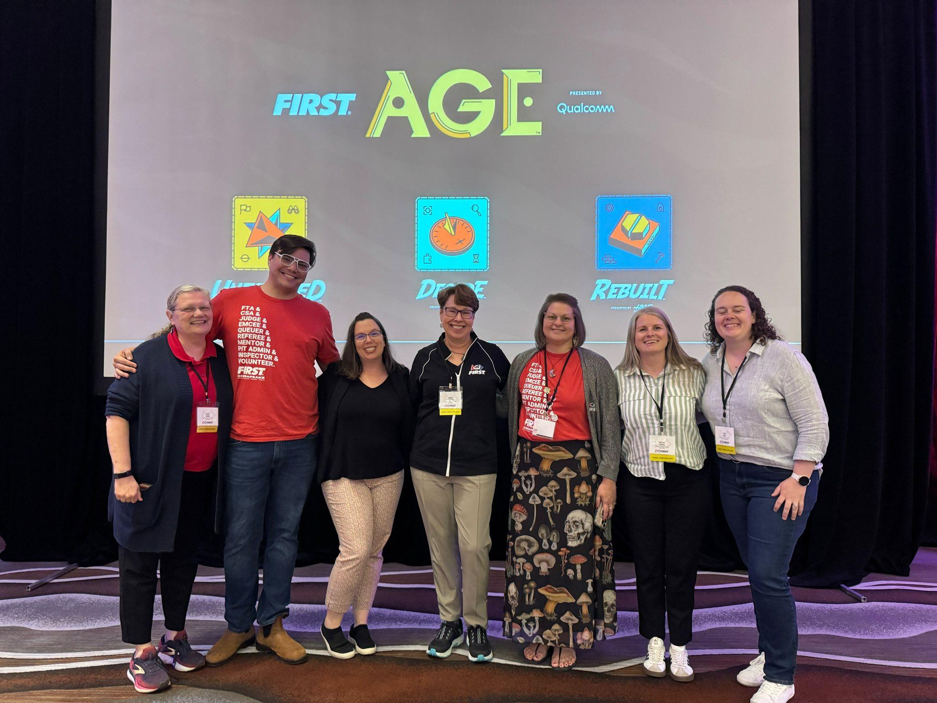
Welcome!
FLL has three levels, and we are FLL CHALLENGE.
FLL Challenges age range in the US is 9-14
FLL Explore in Maryland has a different Program Delivery Partner, Amber Driesman. She works through FIRST Chesapeake.
FLL Discover does not have events or a local manager
FIRST Chesapeake is also responsible for FTC (grades 7-12) and FRC (grades 9-12)
FIRST Community Conference MD/DC/VA team June, 2025

Slide 5
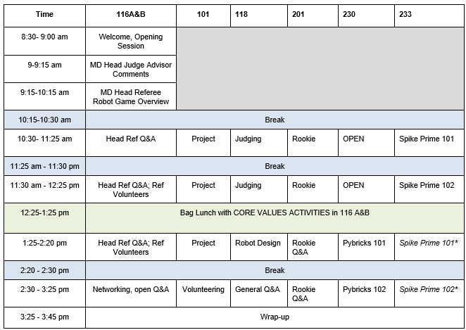
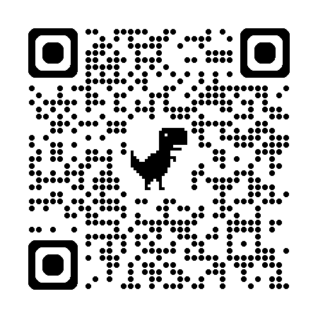
Sessions (link provided again at the end!)

Slide 6
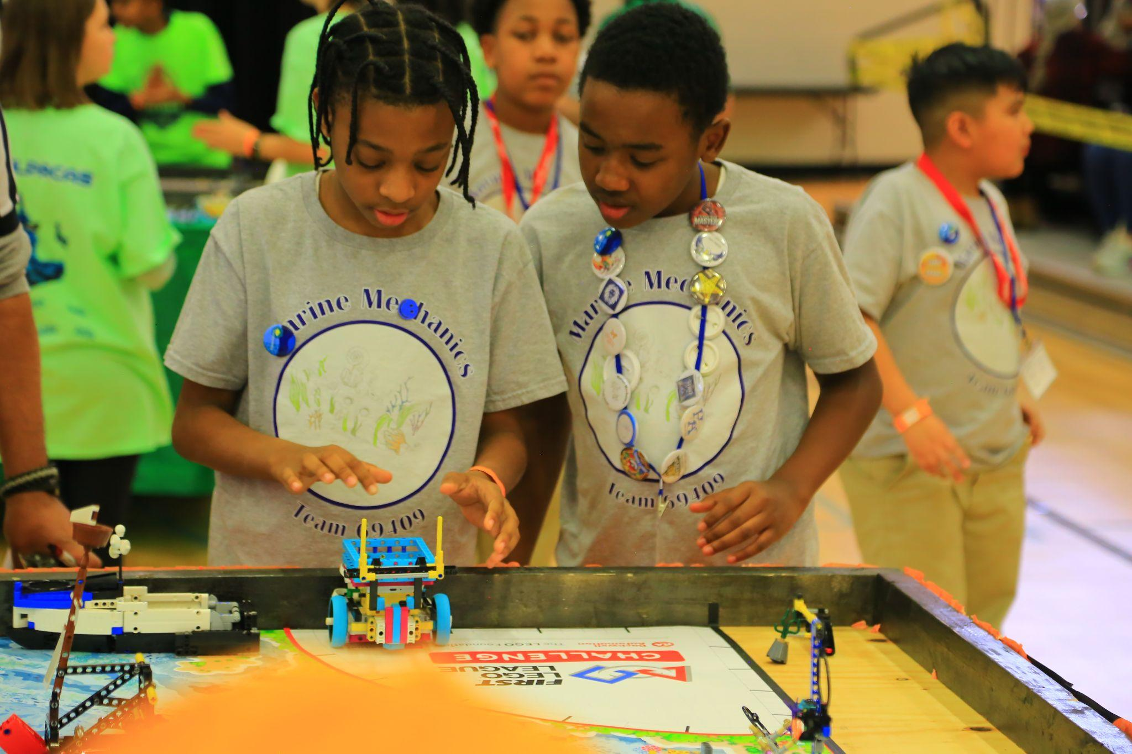
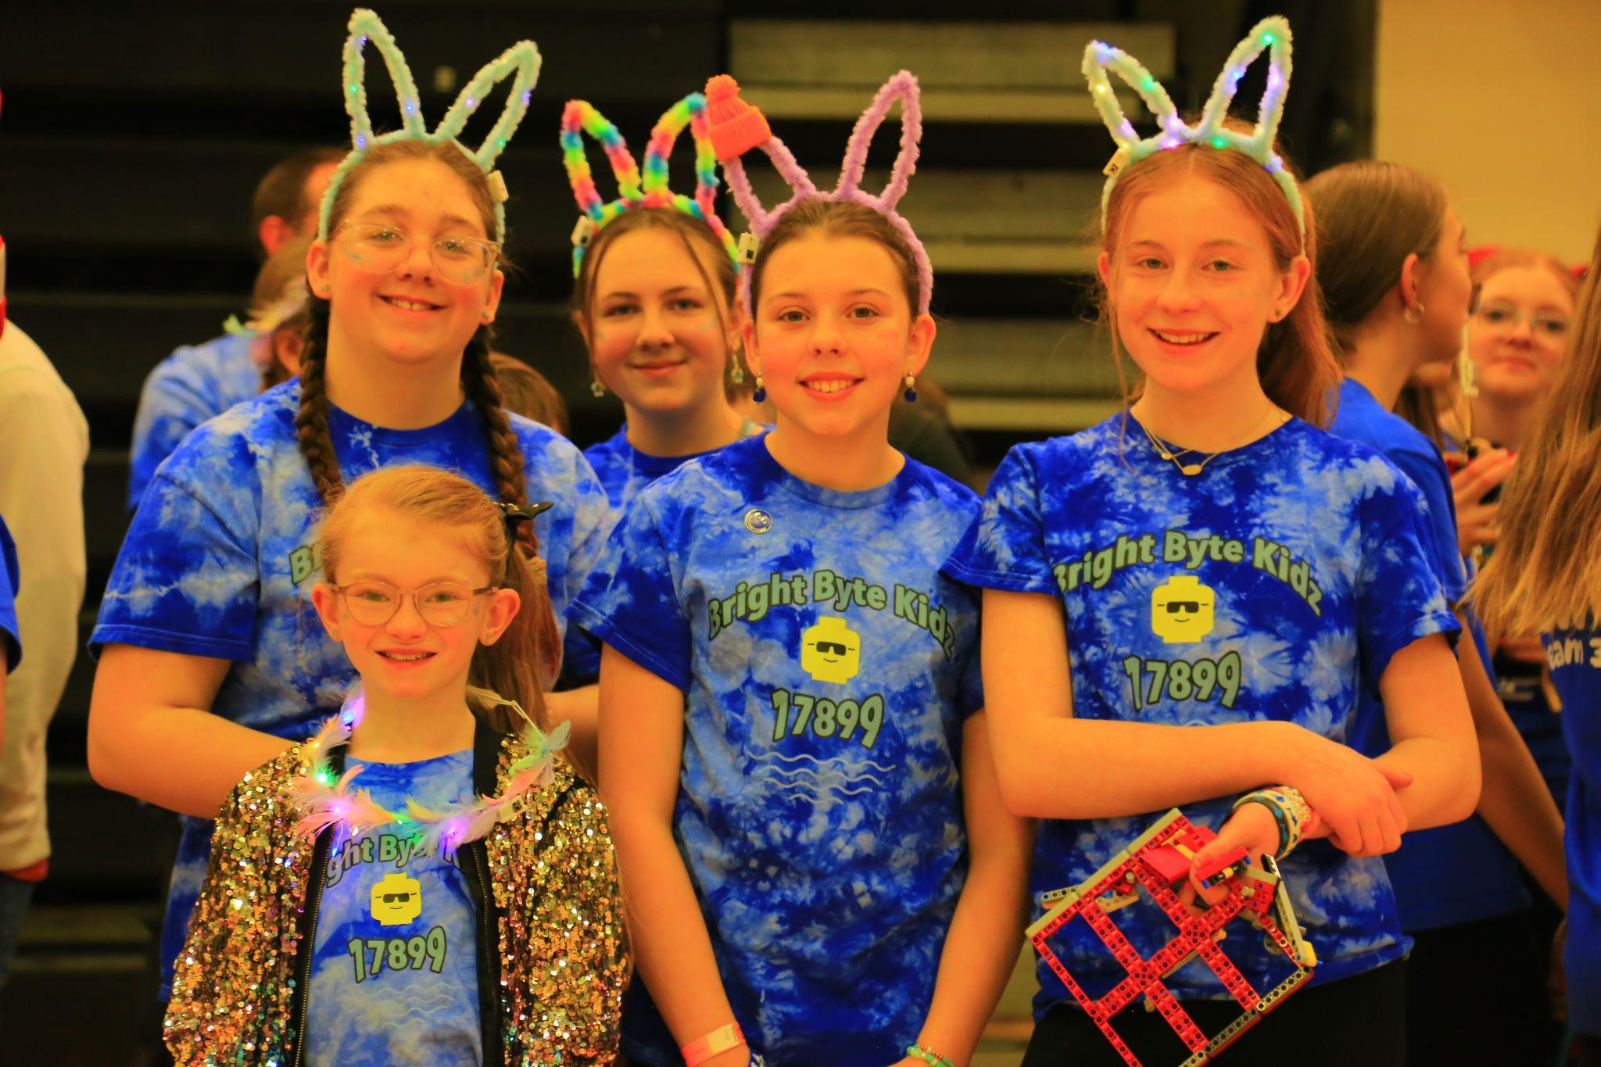
Fun Facts about FLL in Maryland
The beginning: Bel-air Boys and Girls club
20 Teams 2003
40 Teams 2004
UMBC in our 20th year!
2005-2010: 60 to 200 Teams
2011-2019: up to over 350 Teams
2020-2022: ~100-200
2022-2023: ~230 Teams
2023-2024: ~325 Teams
2024-2025: ~325 Teams
2025-2026 On the way to 325+
53 Rookies as of 9/24
A total of 255 +85 intent +? 9/26
Breakdown estimate
36% Community
33% Public School
18% Private School
12% Youth Org, Home School

Slide 7
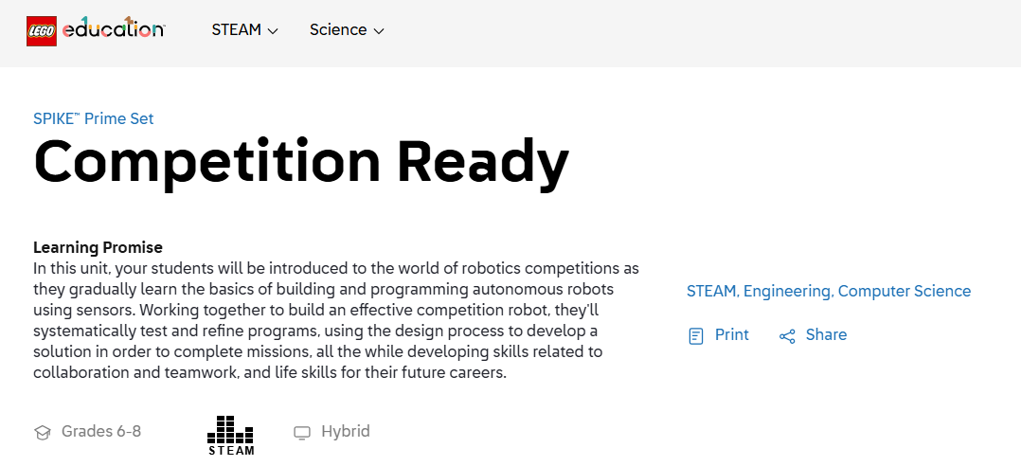
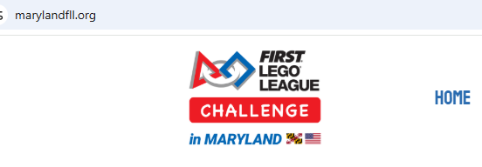
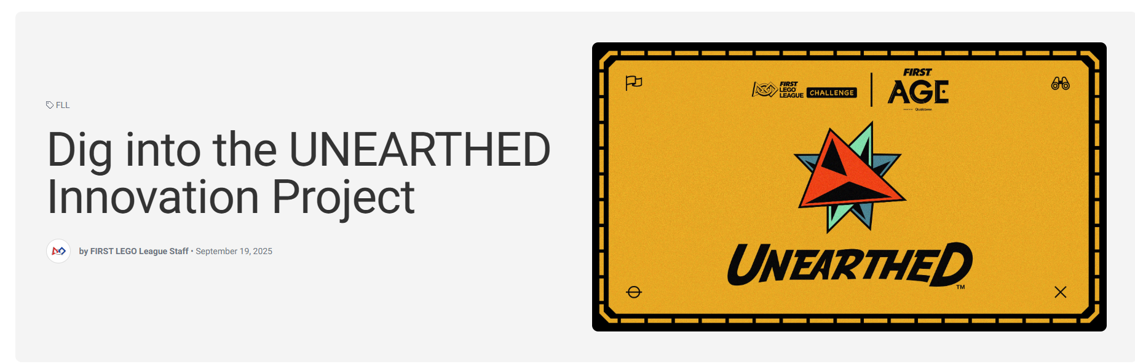
A
Rookie ABC’s
LEGO Education can get you started on Robot Game
https://education.lego.com/en-us/lessons/prime-competition-ready/
FIRST has Project Resources
Note: FIRSTInspires.org will migrate
Sep 30.
B
C
marylandfll.org
All things Maryland
including
Qualifiers
https://community.firstinspires.org/dig-into-the-unearthed-innovation-project
Notes:
Visit the FIRST® LEGO ® League YouTube Channel to watch the SUPERPOWERED season launch video.

Slide 8
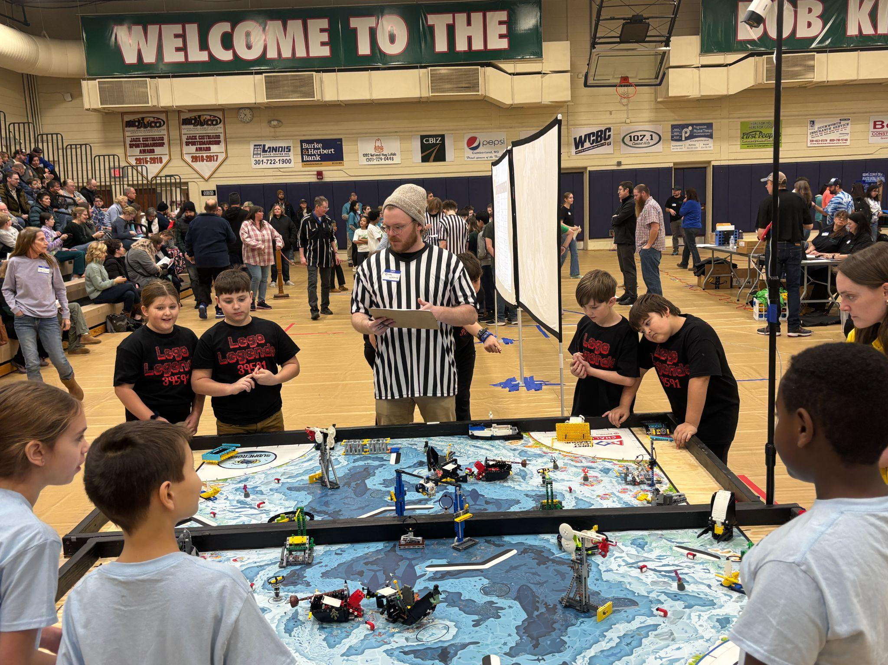
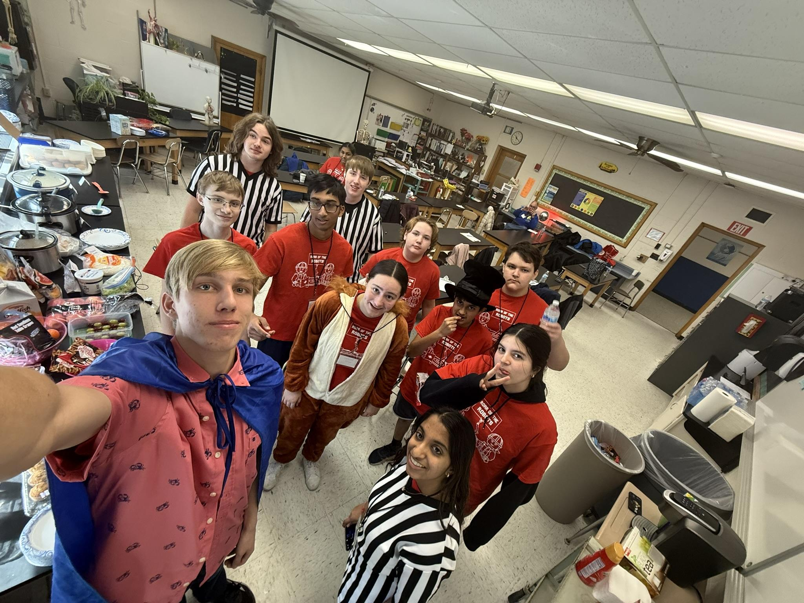
What should I expect at the Qualifier?
Answer: FUN!!!!!
Each team will compete in ONE “Qualifier”, or Qualifying Tournament
The goal is for every Qualifier to provide a similar experience
Judging, scoring, refereeing, core values expectations, respect, learning, corporation, gracious professionalism same as the Championship
Hosts are often FRC and FTC teams, many of them former FLLers; they love doing this
Celebrate your team wherever they end up by the date of your assigned Qualifier!

Slide 9
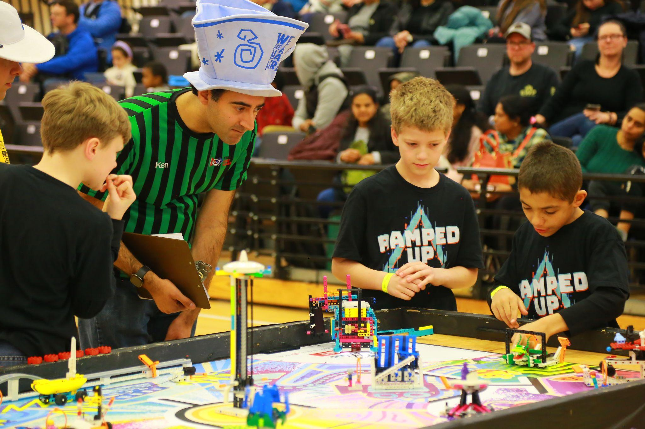
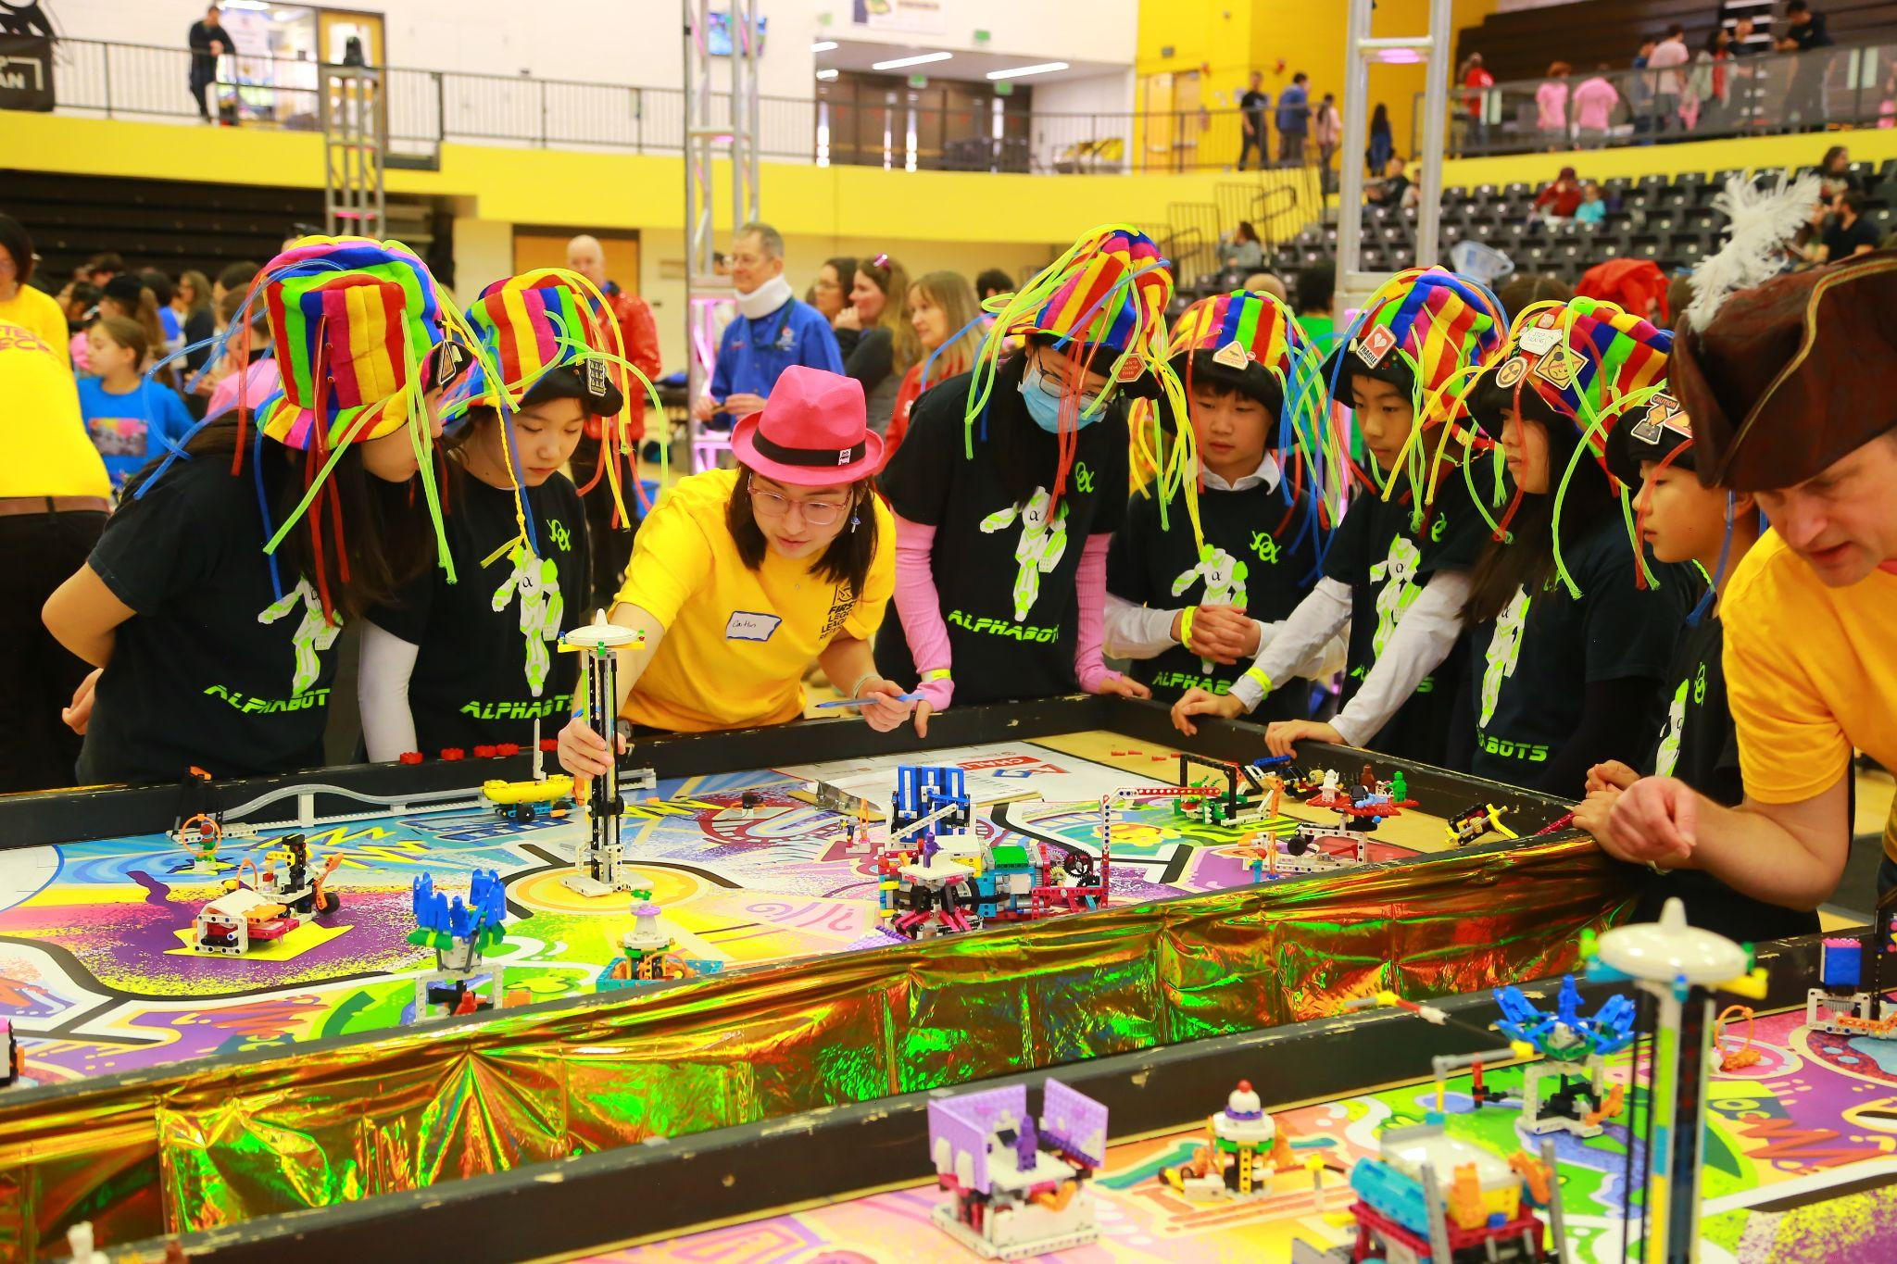
Sample Schedule for Qualifiers and State
7am-8:30am Check –in and set up for teams to get into the PIT Area
8:15am Coaches Meeting
9am-1pm Judging and Practice Rounds
Combined Judging, all at once
At least one practice round in morning
12:30pm Opening Ceremony
1pm-4pm Robot Match Rounds
4:30ish Awards Ceremony

Slide 10
Maryland Qualifiers
To participate in a Qualifier and State Tournament: One time Registration Fee (Maryland) : $100 Due at registration.
To be assigned to a Qualifier, teams must be EVENT READY
Two coaches YPP and Consent completed
FIRST Registration paid
To receive entrance into the State Championship Tournament, teams must participate and be selected from the Qualifiers.
Advancing teams are notified at the end of each Qualifier. An additional fee of $100 will be charged for the State Tournament.

Slide 11
Qualifier Details (also on website)
Make your Qualifier a Priority for your team, just like any other major extracurricular activity.
Qualifier Registration:
Open October 6 to 14. A link will be provided with additional instructions.
Payment by credit card is preferred; payment can be made by a person other than the Coaches or Administrator; they must KNOW THE TEAM NUMBER.
Your choice of top four, including at least one December event.
Any circumstances that may limit your choice can be noted. Do not cite any of the following reasons, as we cannot take these factors into account:
Rookie team status or rookie coaches
Vacations or work travel impacting coach or team members
Other extracurricular activities conflicting with dates
Assignments will be announced within about 10 days of registration closure, at least 6 weeks before the first event.
You should be able to go to the planned snow date
Some events may have very limited open slots due to Tournament Host requests for local and sponsored teams.
Events likely to have limited capacity beyond requested teams: Eastern Shore, REACT Allegany, Roar of the Robots 1 and 2, Garrett, Baltimore City.
If your team is one of the sponsored teams, the Tournament Host will notify you. Choose that event as your first choice.
If your team is NOT sponsored by one of these events and has not had confirmation from the Tournament Host that your team has been requested, DO NOT list it as your first choice.

Slide 12

Qualifiers in Maryland Dec
Date | Snow | Name | City
Sat, Dec 13, 2025 | Sat, Jan 17, 2026 | McDonogh School Qualifier | Owings Mills
Sat, Dec 13, 2025 | Sat, Feb 7, 2026 | Battle by the Bay | Arnold
Sun, Dec 14, 2025 | Sun, Jan 11, 2026 | Battle of the Baltimore Beltway | Brooklandville
Why December?
No winter break to forget or lose momentum
Winter break is less stressful
No one is ever 100% ‘ready’; all have the same opportunity
Teams qualifying for Championship have the most time to refine and improve
These are great events!
As of 23 September, 2025. Subject to change.

Slide 13
Qualifiers in Maryland Jan-Feb
Date | Snow | Host | City
Sat, Jan 10, 2026 | Sat, Jan 17, 2026 | Eastern Shore Regional Qualifier* | Salisbury
Sun, Jan 11, 2026 | Sun, Jan 18, 2026 | Frederick County Qualifier | Ijamsville
Sat, Jan 17, 2026 | Sat, Jan 24, 2026 | REACT Allegany Qualifier* | Cumberland
Sat, Jan 17, 2026 | Sat, Jan 24, 2026 | Roar of the Robots 1* | Westminster
Sun, Jan 18, 2026 | Sun, Jan 25, 2026 | Roar of the Robots 2* | Westminster
Sat, Jan 24, 2026 | Fri, Jan 31, 2025 | M-NCPPC FLL Challenge Qualifier | Fort Washington
Sat, Jan 24, 2026 | Sat, Jan 31, 2026 | South County Showdown | Edgewater
Sat, Jan 24, 2026 | Sat, Jan 31, 2026 | Garrett Qualifier* | Accident
Sun, Jan 25, 2026 | Sun, Feb 1, 2026 | Blazers Beltway Blast | Silver Spring
Sat, Jan 31, 2026 | Sat, Feb 7, 2026 | Baltimore City Qualifier* | Baltimore
Sun, Feb 1, 2026 | Sun, Feb 15, 2026 | Rockville Robo Rumble | Rockville
*Host invitations may limit availability
As of 23 September, 2025. Subject to change.

Slide 14
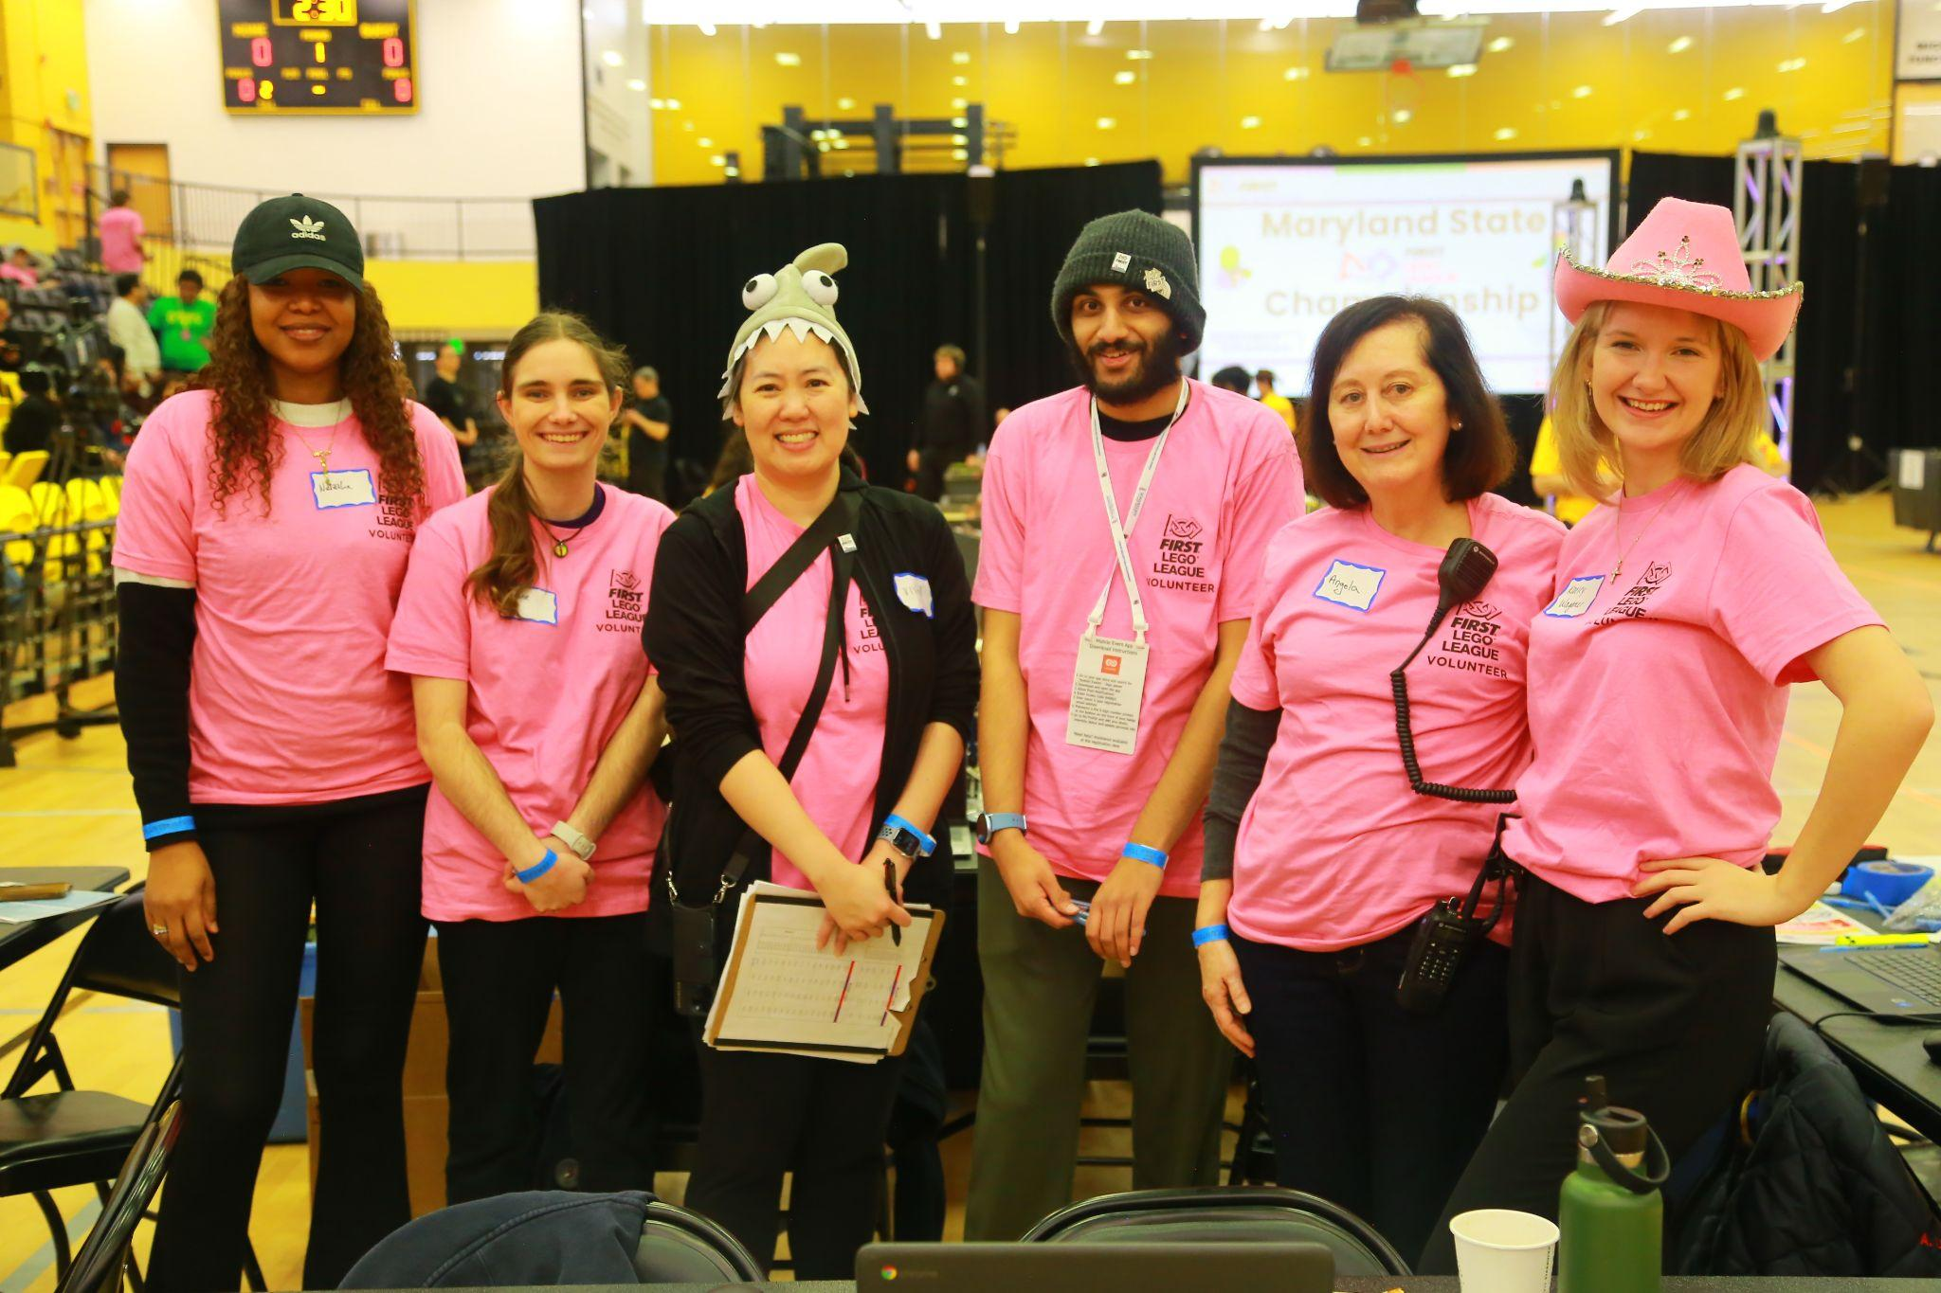
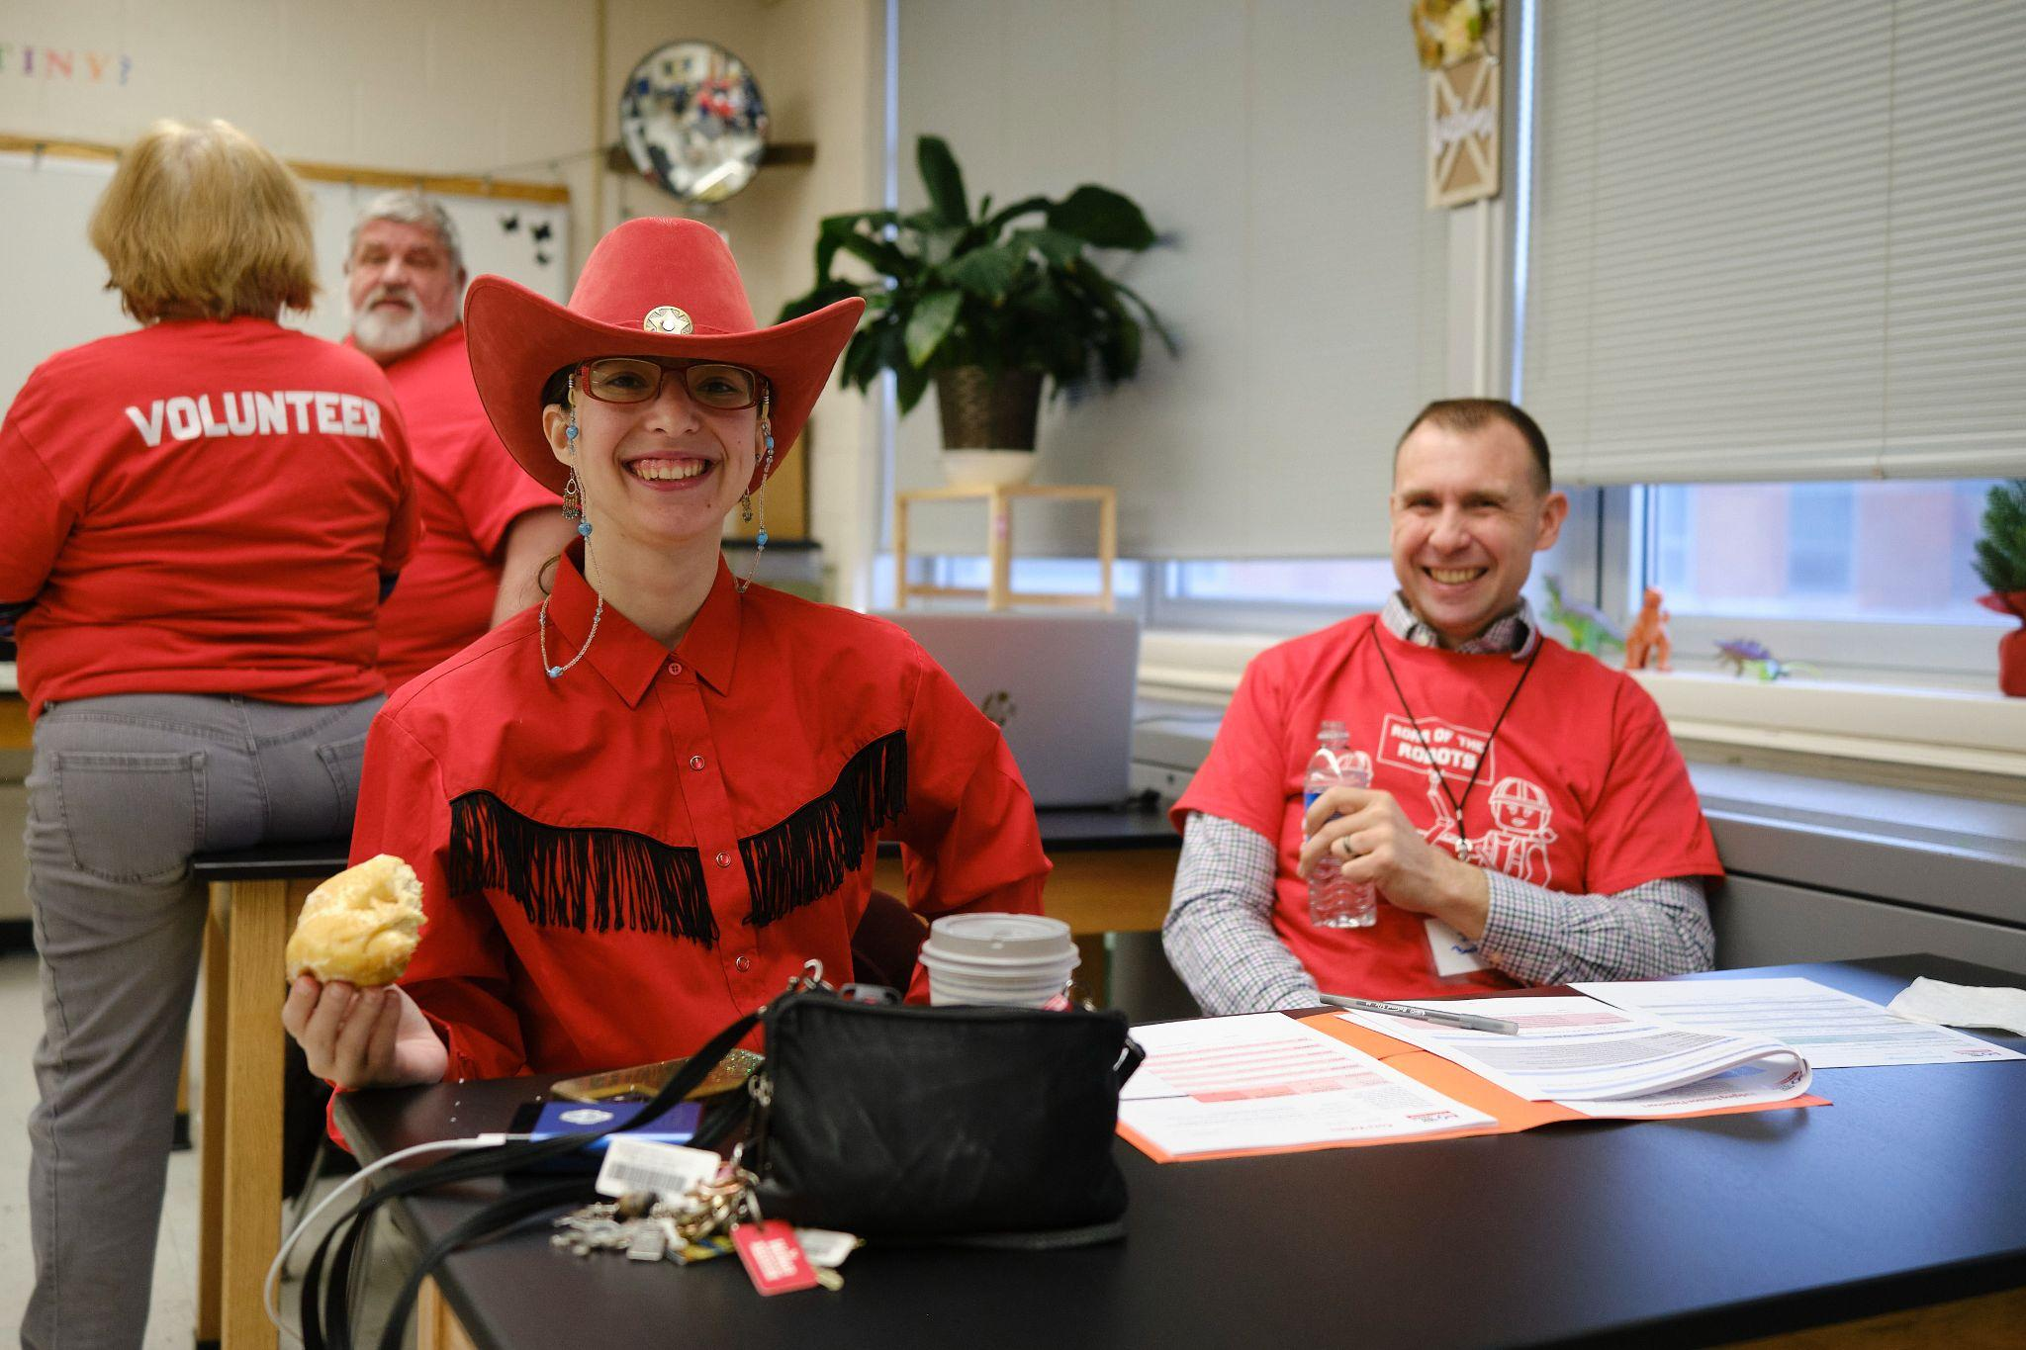
Volunteers Make it all work!
All events are completely volunteer efforts
14 or 15 events means we need to fill hundreds* of volunteer roles including:
250+ judges,
100+ referees,
14-15 tournament directors, volunteer coordinators, scorekeepers, emcees,
Coaches are the best judges and referees, so please volunteer!
This does not include the State Championship, for which we need over 100 more volunteers.

Slide 15
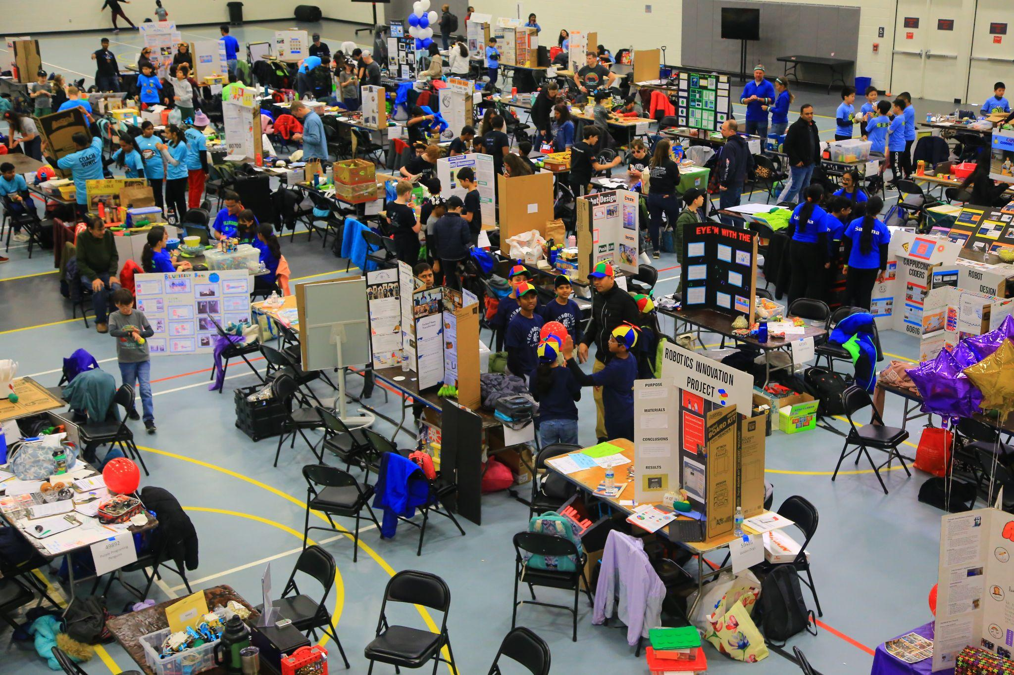
After Your Qualifier
Some teams from qualifiers advance to the February 21st Maryland State Tournament at UMBC
Options for official tournaments after February
Tentative Invitational at FRC District Championship in Virginia
Announced in November:
1 or 2 teams to World Championship in Houston, Texas
Open/Invitational events in the US and in other countries
Options for unofficial events
Team sponsored scrimmages
Local showcases
Outreach and demonstrations

Slide 16
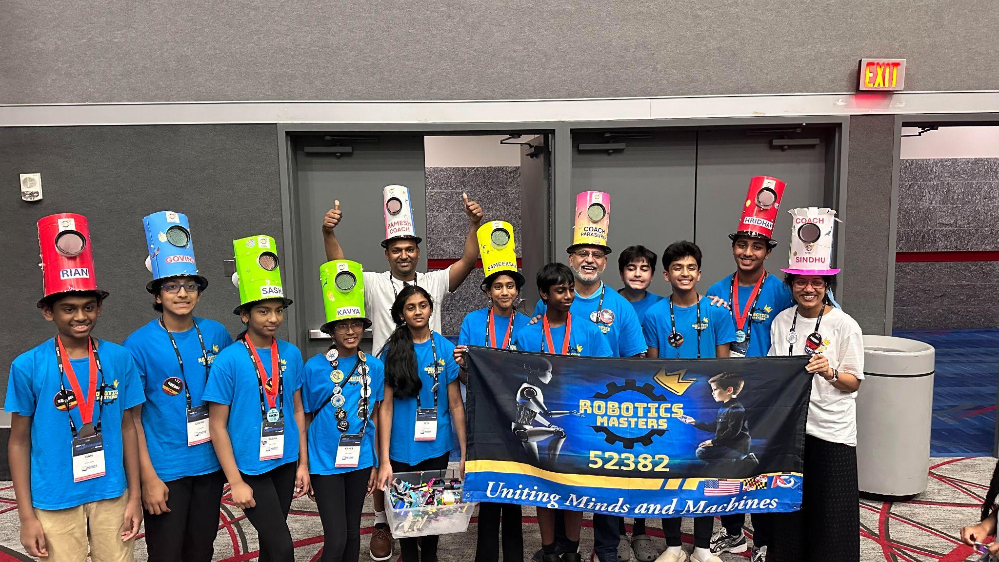
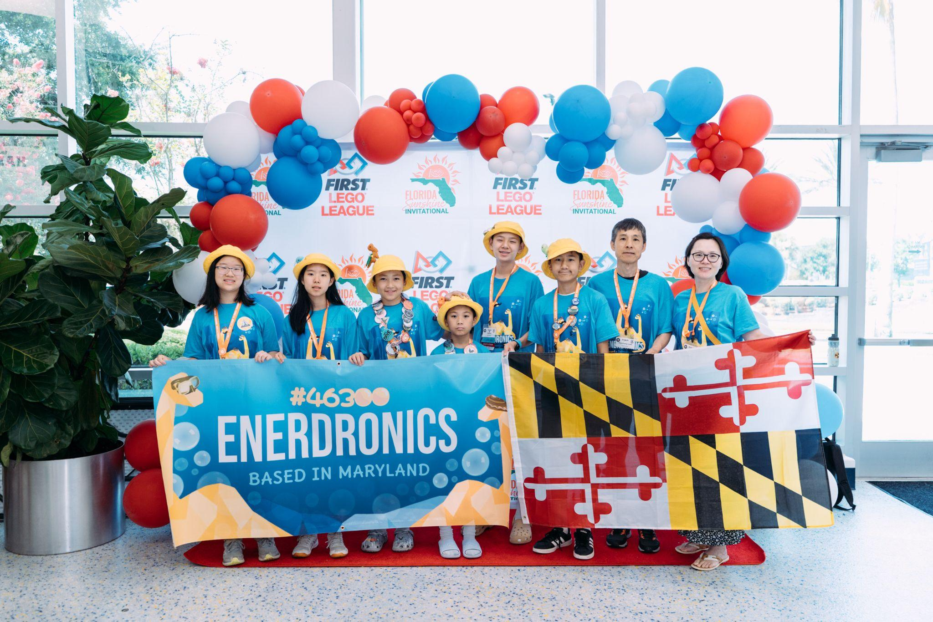
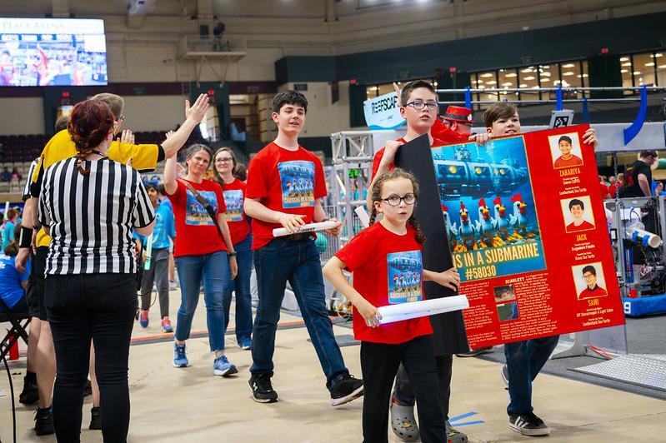
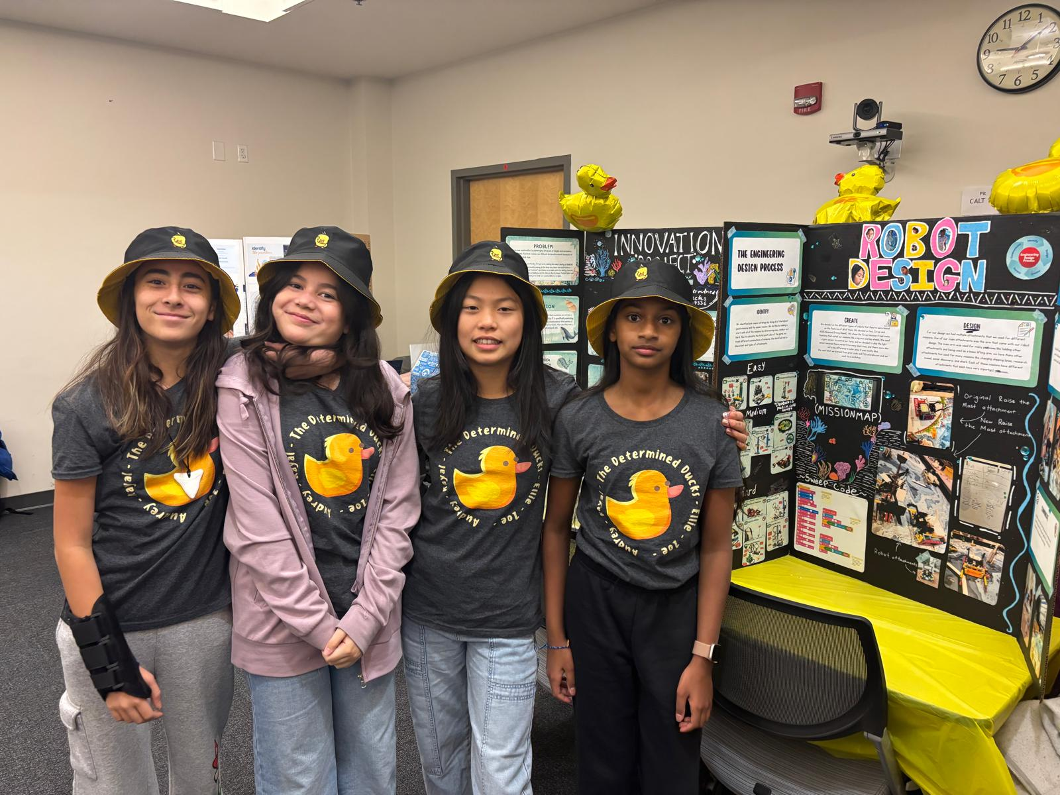
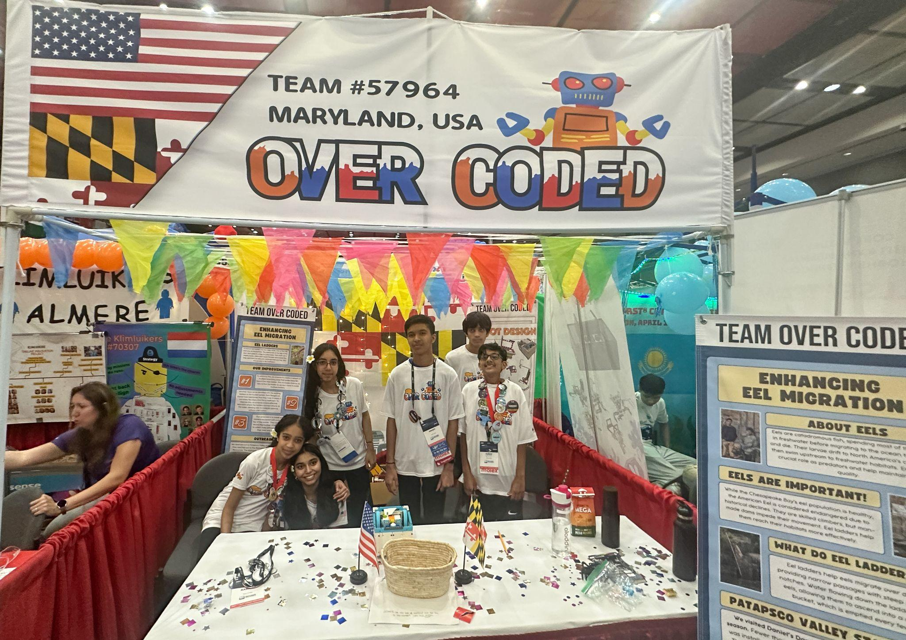
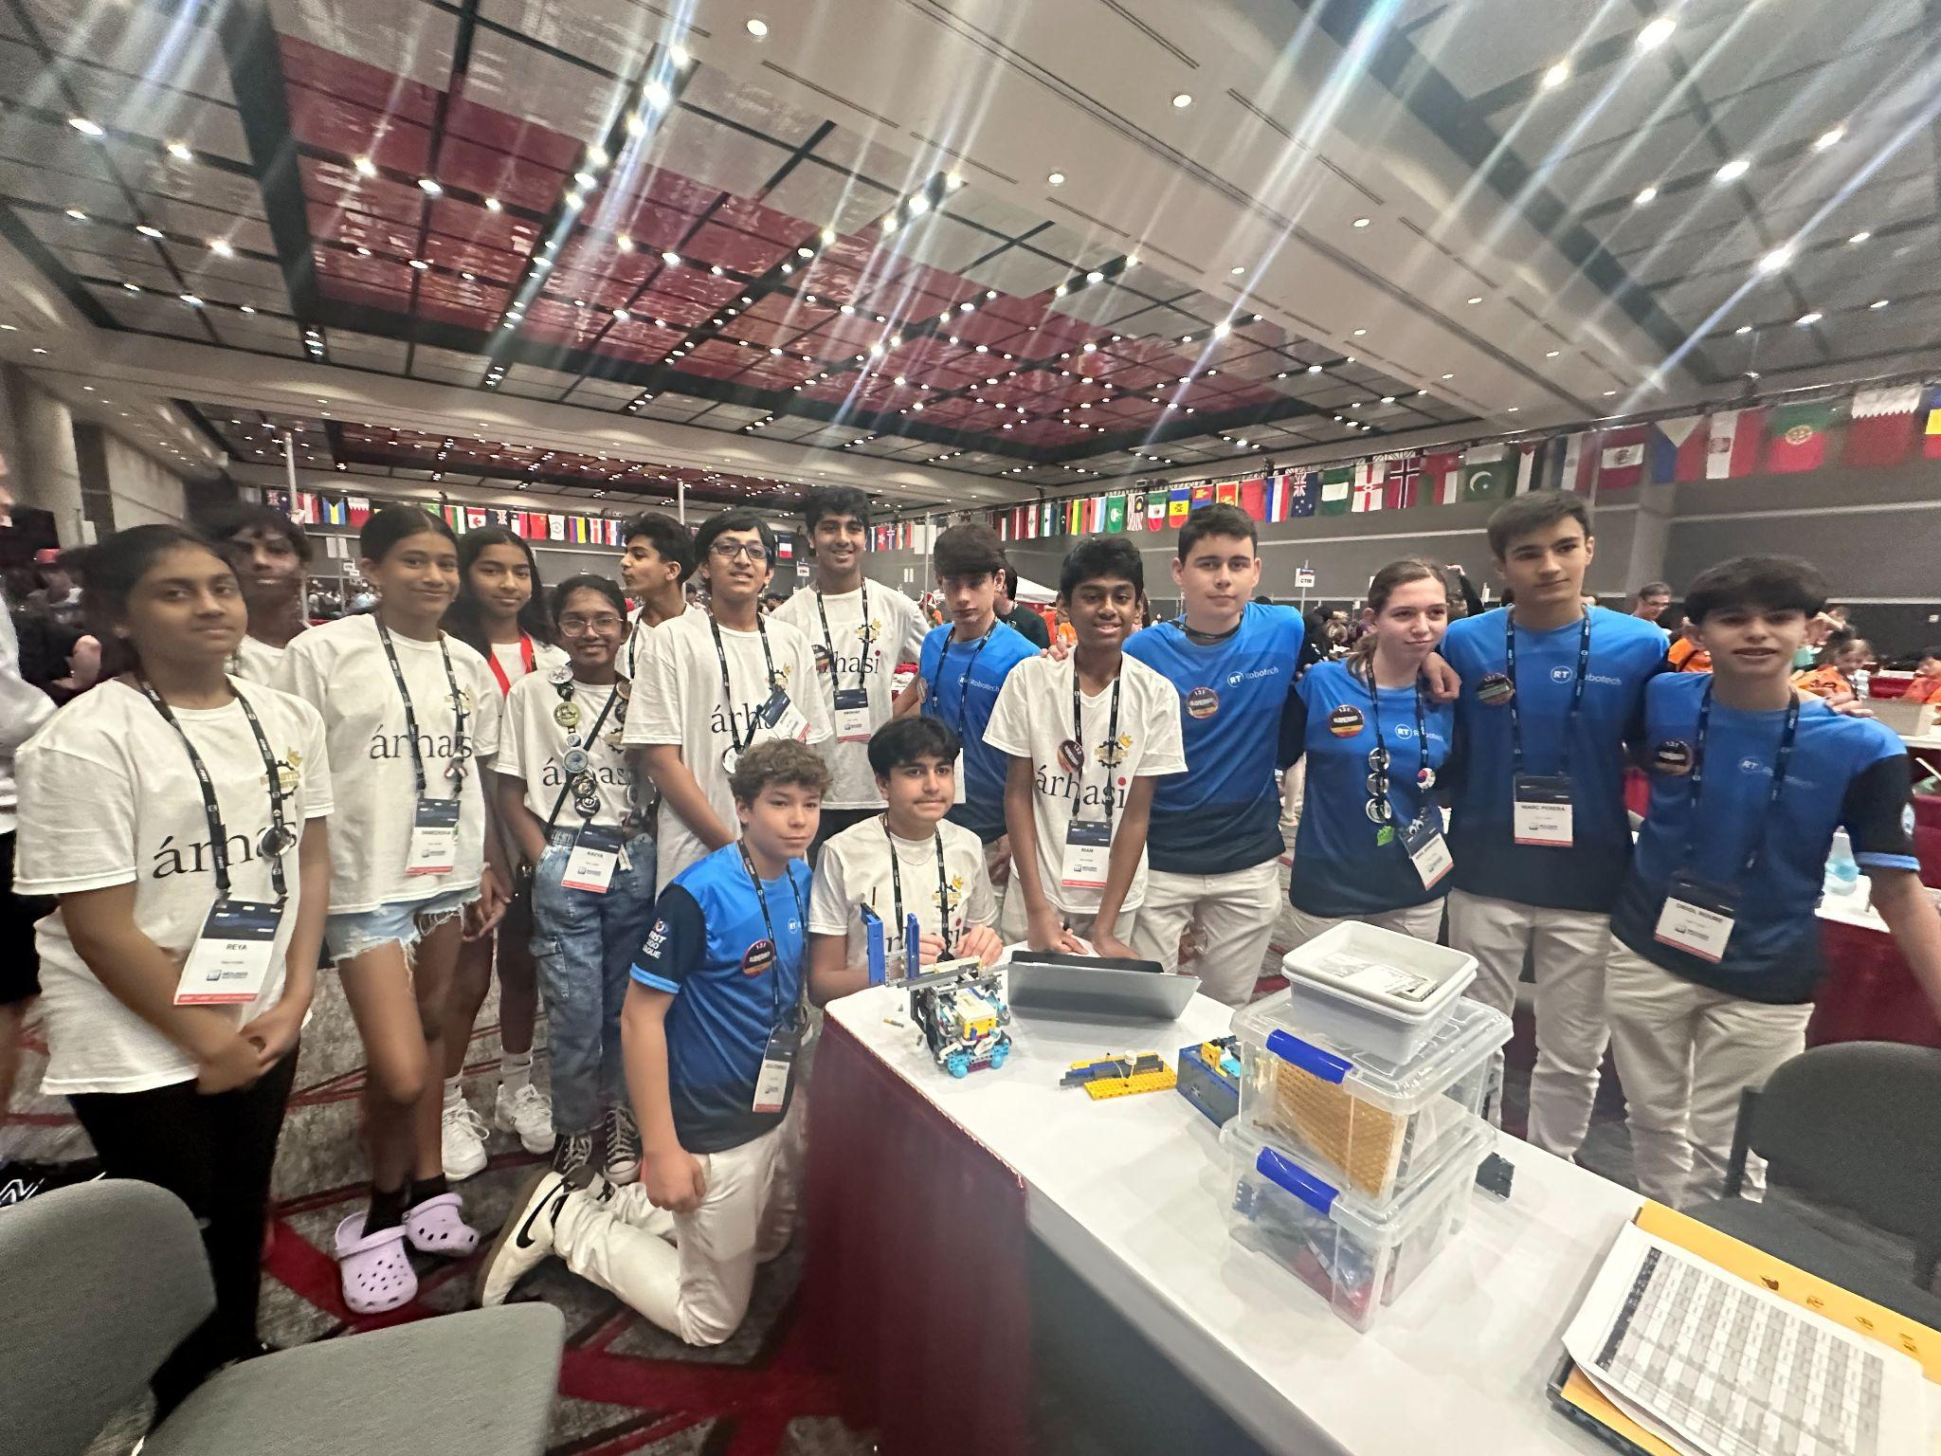
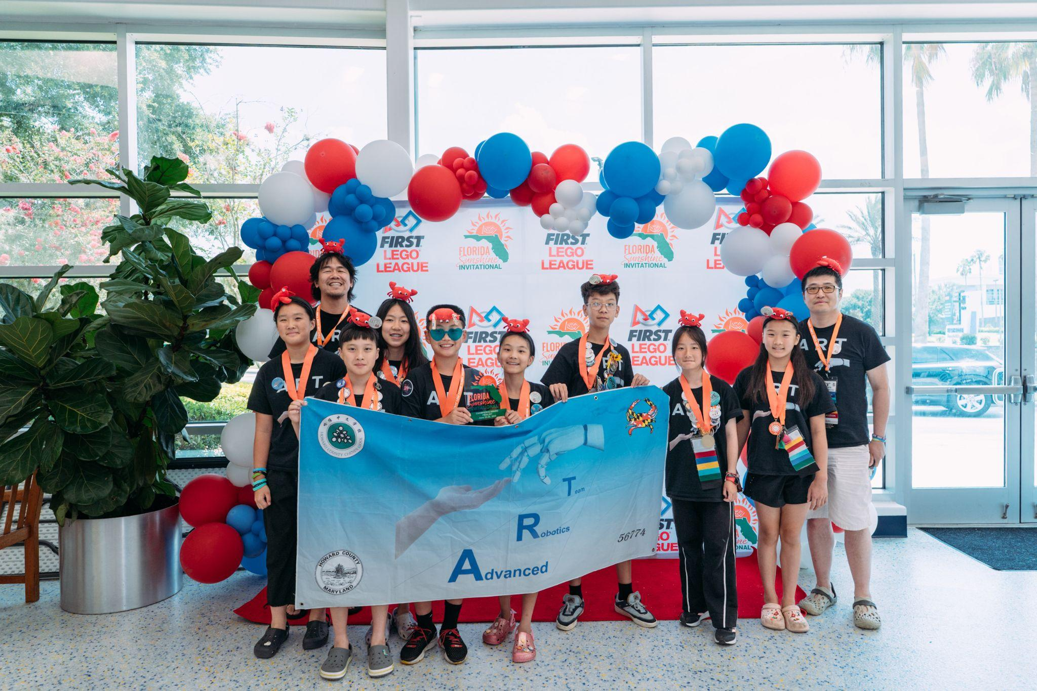
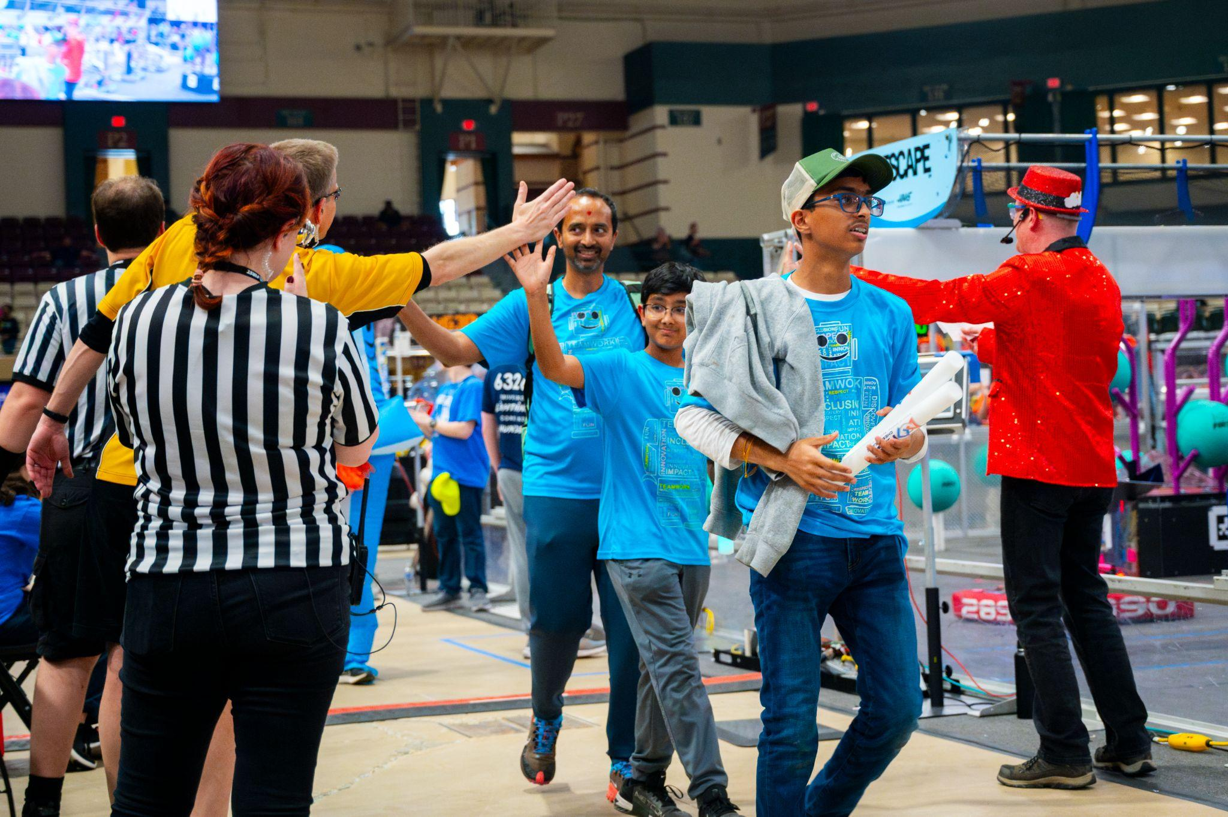
Post Season Excitement 2025
Some of the 14 Teams in Apr-June events

Slide 17
Ways to Connect and Ask Questions
Maryland Coaches Google Group
(all coaches automatically subscribed)
No Spamming
No Fundraising
Anything said, remarked, and commented as inappropriate will have you removed.
Please:
-Ask questions to other teams
-Ask for technical Help about FLL
-Good conversation on ideas is allowed!
Please Make sure if you have any Mentors, Coaches etc, have them sign up by following these instructions. Group name is fll_maryland_coaches-group@umbc.edu
FLL Challenge Website
Challenge, Updates, & Resources | FIRST

Slide 18
NEW Support for Teams
QR Codes on the final slides, links to be sent in the Newsletter
“Ask and Archeologist” - a live Zoom session November 5th. Thank you, Angie de Guzman and the Maryland Council for Social Studies.
Workshop and Scrimmage November 9th at Berman Hebrew Academy. Thank you, Ryan Rich.
Drop-in Coach Office Hours 2-4 nights per week Oct/Nov. Link to be shared. Thank you, Boyd Fletcher, Jie Zhang, Ryan Rich, Parasuram Iyer, Chirag Sangh
Mentor connection for virtual and in person support. Underway for teams who checked off on their Dashboard. Signup for others to be announced.

Slide 19
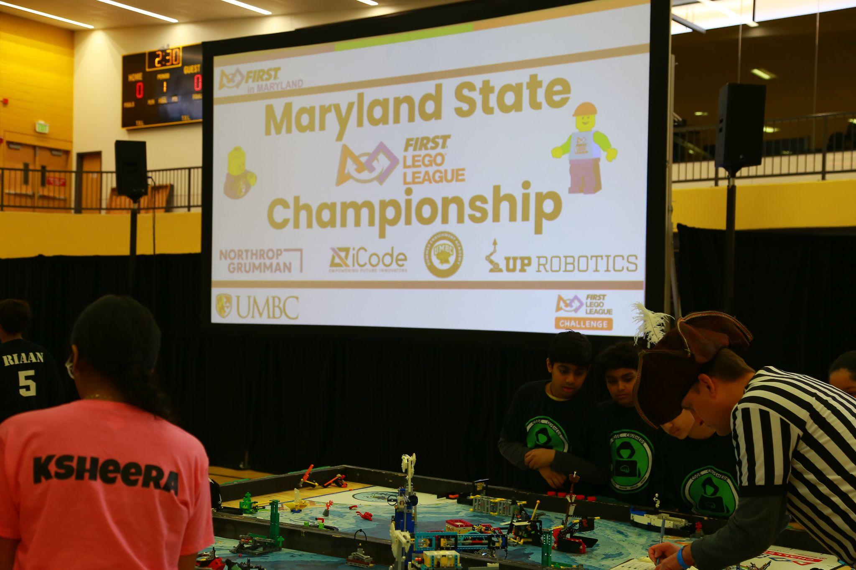
Judging & Team Advancement Process Explained
Dave Baran, Maryland FLL Challenge Head Judge Advisor

Slide 20
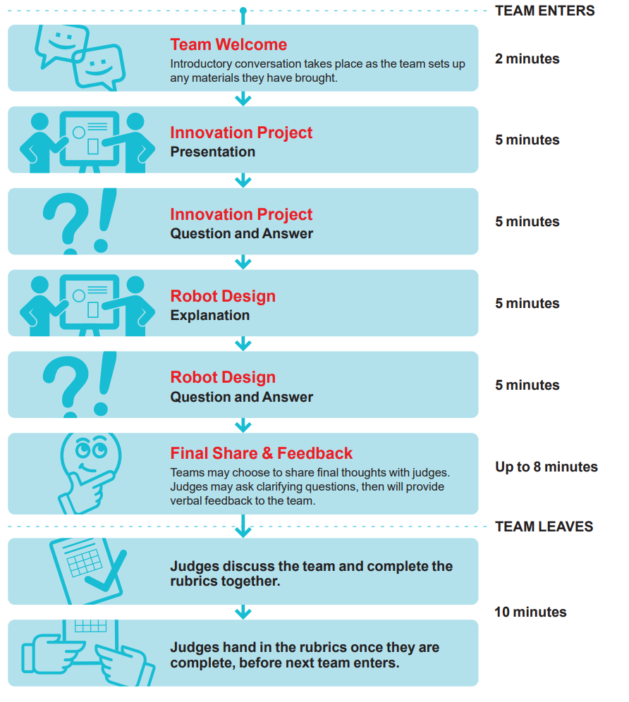
Judging Overview
Happens during a 25-30 minute session covering all areas
Takes place in a closed room
Only 1-2 coaches will be allowed to join (dependent on qualifier)
Coaches are observers, not participants
All students must participate
Know the Rubrics!

Slide 21
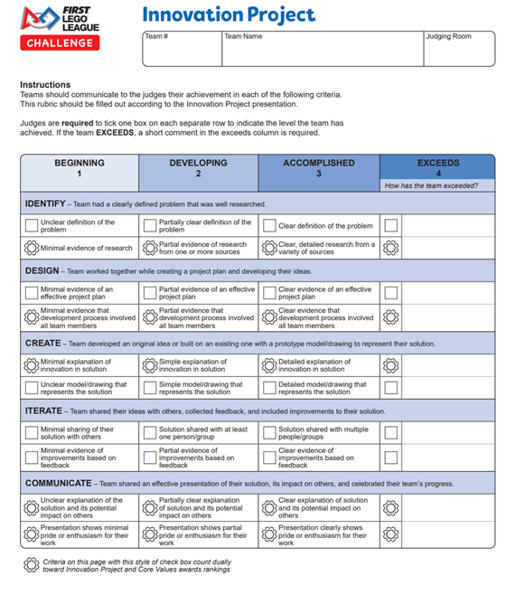
Judging Updates
No major changes for this season

Slide 22
Awards
Required Awards
Champion’s Award
Core Awards
Core Values
Innovation Project
Robot Design
Robot Performance
Optional Awards
Judges Awards
Engineering Excellence
Breakthrough
Rising All-Star
Motivate
Local Awards
Teams can only win 1 judged award
Total Awards given at a Qualifier (Required + Optional) is based on number of teams attending
Target percentage is ~40% of teams at a qualifier receive an award
Every registered team member will receive a medal
Notes:
Awards:
One award per team

Slide 23
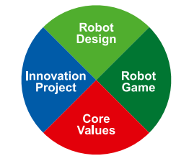
Advancement
Similar percentage of advancing teams across all qualifiers
Last season ~20% of teams advanced
Champions Award criteria used - equally weighted performance across all four areas
Robot Design
Core Values
Innovation Project
Robot Performance
Teams may win awards without advancing and may advance without winning Awards!
Notes:
Awards:
One award per team

Slide 24

State Tournament Info
How many teams advance to States?
Core Awards Given out at Qualifiers and State Championships
Champion’s Award
Robot Design Award
Robot Performance Award
Innovation Project Award
Core values Award
Judges Choice (May be up to 2 Teams)
Amount of Awards is based on the amount of teams in each qualifier
Every Student will receive a Medal at competition
Around 20% of teams advance
Can my Team visit, even if we don’t Qualify?
Of course, You may not be able to compete, but please come see the competition! It’s a blast, and fun to watch.

Slide 25
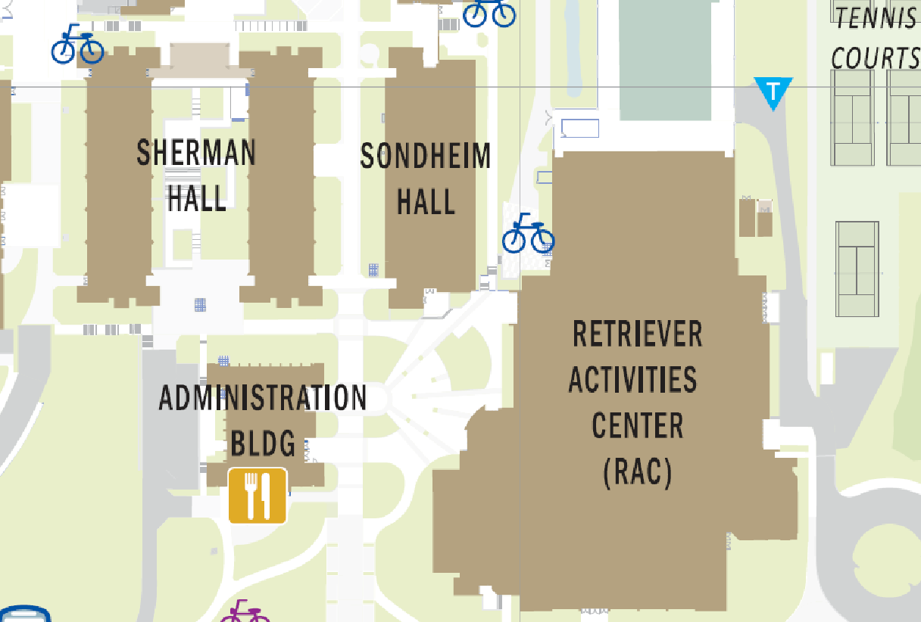
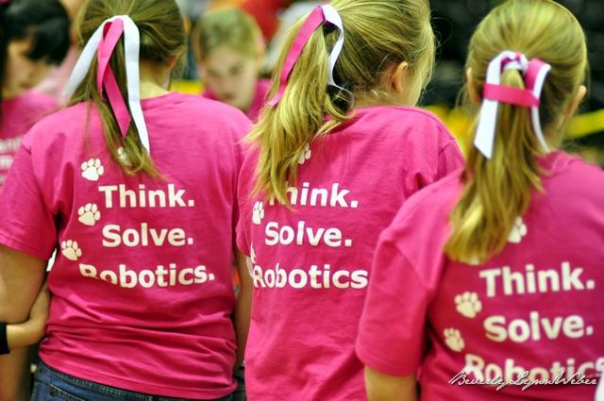
Maryland State Championship Location
Date: February 21st Snow Date ____
Location: The RAC at UMBC

Slide 26
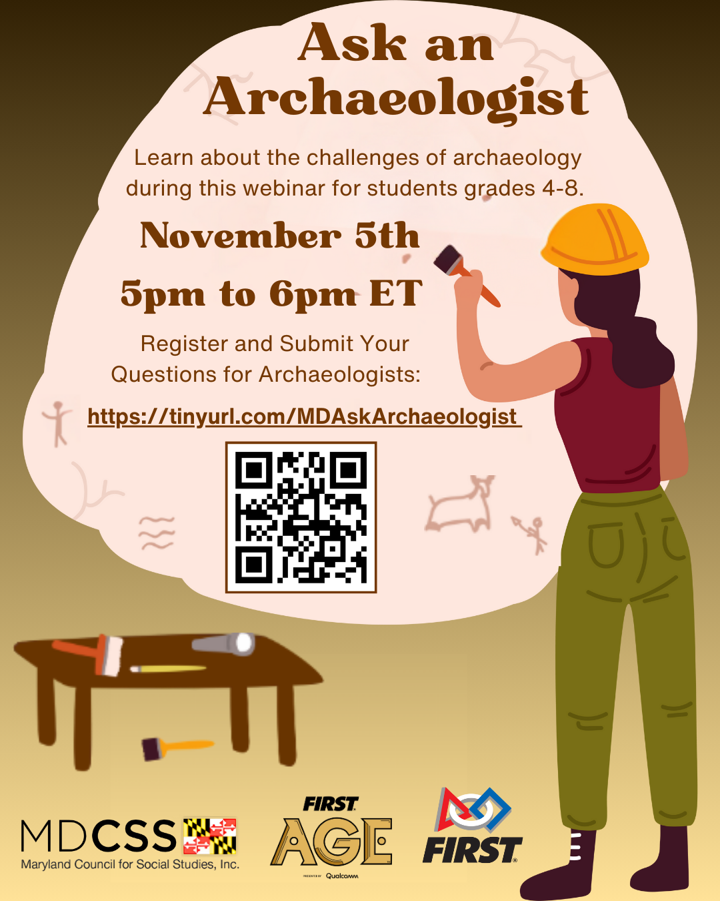

Slide 27
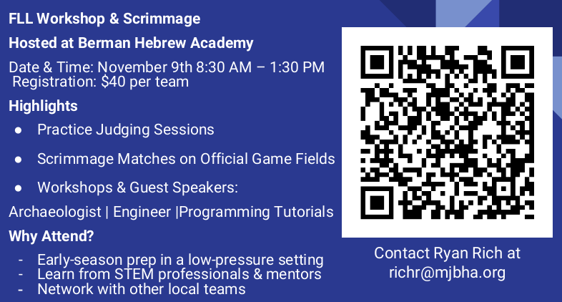

Slide 28
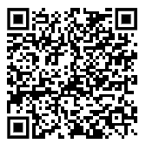
Breakout Sessions
Find your first session by 10:30.
Scan and complete the session sign for each session. Enter one valid team number, please!
Sessions are open until filled.
Please return to 116 if you have questions or cannot find a breakout session with space.

