Slide 1

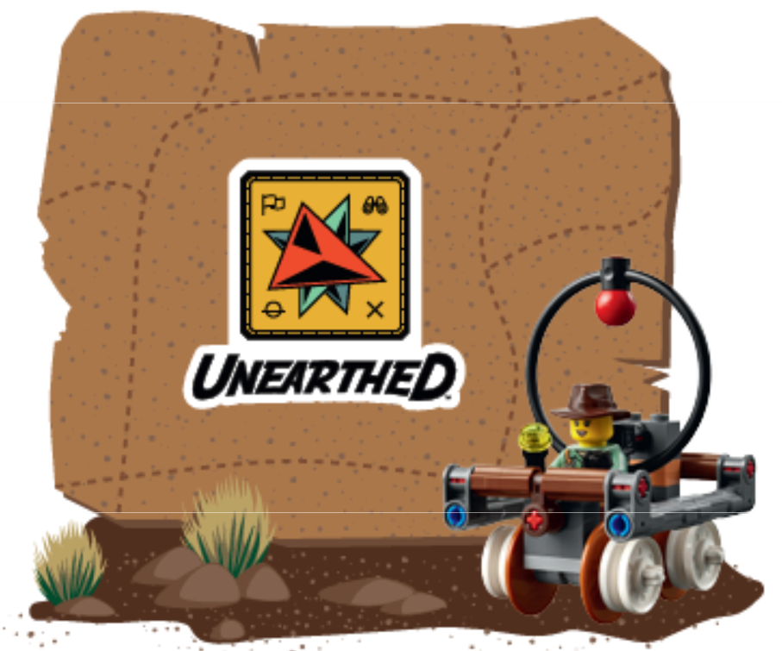
FIRST LEGO League
Robot Game
What is
FIRST LEGO League?
Preparing to Judge
Teams
Awards
The Decision Process
Notes:
Welcome to FIRST LEGO League Judge training.

Slide 2
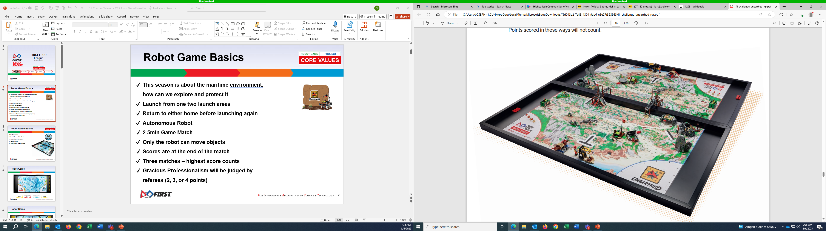
Robot Game Basics
This season is about archaeology, how can we explore what's hidden and reveal stories of the past
Launch from one two launch areas
Return to either home before launching again
Autonomous Robot
2.5min Game Match
Only the robot can move objects
Scores are at the end of the match
Three matches – highest score counts
Gracious Professionalism will be judged by referees (2, 3, or 4 points)

Slide 3
Robot Game Basics
Rule Hierarchy:
Robot Game Rule Book
Robot Game Updates
Table Referee
Tournament Head Referee

Slide 4
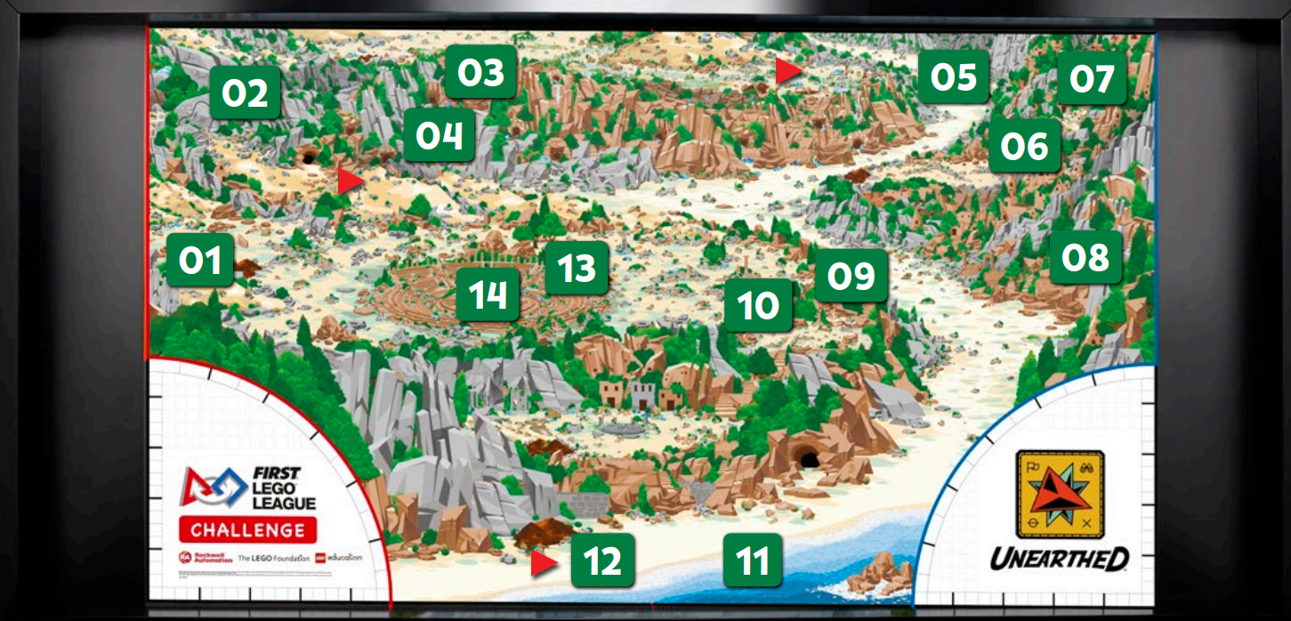
Robot Game
Notes:
When taking notes, discussing teams, and completing rubrics, be specific and share examples or evidence that supports why the team achieved a particular evaluation. Specific comments are more helpful to teams than general impressions.

Slide 5
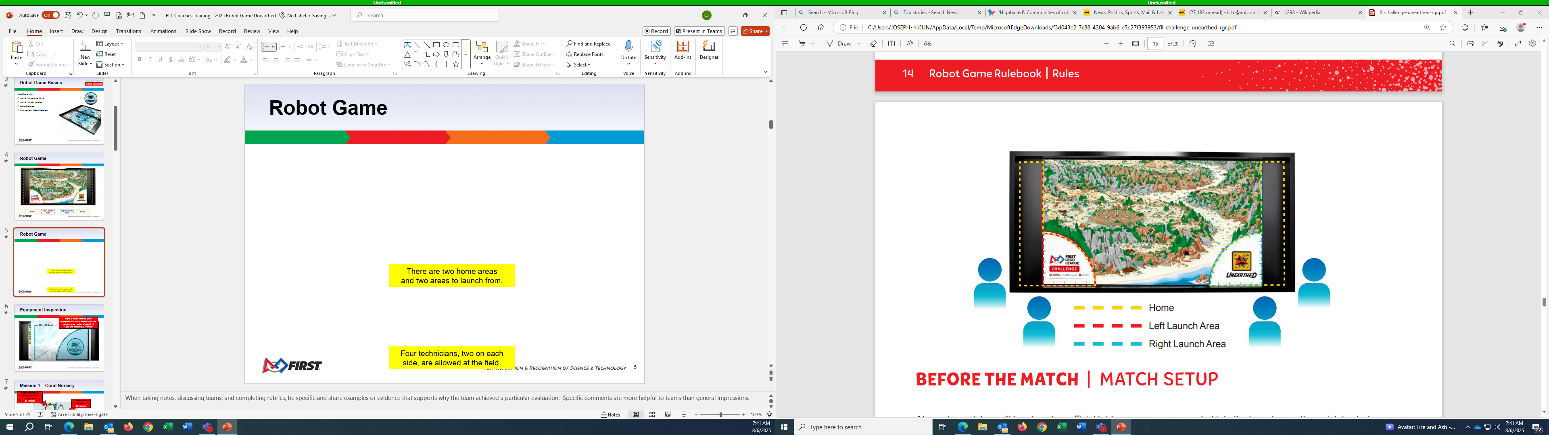
Robot Game
There are two home areas
and two areas to launch from.
Four technicians, two on each
side, are allowed at the field.
Notes:
When taking notes, discussing teams, and completing rubrics, be specific and share examples or evidence that supports why the team achieved a particular evaluation. Specific comments are more helpful to teams than general impressions.

Slide 6
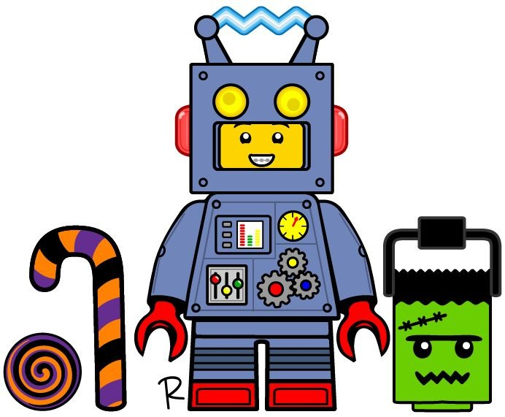
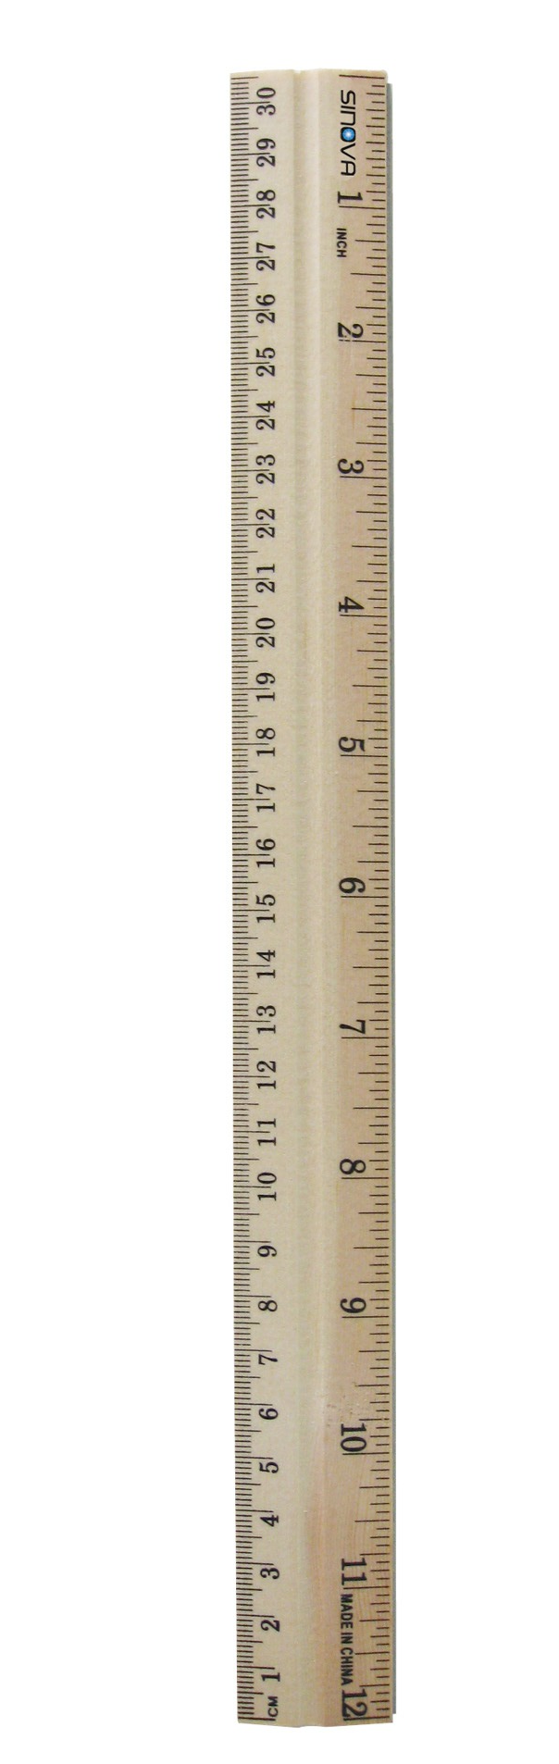
Equipment Inspection
If your robot and all your equipment fit completely in either launch area under a height of 12in, pre-match (20 Points)
Notes:
When taking notes, discussing teams, and completing rubrics, be specific and share examples or evidence that supports why the team achieved a particular evaluation. Specific comments are more helpful to teams than general impressions.

Slide 7
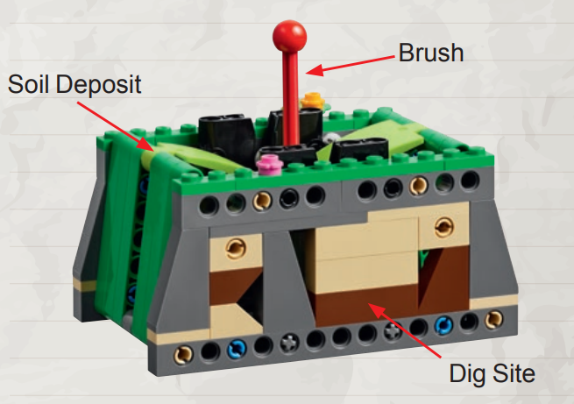
Mission 1 – Surface Brushing
Soil Deposits are completely cleared, touching the mat.
10 Points each
Brush not touching the dig site.
10 Points
No equipment may be touching any part of any mission models at the end of the match.
Notes:
When taking notes, discussing teams, and completing rubrics, be specific and share examples or evidence that supports why the team achieved a particular evaluation. Specific comments are more helpful to teams than general impressions.

Slide 8
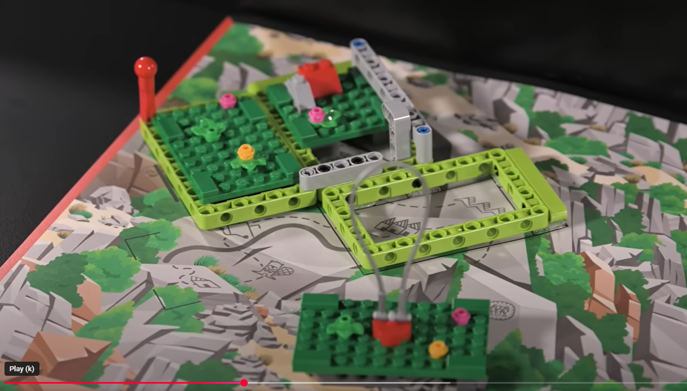

Mission 2 – Map reveal
Topsoil sections are completely cleared
10 Points each
Latch drops fully
10 Points
Section w/ loop no longer touching model
10 Points
Rotated past line on mat.
10 Points
Notes:
When taking notes, discussing teams, and completing rubrics, be specific and share examples or evidence that supports why the team achieved a particular evaluation. Specific comments are more helpful to teams than general impressions.

Slide 9
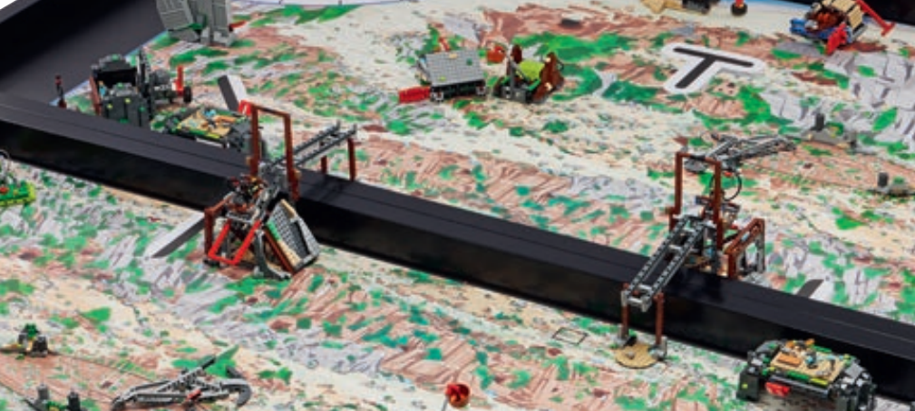
Mission 3 – Mineshaft Explorer
Your minecart is on the opposing team’s field
30 Points
Your cart must be completely through the mineshaft entry
BONUS: Opposing team’s minecart is on your field
10 Points
Notes:
When taking notes, discussing teams, and completing rubrics, be specific and share examples or evidence that supports why the team achieved a particular evaluation. Specific comments are more helpful to teams than general impressions.

Slide 10
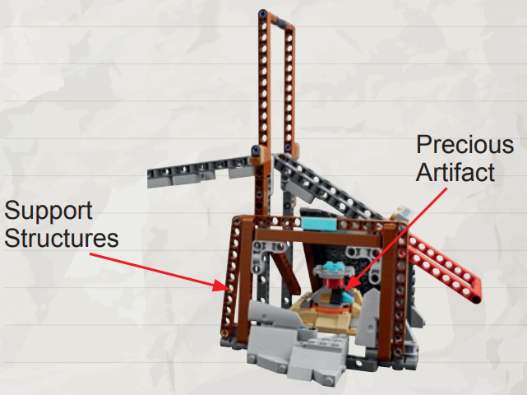
Mission 4 – Careful Recovery
No equipment may be touching any part of any mission models at the end of the match.
Precious artifact not touching mine.
30 Points
Both support structure are standing
10 Points
Notes:
When taking notes, discussing teams, and completing rubrics, be specific and share examples or evidence that supports why the team achieved a particular evaluation. Specific comments are more helpful to teams than general impressions.

Slide 11
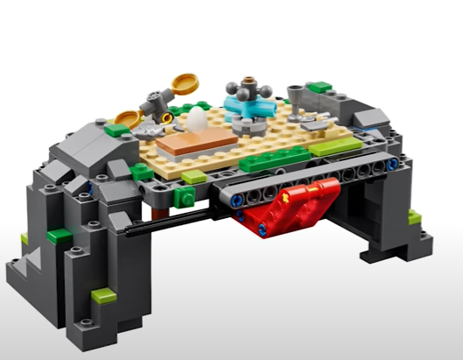
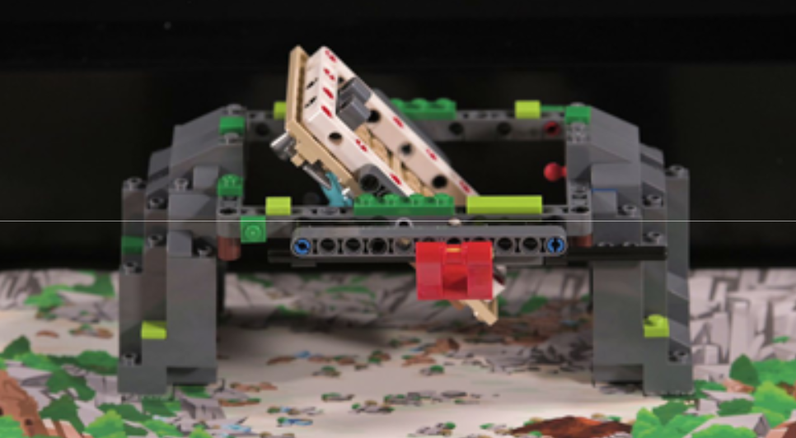
Mission 5 – Who lived here?
Set-up position
If the structure floor is completely upright
30 Points
No equipment may be touching any part of any mission models at the end of the match
Notes:
When taking notes, discussing teams, and completing rubrics, be specific and share examples or evidence that supports why the team achieved a particular evaluation. Specific comments are more helpful to teams than general impressions.

Slide 12
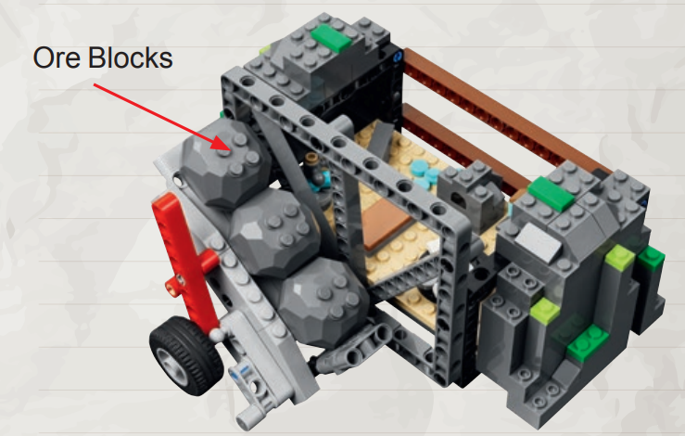
Mission 6 – Forge
Ore Blocks not touching the forge.
10 Points Each
Notes:
When taking notes, discussing teams, and completing rubrics, be specific and share examples or evidence that supports why the team achieved a particular evaluation. Specific comments are more helpful to teams than general impressions.

Slide 13
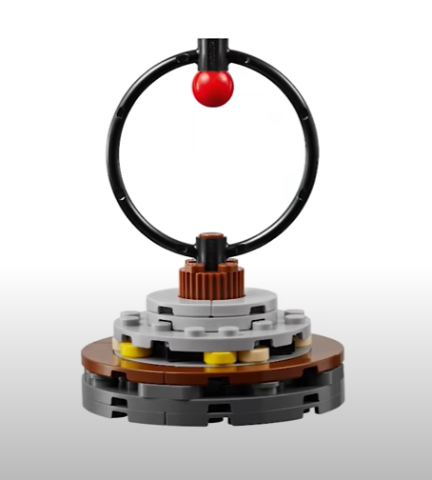
Mission 7 – Heavy Lifting
Millstone is no longer touching its base.
30 Points
Notes:
When taking notes, discussing teams, and completing rubrics, be specific and share examples or evidence that supports why the team achieved a particular evaluation. Specific comments are more helpful to teams than general impressions.

Slide 14
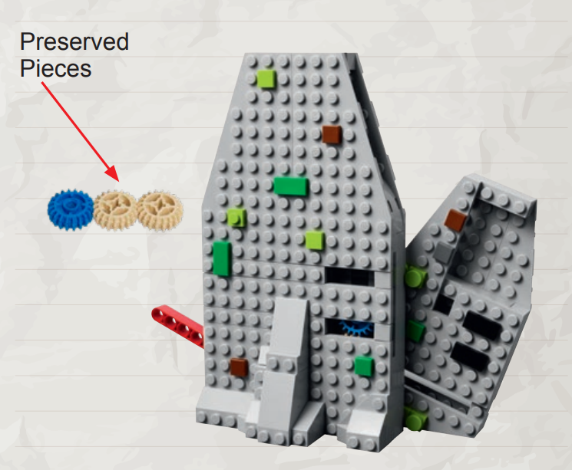
Mission 8 – Silo
Preserved pieces are outside the silo.
10 Points Each
Notes:
When taking notes, discussing teams, and completing rubrics, be specific and share examples or evidence that supports why the team achieved a particular evaluation. Specific comments are more helpful to teams than general impressions.

Slide 15
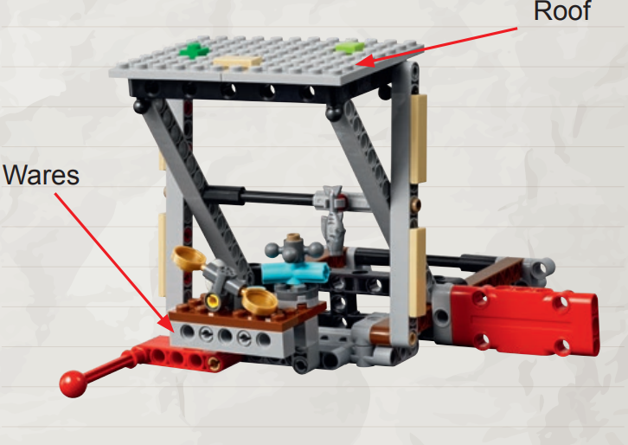
Mission 9 – What’s on sale?
No equipment may be touching any part of any mission models at the end of the match.
Roof is completely raised
20 Points
Market wares are raised
10 Points
Notes:
When taking notes, discussing teams, and completing rubrics, be specific and share examples or evidence that supports why the team achieved a particular evaluation. Specific comments are more helpful to teams than general impressions.

Slide 16
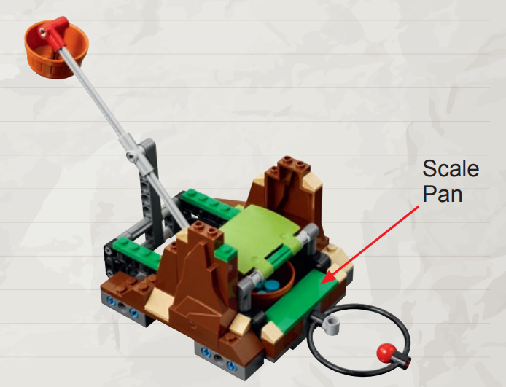
Mission 10 – Tip the Scales
Scale is tipped and touching the mat.
20 Points
Scale pan is completely removed
10 Points
Notes:
When taking notes, discussing teams, and completing rubrics, be specific and share examples or evidence that supports why the team achieved a particular evaluation. Specific comments are more helpful to teams than general impressions.

Slide 17
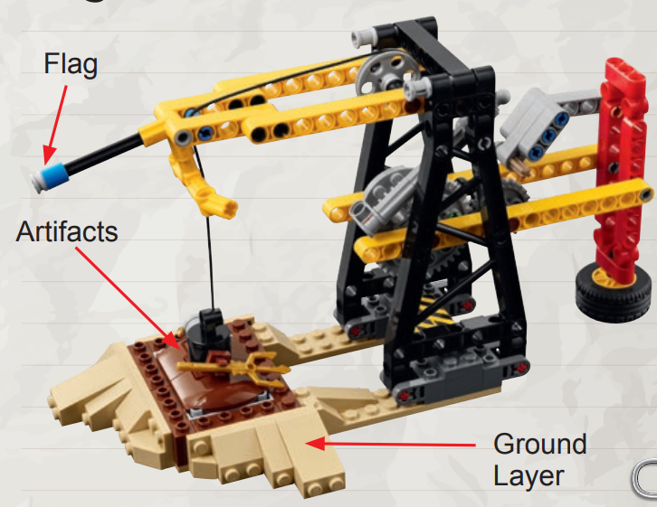
Mission 11 – Angler Artifacts
Bonus: Flag at least partly lowered
10 Points
No equipment may be touching any part of any mission models at the end of the match.
Artifacts are raised above ground layer
20 Points
Notes:
When taking notes, discussing teams, and completing rubrics, be specific and share examples or evidence that supports why the team achieved a particular evaluation. Specific comments are more helpful to teams than general impressions.

Slide 18
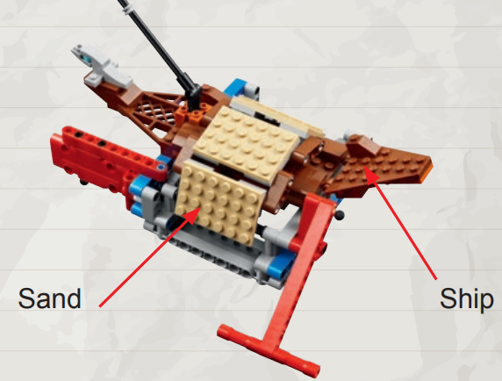
Mission 12 – Salvage Operation
No equipment may be touching any part of any mission models at the end of the match.
Ship is completely raised
10 Points
Sand is completely cleared
20 Points
Sand is considered completely cleared when activator is past the line on the mat.
Notes:
When taking notes, discussing teams, and completing rubrics, be specific and share examples or evidence that supports why the team achieved a particular evaluation. Specific comments are more helpful to teams than general impressions.

Slide 19
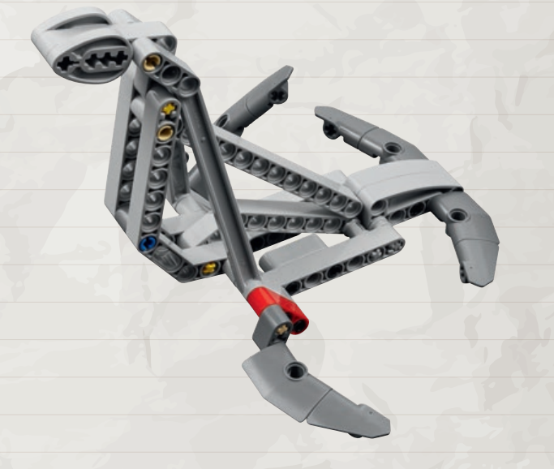
Mission 13 – Statue Rebuild
No equipment may be touching any part of any mission model at the end of the match.
Statue is completely raised.
30 Points
Notes:
When taking notes, discussing teams, and completing rubrics, be specific and share examples or evidence that supports why the team achieved a particular evaluation. Specific comments are more helpful to teams than general impressions.

Slide 20
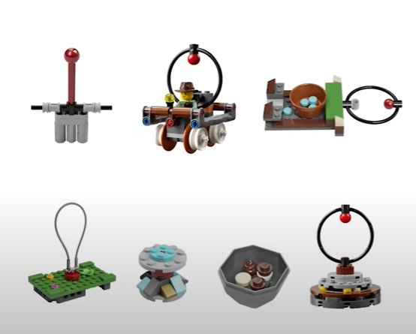
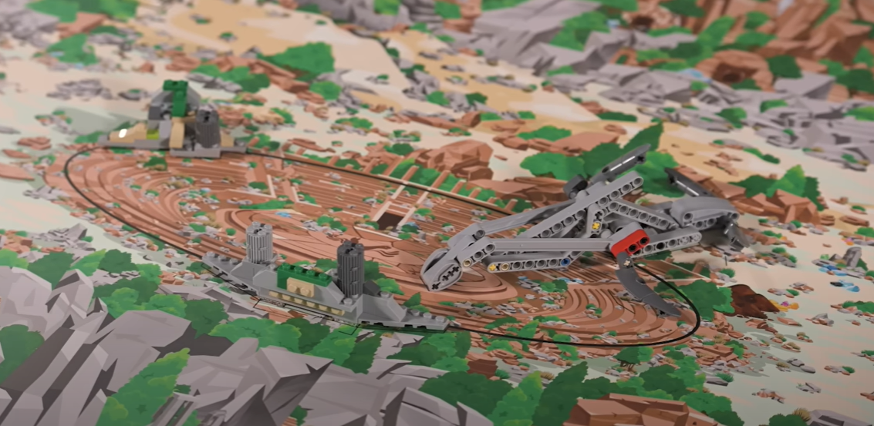
Mission 14 – Sample Collection
No equipment may be touching any part of any mission model at the end of the match.
Brush
Minecart
Scale Pan
Topsoil
Millstone
Precious Artifact
Ore w/ Artifact
Forum
Artifacts touching mat and at least partly in forum.
5 Points each
Notes:
When taking notes, discussing teams, and completing rubrics, be specific and share examples or evidence that supports why the team achieved a particular evaluation. Specific comments are more helpful to teams than general impressions.

Slide 21
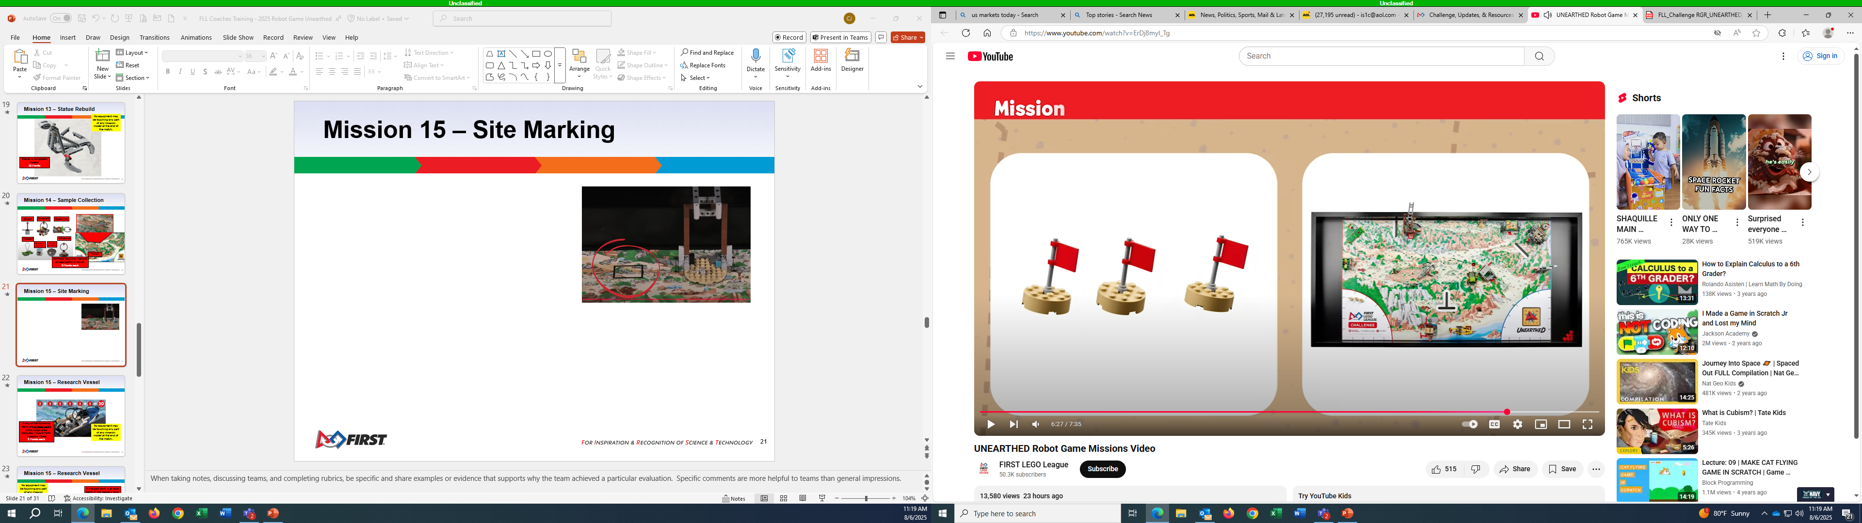
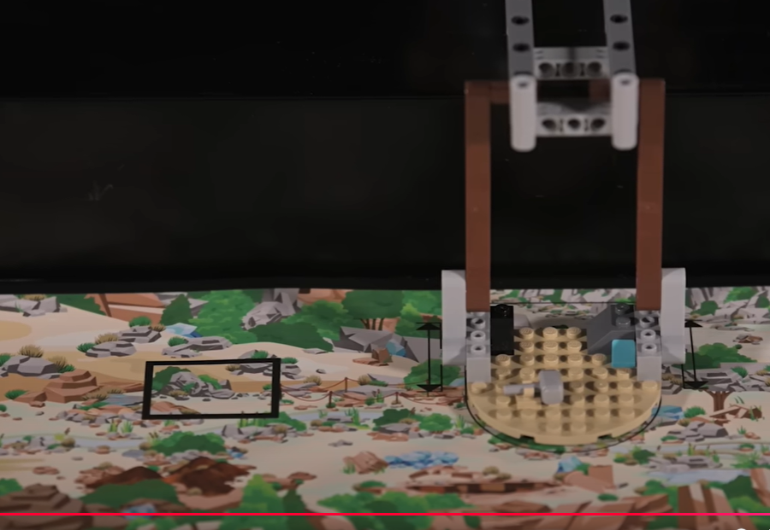
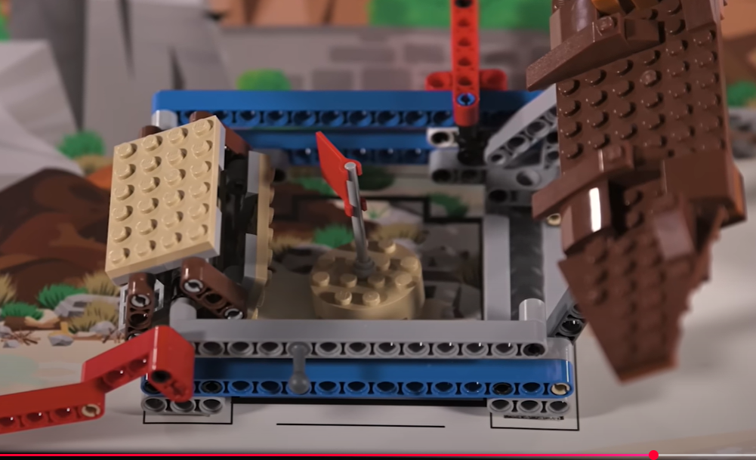
Mission 15 – Site Marking
Site with a flag at least partly inside and touching the mat
10 Points each
Notes:
When taking notes, discussing teams, and completing rubrics, be specific and share examples or evidence that supports why the team achieved a particular evaluation. Specific comments are more helpful to teams than general impressions.

Slide 22
Precision Tokens
You begin the match with six precision tokens worth 50 free points.
The referee holds onto them.
If you interrupt the robot outside of home, the referee removes one token.
You keep points for the number of remaining tokens at the end of the match.
If the number remaining is:
1: 10 3: 25 5: 50
2: 15 4: 35 6: 50

Slide 23
Terms
Equipment: Everything teams bring to the match. (See rules “Before the Match” for details)
Field: This consists of the border walls and everything inside them. (The mat, mission models and home areas are all part of the field)
Interruption: Any interaction by technicians with the robot or objects in contact with the robot after it has been launched.
Launch: The act of activating the robot from rest when completely within its designated launch area to cause it to move autonomously.
Match: The 2.5 minutes when the robot completes as many missions as possible to earn points.
Mission: One or more tasks that can be completed for points. Teams may try missions in any order or combination.
Robot: Your controller and any equipment combined with it by hand and intended to not separate from it, unless by hand.
Technicians: Team members standing at the table who are handling the robot during a match.

Slide 24
Equipment
1 Controller
4 Motors
Sensors: Only touch/force, color, distance/ultrasonic, and gyro sensors are allowed (any mix and number) in any one match.
Lego wires, one power pack (or 6 AA batteries) and one microSD card.
One sheet of notebook paper per home area for program notes. (Does not count as “equipment”)
No remote controllers of any type are allowed.
Additional or duplicate mission models are not allowed.

Slide 25
Before The Match | Match Setup
Teams will not be given additional storage space. Storage tables or trolleys are not allowed. Everything must stay on the table or in the hands of a technician.
Equipment stored on the table may extend past the left/right walls only.
After the team has passed inspection, they will be given a couple of minutes to set up. They start by distributing their equipment between the two home areas.
Team members must then divide into two groups and position one group at each side of the field (left and right).
These members cannot switch sides during the match. (four or more: two per side; three: 1 and 2 team choice; two: one each).
All other team members must stand back.
Teams may never have more than two technicians at a single home area, but team members may swap places with technician(s) on their side at any time.

Slide 26
During the Match | Inside Home
Home is split into two areas. Each home area contains its own launch area.
Technicians may use their hands on the robot, equipment, and mission models when these are completely within their home area.
When launching:
• Technicians may not keep anything from moving.
• The robot and anything it is about to move must fit completely inside the launch area.
Technicians may not: Touch anything outside of their home area; cause anything to move or extend outside this area, except the robot; hand anything to the other home area. (Points scored in these ways will not count).
After any launch, technicians should allow the robot (and anything it is in contact with) to return completely into home before interrupting it.

Slide 27
During the Match | Outside Home pt1
If technicians interrupt their robot, it must be relaunched. If the robot was outside home (even partly) when it was interrupted, they lose one precision token.
If the robot was partly outside home: Bring the robot into that home area.
If the robot was completely outside home: Return the robot to either home area.
If the object was with the robot when it launched: Keep it. Bring it with the robot.
If the object was obtained after the robot was launched: Give it to the referee for the remainder of the match.
Exception: If the team does not plan to launch again, they may stop their robot in place without
losing a precision token. The robot and anything it is in contact with should remain in place where it was interrupted.

Slide 28
During the Match | Outside Home pt2
If a piece of equipment or a mission model is dropped or left outside of home, wait for it to come to rest:
If it rests completely outside home: It stays as is unless the robot changes it.
If it rests partly in home: It stays as is unless the robot changes it. Alternatively, at any time, the technicians may remove it by hand. If the object removed by hand was a mission model, it must be given to the referee for the remainder of the match. If the object was equipment, it must be taken into that home area, and the team will lose one precision token.
Teams cannot separate the Dual Lock, take models apart, or break a mission model.
If a mission model is combined with anything (including the robot) the combination must be loose enough or simple enough that, if asked, the technician could free the model in perfect original condition in a single motion.
Teams also may not interrupt their robot in such a way that they earn points from it. Points scored in these ways will not count.
Teams may not interfere with the opposing field or robot unless there is a mission exception. Points failed or lost due to interference will score automatically for the other team.

Slide 29
After the Match
After 2.5 minutes, the match ends. Technicians must stop their robot and touch nothing else.
For scoring, all mission requirements must be visible at the end of match.
When something is required to be “Completely In” an area, the lines and airspace above that area counts as “in” unless otherwise mentioned.
The Referee will document the results of the match with the team.
When there is agreement on the results, the team signs the scoresheet and it becomes official.
When no agreement is reached, the head referee makes the final decision.
Only the teams best score (out of three official matches) counts towards awards and advancement.
Ties are broken by using second and third best scores. If scores are still tied, local referee will decide what to do.

Slide 30
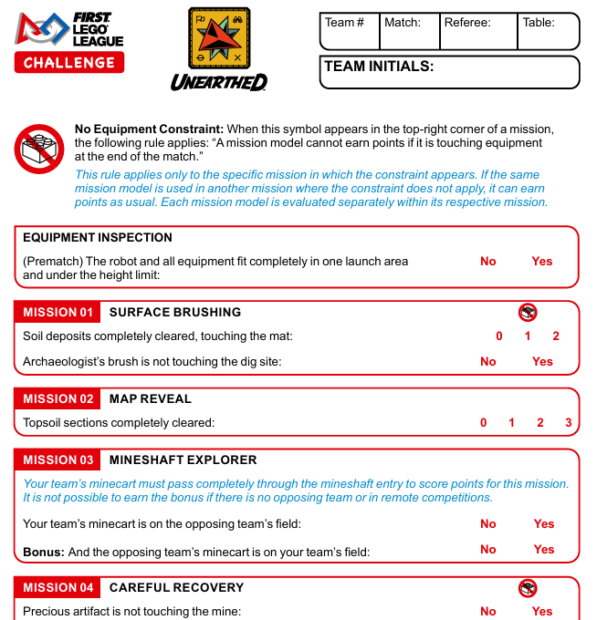
After the Match: Scoresheet
23456
2
Joe
4
NJD
Referee completes the score sheet (kids – NOT COACH – can watch)
WHATS OUR SCORE?? Referee annotates/tally's success and penalties, but do not add up points.
Team members are encouraged to challenge referee calls.
Team members must initial and certify the scoresheet when they agree.
COACHES NOT INVOLVED IN SCORING/NEGOTIATING WITH REFEREE.

Slide 31
Tips
Rules are important. Read them, then read them again. Anything not mentioned in the rules does not matter.
Kids are the only ones allowed to talk with the referees (Not Coaches). Bring a copy of the rules to the tournament,
don’t be afraid to have your team challenge the referees.
Build models exactly as shown. Many
teams find their solutions don’t work when
they get to the tournament and discover their models
at home were built incorrectly.
Kids do the work, coaches should stand back and let the kids work at the competition table, your job is to cheer.

Slide 32
Tips
Conditions differ, each table will be a bit different (lights, bumps) make sure your strategy/robot is robust. Run your robot on another team’s table, invite them to yours.
Many people find it hard to work well under pressure,
where do you feel more pressure than when
running your robot at a competition.
What can you do? Practice, practice,
practice. Stop building and programming
your robot at least a week before the competition,
and use the time to practice getting your robot to succeed
reliably at what it already can do.

Slide 33
Tips
Don’t touch the mission models on the competition table. If you think something is wrong with the way they are set up, you should ask the Referee to adjust them. You can ask the Referee to test the mission model too.
Don’t request adjustments to the angle/direction
of a mission model unless it is specifically
stated in the Field Set Up Guide.
The table will not be customized/optimized
for your team’s solution.

Slide 34
Tips
Don’t assume that the Referee will grab the robot when it is stuck. The kids should talk to the Referee ahead of time and let them know that you would like them to help with this since your team members cannot reach the robot quickly.
Don’t keep yelling instructions from the sidelines.
The kids have got this. They have been
working for months for this moment.
They need to make their own decisions
(good or bad). You should have very little to do
other than get them to the right table on time.
Do not bring extra mission models to the table
VOLUNTEER AT A TOURNAMENT!

