Slide 1
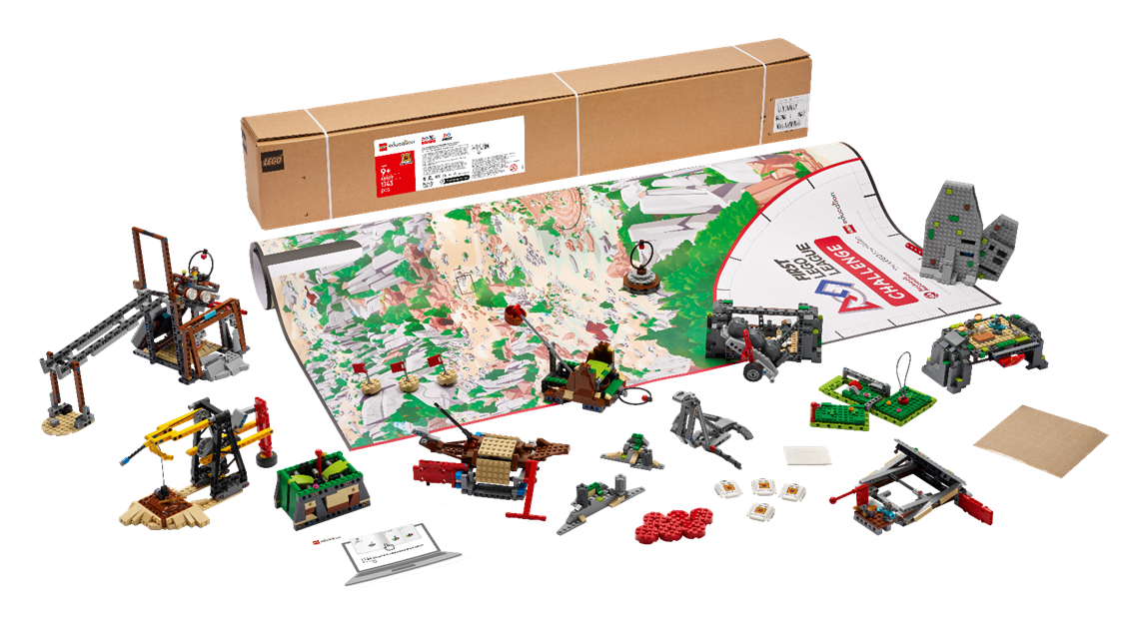

Robot Design

Slide 2
Goal & Agenda
Goal:
Provide a Framework to succeed in Robot Games
Agenda
Robot Design Thoughts
Attachments
Parts
Code
Competition Day
Games
Presentation
Final thoughts
Notes:
Expecting the audience to be one of two groups, new coaches or coaches struggling with robot games and want some pointers. Or returning coaches looking for tips to improve their robot game. If you are already getting 400+ points and figuring out how to get 100% of points, I can’t help, but there is a video in a few slides for you!

Slide 3
About me
Jie Zhang
Software Engineer
2024-2025 Coach for Advanced Robotics Team (56774)
Howard County Chinese School - weekend language school
Finished 8th at State Championship, 2nd Place Robot Performance Award, Core Value finalist
Champions Award Finalist at Florida Sunshine Invitational
2023-2024 (different coach): First Place at State, competed in World Championship
Been an FLL parent for 3 years, into 4 years

Slide 4

Ultimate Robot
Notes:
From a team in Spain, not sure even sure they compete in FLL. Want to point out these things:
This robot setup is even beyond something me as an adult can imagine
International teams can to go 16 years old.
They swap ‘cores’ instead of attachments, this allows them to pre-align the body of the robot, saving time
The last mission, notice there attachment is still moving even after the robot is not contacting it, either using rubber bands or wind-up motor
If you are looking at the ‘ultimate’ robot, I can’t help you, YouTube can.

Slide 5

Keep it simple!
You don’t need a complex robot!
You don’t need complex attachments!
You can get 50% of score with basic robot
A lot of the missions are either:
push down
lift up (or pick up a looped mission element)
push in
pull out
Conservative Est. of 270 pts for Unearthed Challenge
Would have placed 19th at Maryland State Championship (Submerged Season)
https://flltournament.com/Scoreboard.aspx?TID=29644
Notes:
270 is a conservative estimate, if you stretch the definition of the 4 basic actions a little, you can probably get more.

Slide 6
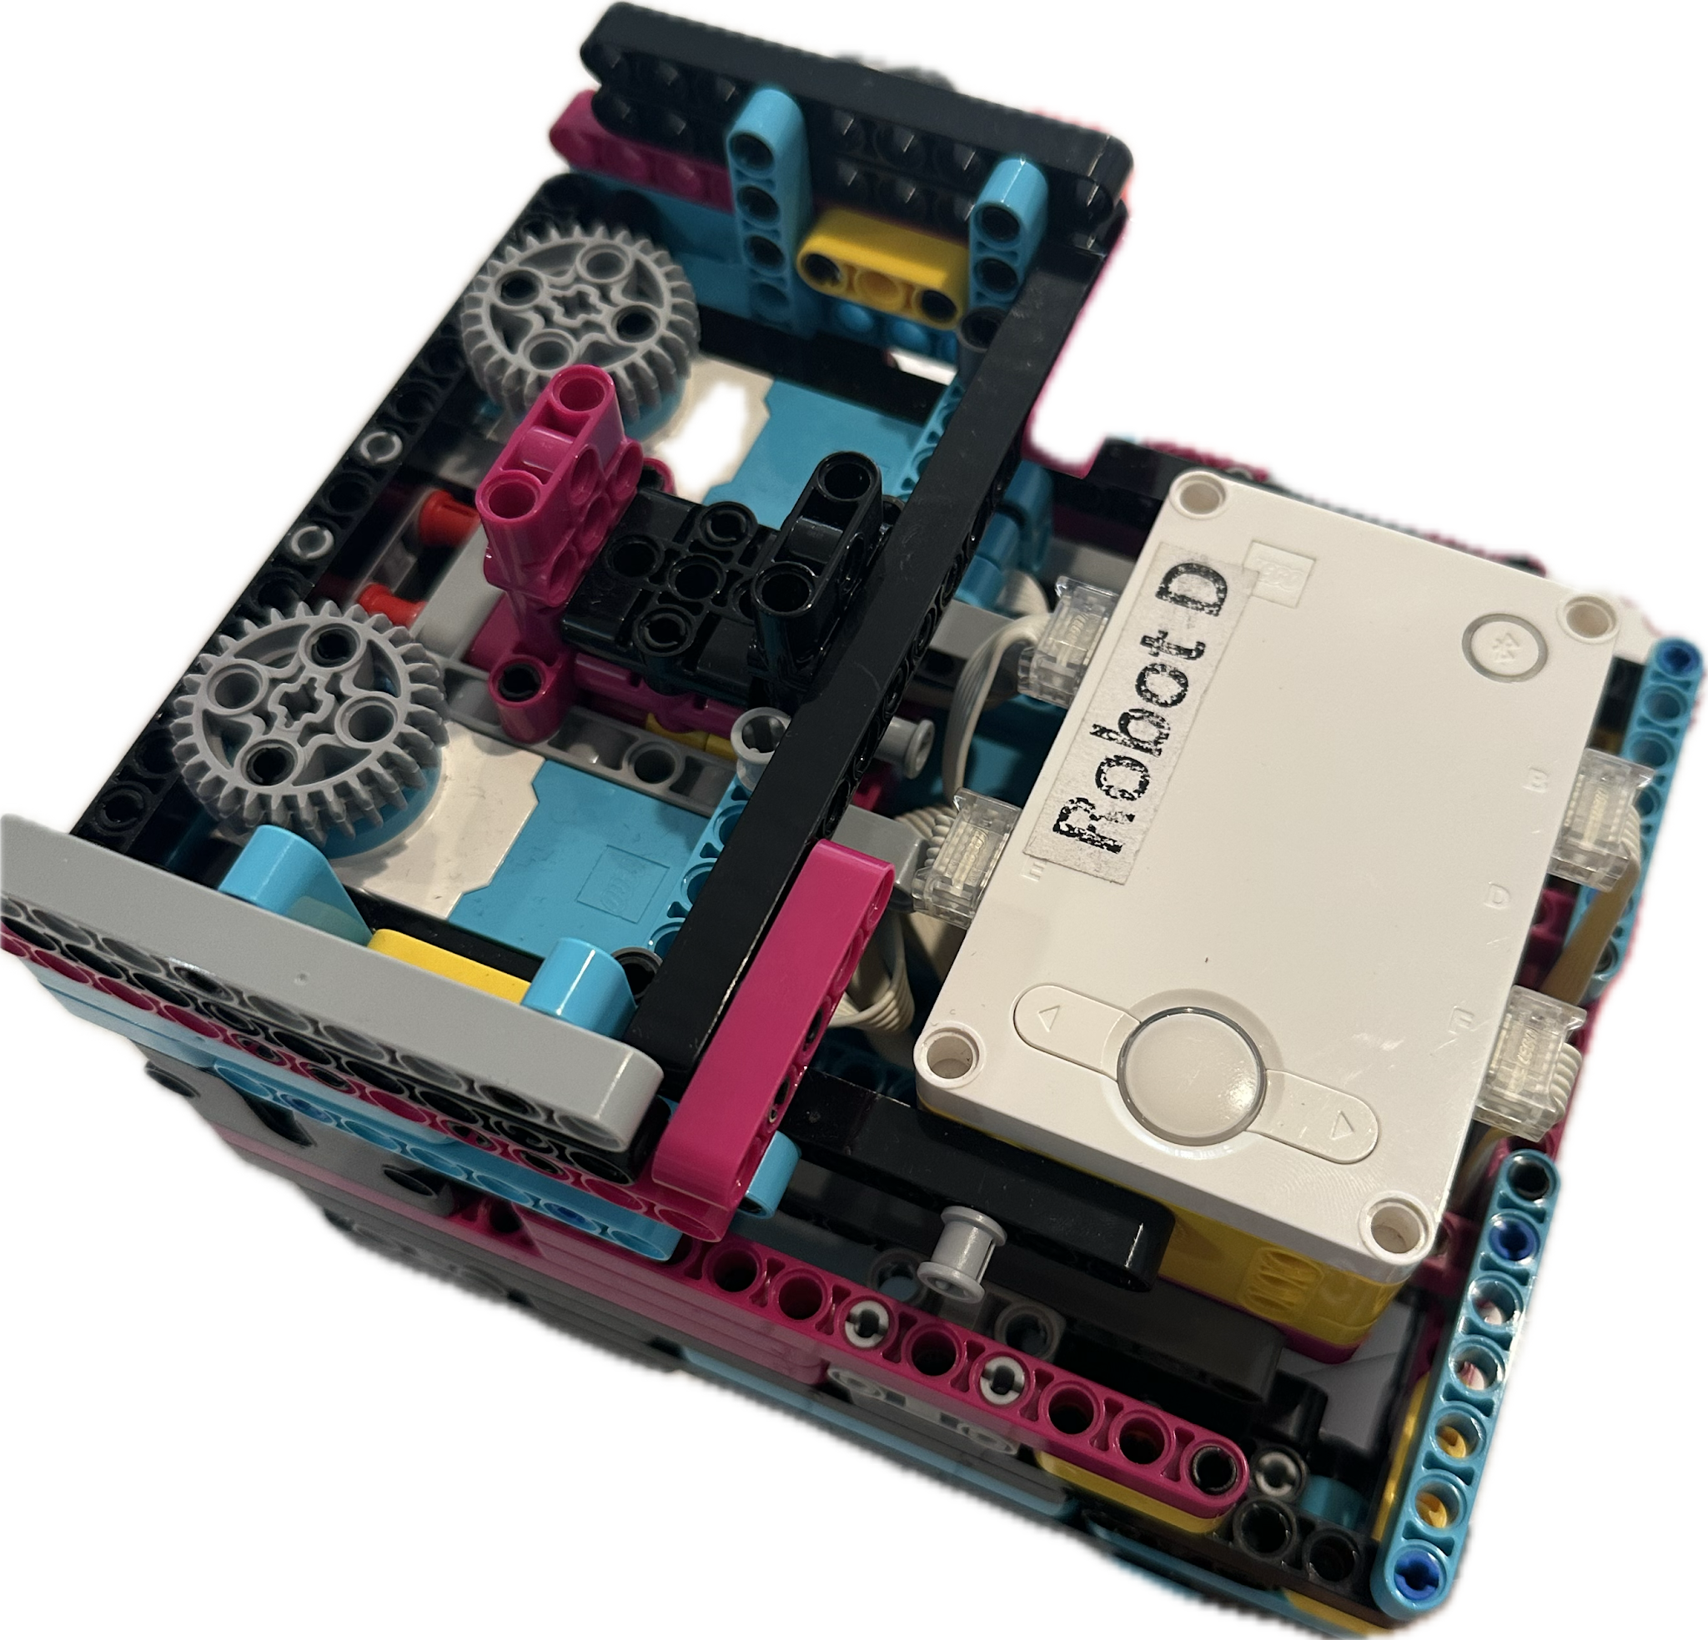
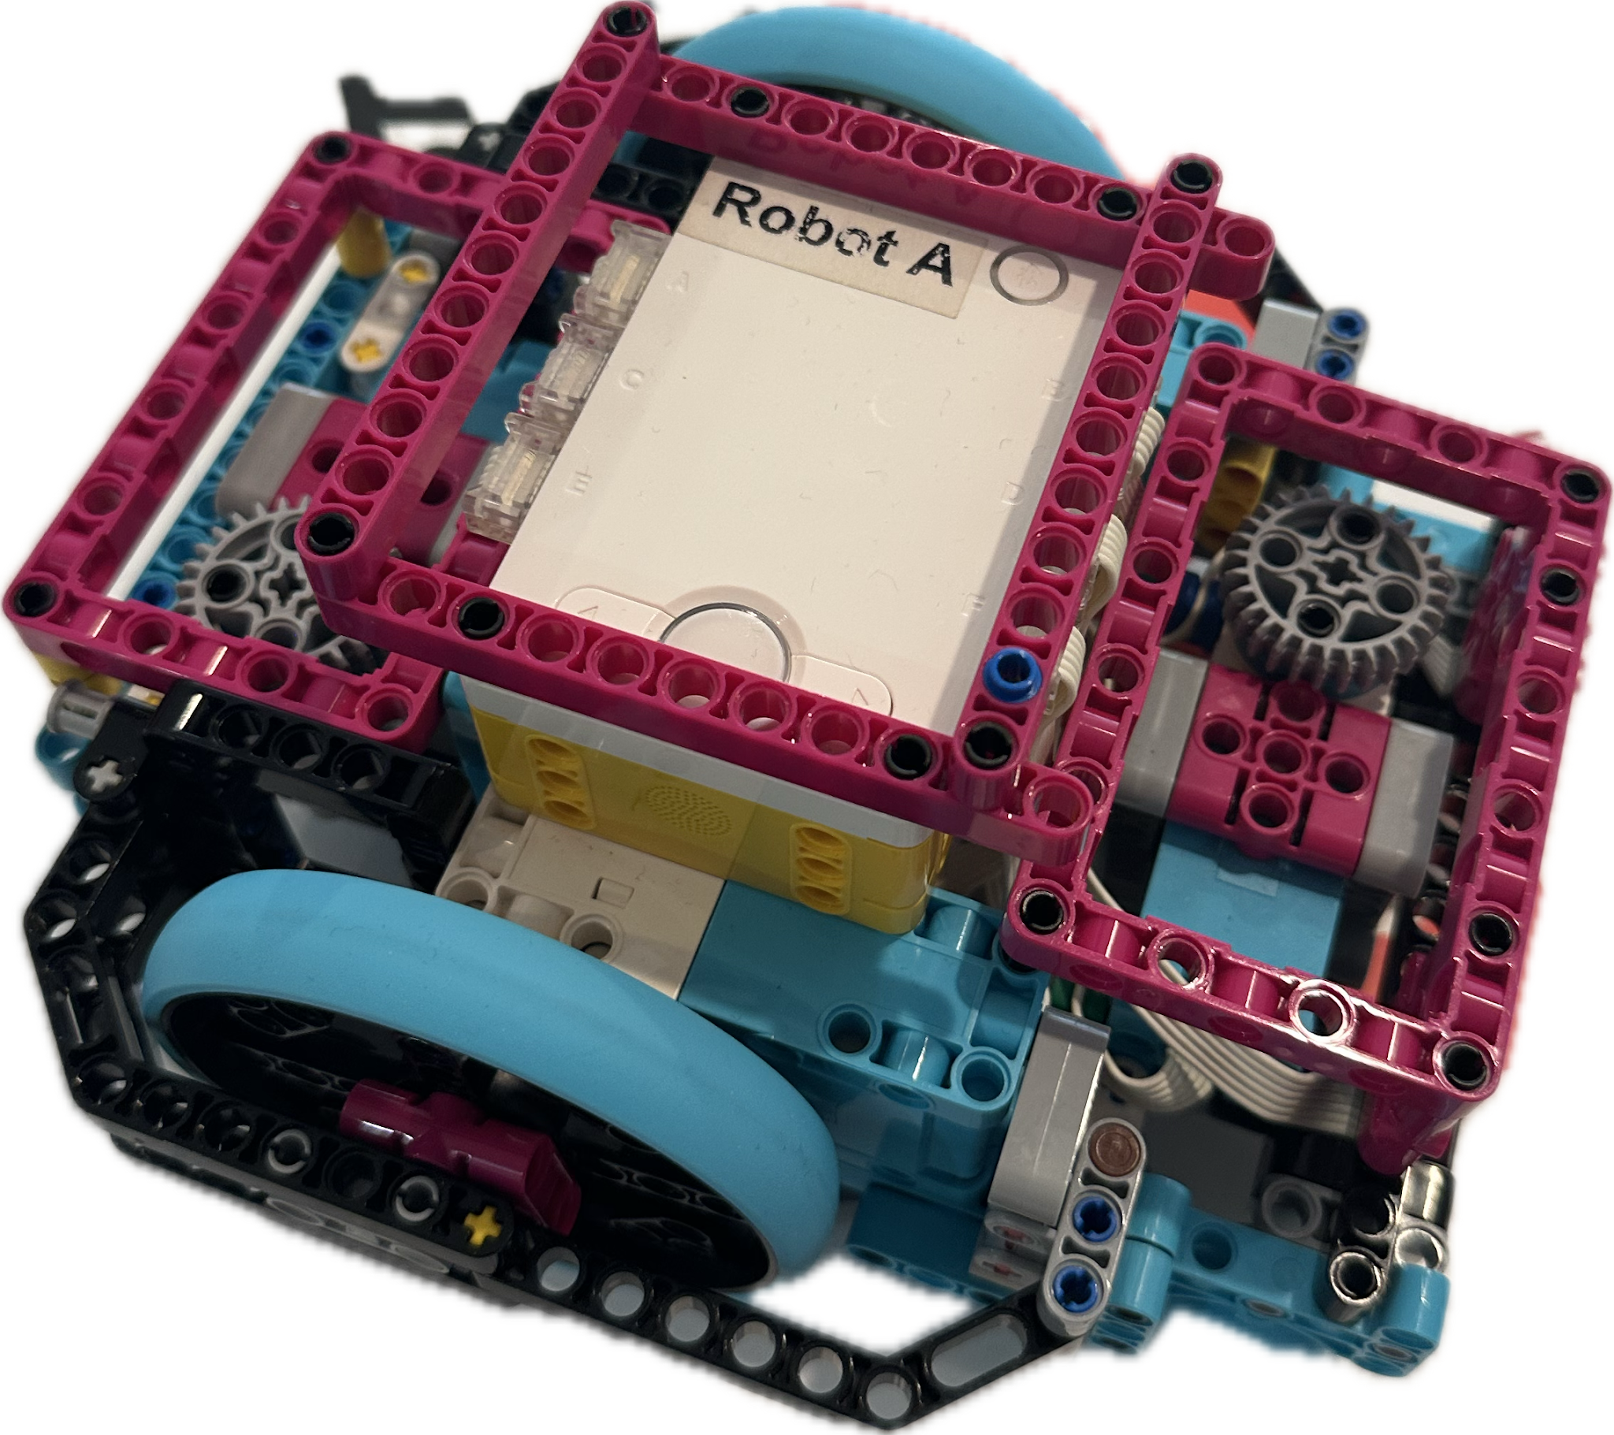
Our Robot
Notes:
225 pts with ADV at Qualifier, 9th. Advanced to State
Robot A is Advanced Driving Base, more on that in a few slides
Robot D is our ‘Box Robot’ which we used in State and Florida Invitational

Slide 7
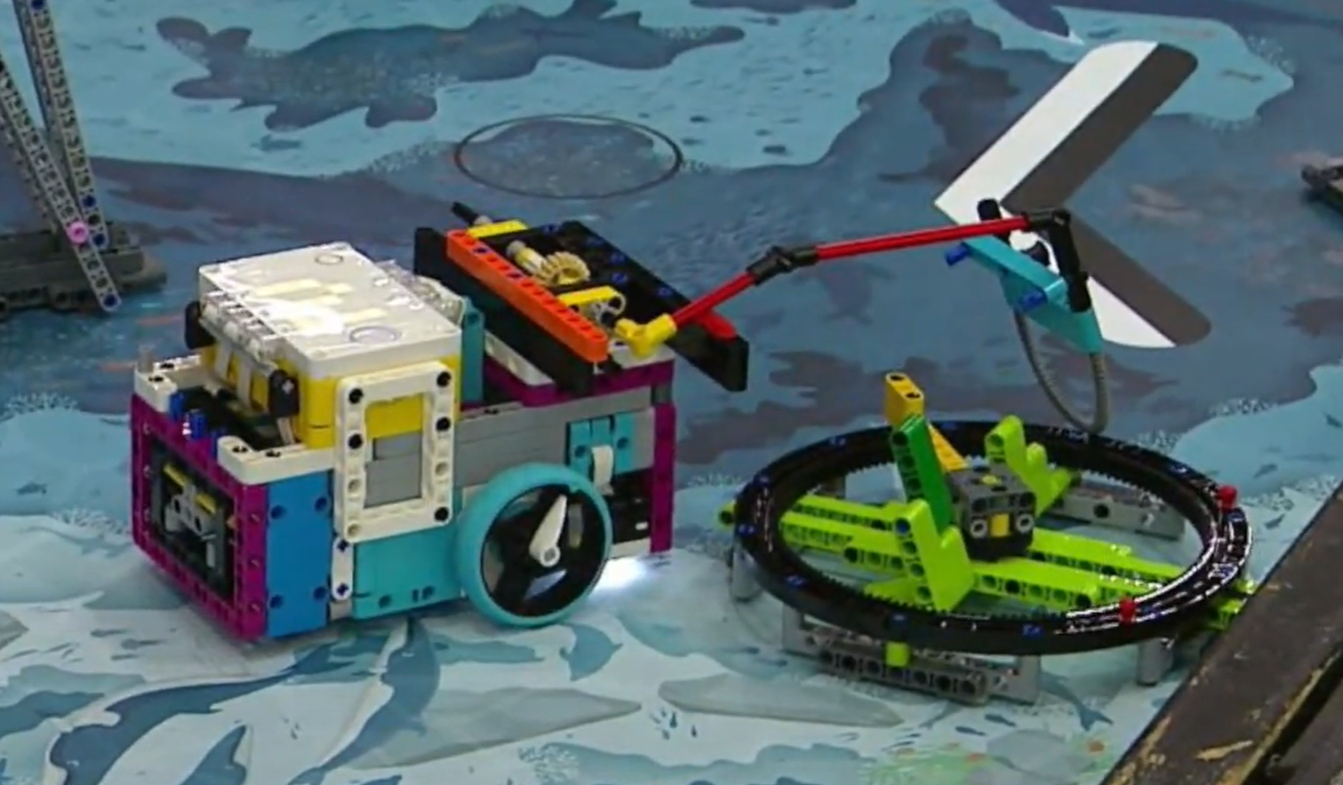
Enerdronics (#1 2024, #2 2023, #1 2022)
Notes:
This is a screen grab of Enedonics robot, it isn’t complicated but they perennially do very well.

Slide 8
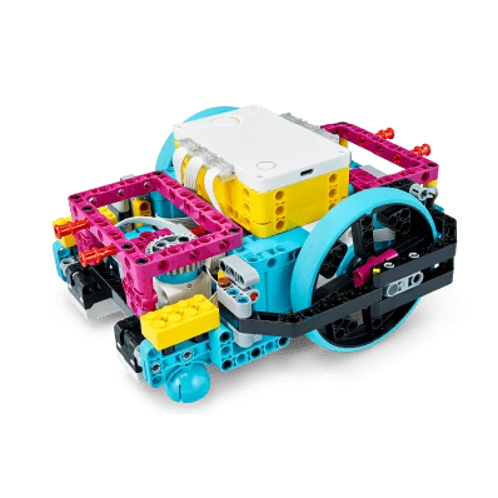
Advanced Driving Base
From the LEGO Spike Prime Kit instructions, comes with two attachments (tools) as well
If you use the Advanced Driving Base & Attachments 100%, you may not receive robot design innovation points
We used it, but made custom attachments and we got Robot Design award
Talk/Document why decisions were made (it’s in the Rubric)
Notes:
Qualifier: 225 points, 9th/28 teams with ADV
Learn from ADV and tools, improve on it get get better results and innovation points in Robot Rubrics

Slide 9
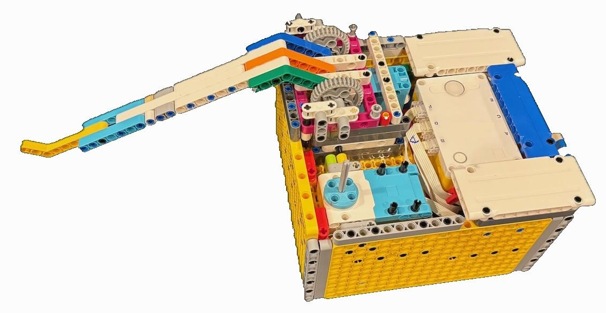
Why/Why Not Box robots
Pros:
Box robots allow easier alignment
Most/All robots are alignment based, very few use sensors for map location
Box robots generally use drop-in/snap on attachments vs pegged attachments
Weight == better friction on mat
Cons:
Box robots are large
Complex for younger/new teams
Talk/Document why decisions were made (it’s in the Rubric)
Notes:
Straight/Consistent sides allows for better alignment.
Another example of Box robot

Slide 10
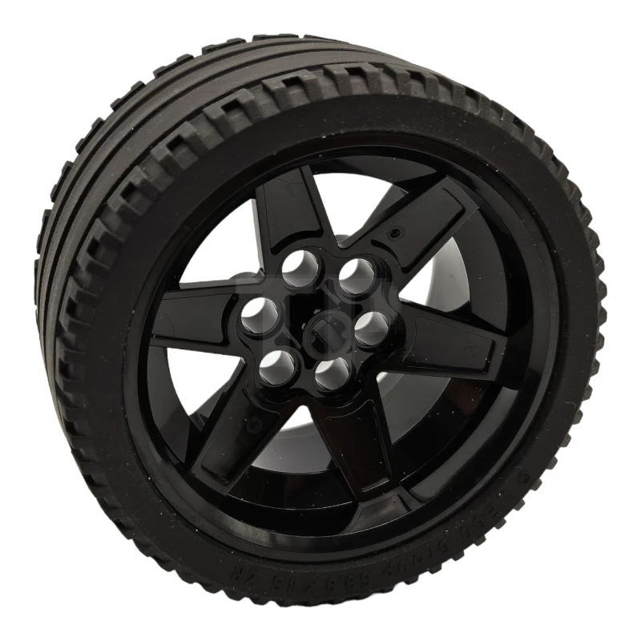
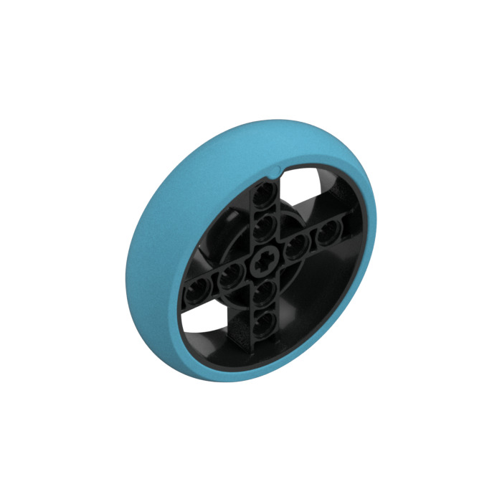
Wheels
More surface area
Has treads, typically better traction
Minor inconsistencies (size/roundness)
Can deform because of weight
Stiff, consistent
Easily attracts dirt
Low surface area of contact (½ inch)
Discuss/Document why you chose your wheel (it’s in the Rubric)
Notes:
TYRE LOW WIDE Ø56 X 28
RIM WIDE 43,2X26 W 6 HOL.Ø 4.8
Generally teams who switch to EV3 wheels generally don’t covert back.

Slide 11
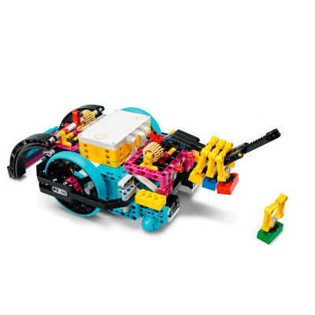
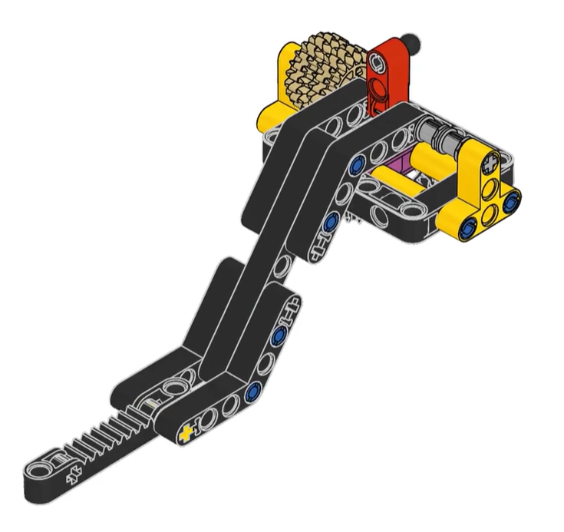
What are Attachments (Tools)
+
=
They are LEGO constructs that can be added and removed from a robot base relatively quickly
They are designed to perform actions/missions
Can be passive or driven by motors

Slide 12
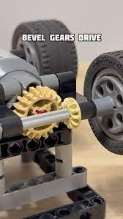
Design considerations
Multi-mission attachments
One simple attachment can do multiple missions (lift, push down)
One complex attachment can do multiple missions
Motion translation
Motors may be mounted vertically/horizontally, use bevel gears to translate motion to horizontal/vertical
Passive Attachments
Torque/Gear Ratio/Skipping

Slide 13
Design considerations (Cont)
Drop-in vs Pegged
Drop-in faster to change out, but sometimes can be loose fitting (or pop out in a push down action)
Drop-in more complicated to build
Pegged attachments are locked in, takes longer to change
Pegged attachments are generally simpler
Talk/Document why decisions were made (it’s in the Rubric)
Notes:
Teams have 2.5 minutes to do as much as possible, switching attachments takes time. Drop in attachments save time. Need design attachment to account for Newton 3rd Law.
Pegged attachments takes time to change, when taking apart the pegs could be stuck

Slide 14
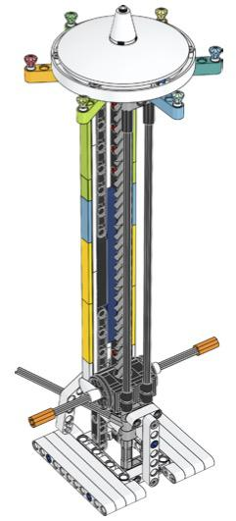
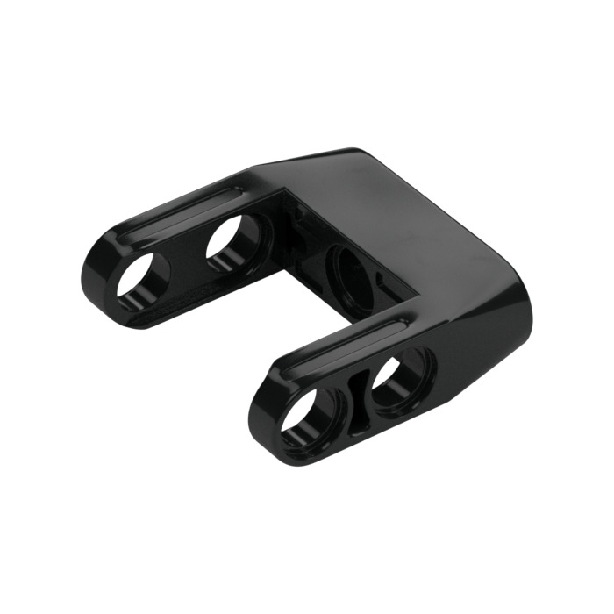
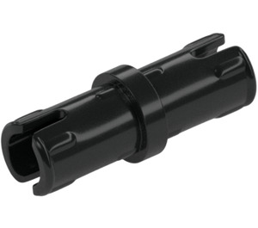
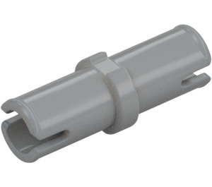
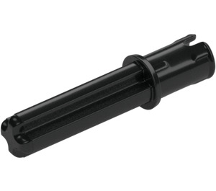
Design considerations (Cont)
Consider using two motors for attachments
Improves time in robot performance if two motors can do different missions in single run
Use the larger motors for the attachments, you need the torque
Take hint from mission models
Many have great gear mechanisms which can be used in attachments
For example, the worm drive from Masterpiece Season Mission 11: Light Show
YouTube
Understand use/purpose of some specialized parts - it can simplify some attachments. examples:
Frame for Motion Translation
Can help to snap on Attachment
Friction vs non-friction can help many situations
Notes:
Shipping Lane from Last year, and Mission 13, Statue rebuild, make sure to use the grey peg

Slide 15
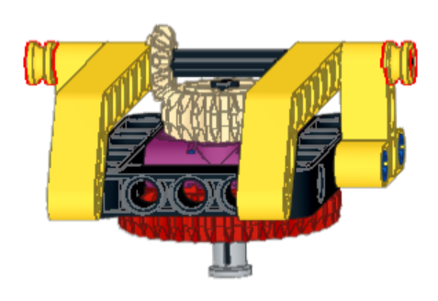
Simple Lifter

Slide 16
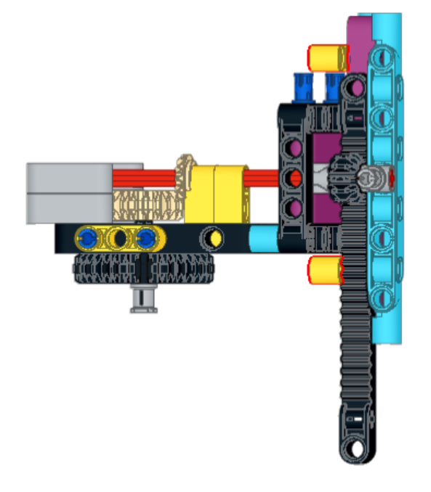
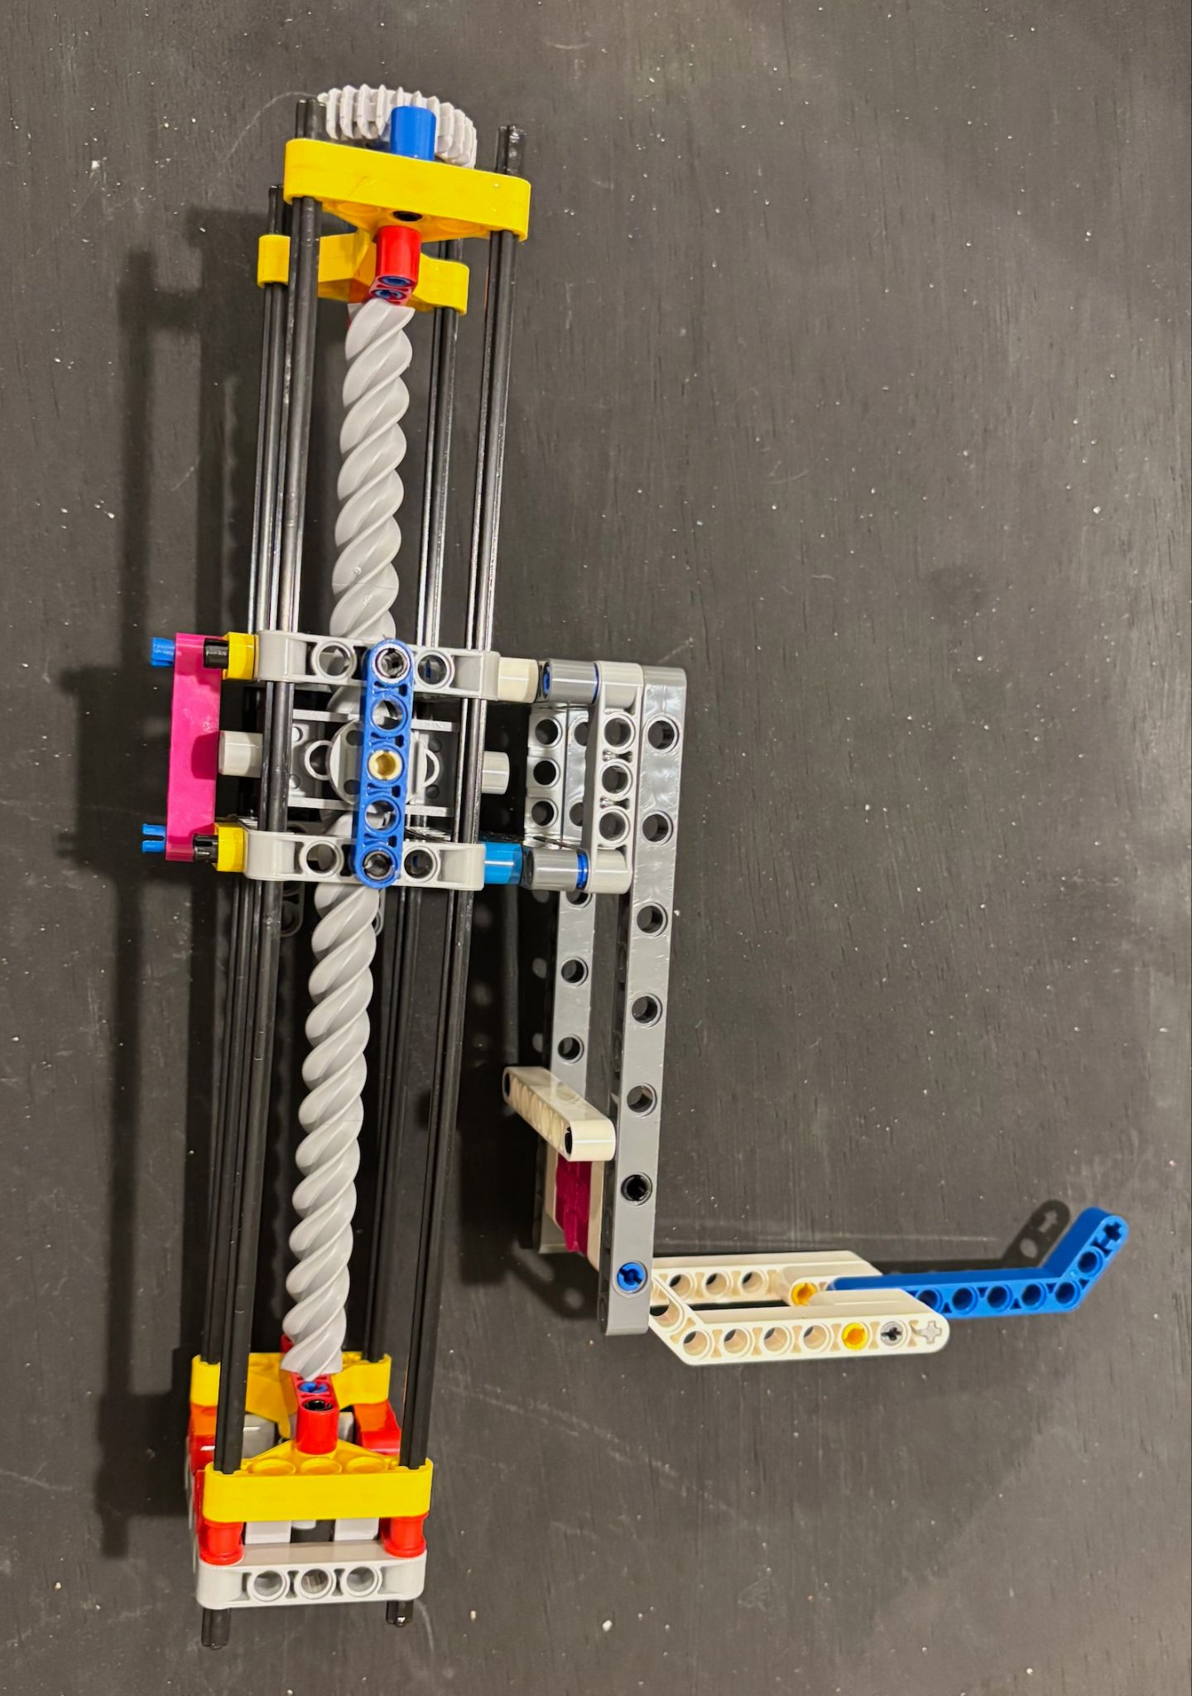
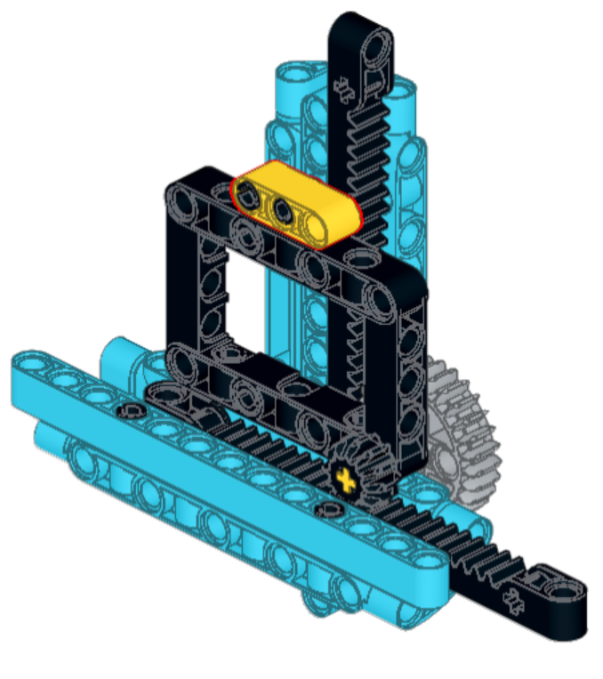
Sample Attachments: Lift (Passive vs Motor)
Derived from Mission 11: Light Show in Masterpiece Season
Notes:
Left attachment is passive, use case could be submersible from Submerged, where a robot runs into the base and lift the submersible.

Slide 17
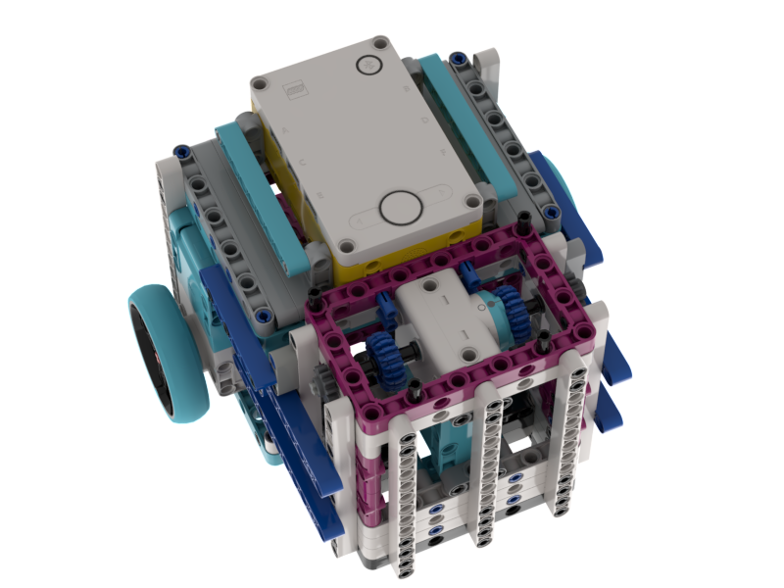
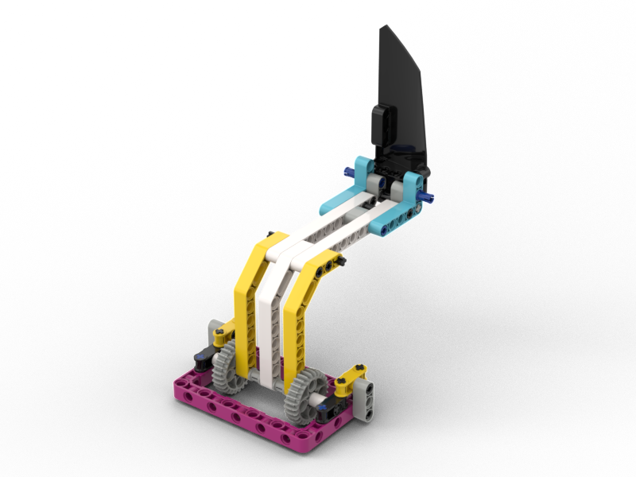
Alternative Motor Mount and Attachment
Notes:
Another version of robot and mount, this motor is mounted vertically, no need for motion translation for up and down motions.

Slide 18
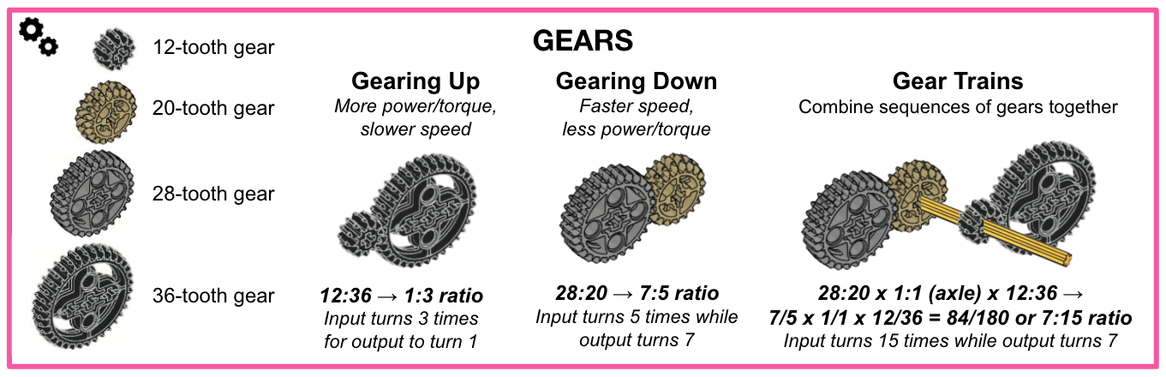
Gear Ratios/Torque
The small and large Prime motors have different torques
Talk/Document why you used certain gears (it’s in the Rubric)

Slide 19
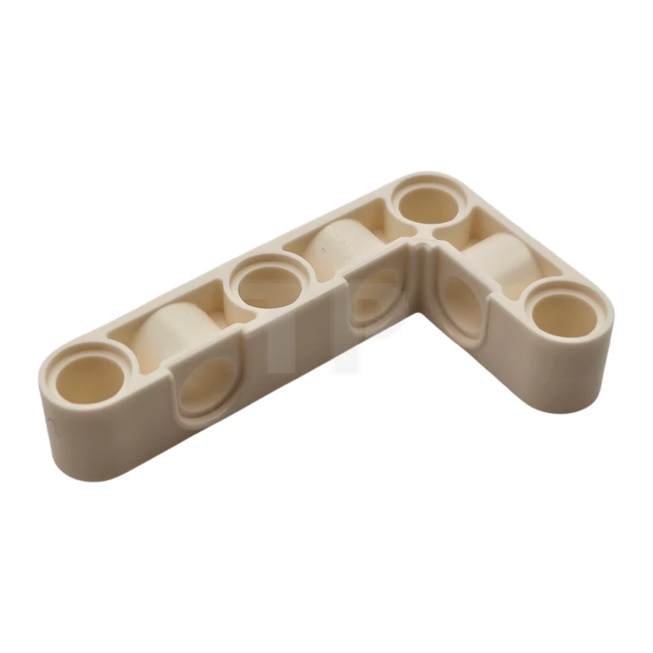
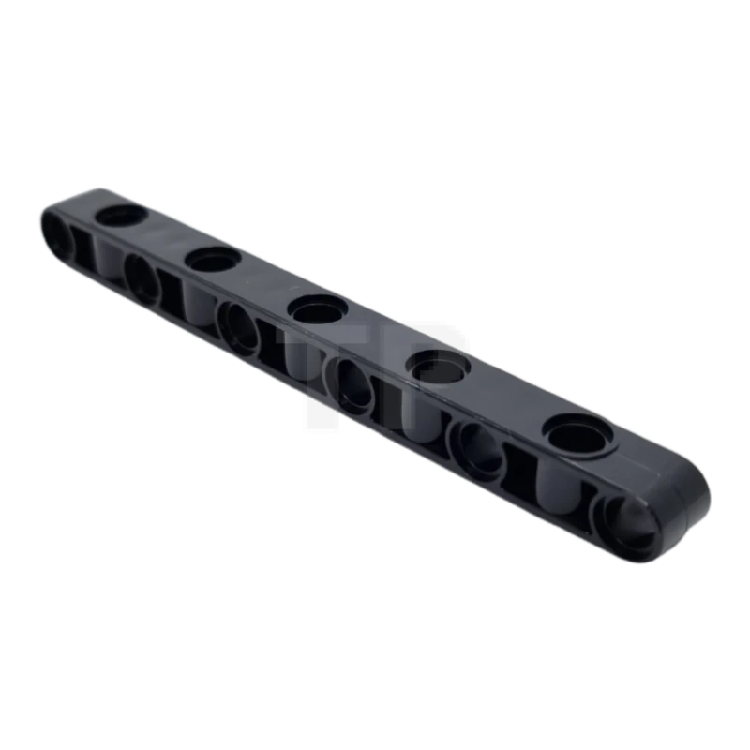
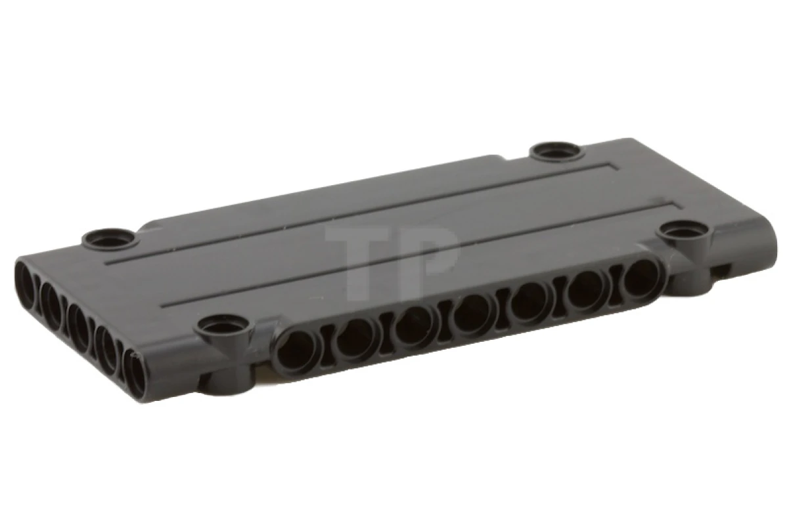
Parts
Ideally enough parts for two complete robots + all attachments
LEGO Pick a Brick: https://www.LEGO.com/en-us/pick-and-build/pick-a-brick
Brick Owl: https://www.brickowl.com/us/
Careful with Amazon, counterfeit parts
Previous FLL Challenge models:
https://andymark.com/collections/first-LEGO-league
List of possible parts: https://brickarchitect.com/parts/

Slide 20
LEGO Spike vs Pybricks
LEGO Blocks
Default option
Works on iPad and Laptops
Easy to learn
Does everything needed
LEGO’s Python does not support libraries, uses a proprietary file format, and is poorly documented
Pybricks (see other conference presentation for more info)
3rd Party/Open Source Python library
Codes in Python, longer learning curve
Has Block Code version which costs money, Python version is free
Code can be simple or complicated
Can be as nuanced or as simple as you need it to be
More finite control over motors and has built in gyro functions
Talk about it, especially if you used Pybricks (it’s in the Rubric)

Slide 21
Code Management
Whatever works..(but do it; you will need it)
Google Drive/MIcrosoft OneDrive
USB Sticks
Labeling file version by name (e.g., mission1_rev1.py, mission1_rev2.py)
Git (Github, Bitbucket, Gitlab, etc…)
We used Github
Coded in Python (text based)
Team used Visual Code to write code
Easily supports GitHub integration
Performed basic commit, push and pull. Some branching
Coach worked with team to resolve merge conflicts.
Github concept of Issues were used to manage Mission documentation (and sharing)
Talk about it (it’s in the Rubric)

Slide 22
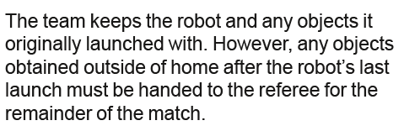
Robot Games Competition Day
Typically have practice tables setup, you sign up for them, rules vary
Typically one Practice Competition
Done on the Competition Tables
Everything exactly like the actual competition, but score doesn’t count
Three actual competition runs
Highest score counts (tiebreakers are next highest score).
Rules are up to two people on each side (4 members), members can swap in
No laptops/bluetooth at competition table
Only one robot allowed at competition table, can bring back-up robot to competition
Verify the table is set up correct, practice this!
Know the rules
No rule forbids robot interacting mission model while in home area
Use Gracious Professionalism in arguing the rules and scores with referee
Notes:
Make the team members responsible for verifying the table is reset correctly, during practice at home incorrectly set up the table to make sure they are checking. Any missed points because they didn’t verify, is their problem-low consequence teachable moment on personal responsibility. This year the Silo mission can be broken, the red lever and plate can come loose making mission impossible to complete, have the table judge verify the mission is still working.

Slide 23
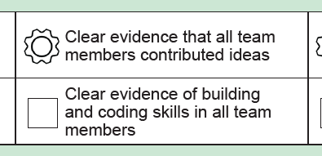
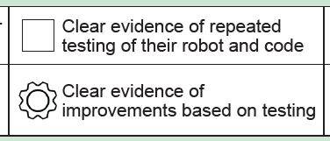
Robot Design Presentation
Understand the Rubric
We split all missions to all team members (in the Rubric)
Issues combining back together
Be clear on how ideas/code was shared
We used GitHub (teamwork)
Have a strategy, even something as simple as a schedule
If you didn’t attempt full points… what criteria did you use to select missions?
Document as much as possible for presentation
Keep old attachments if you have enough parts to show judges on iteration

Slide 24
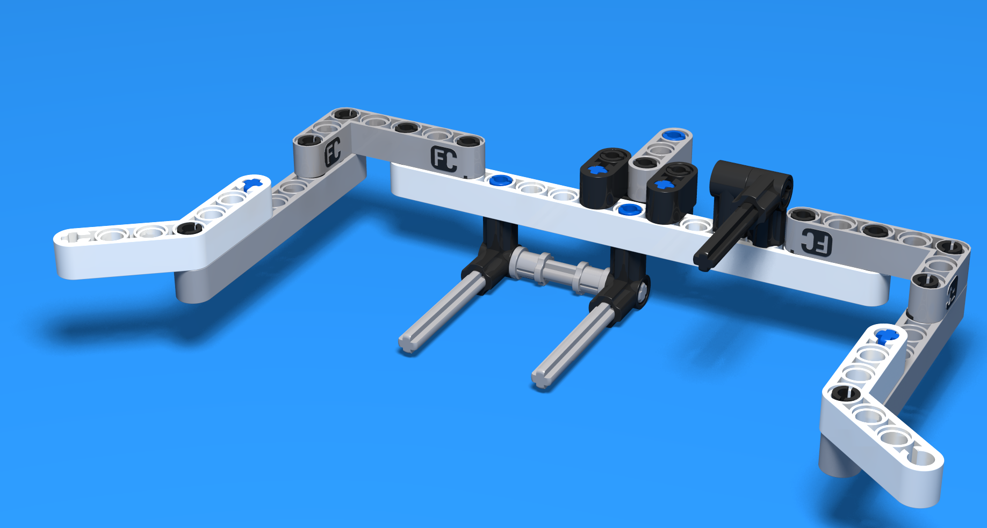
Parting thoughts
Batteries are important
Table cleanliness/Tire cleanliness
Each table is unique!
Wipe clean the wheels
Mechanical Self alignment
These are LEGO pieces, they aren’t consistent or precise
Some mission tolerances are less than ⅛”
No two robots are identical
Murphy’s Law
What can go wrong will go wrong
Notes:
Coaches should keep in mind that kids need to interact with elements of the game board that are five to six feet away with error tolerances often as low or less than 1/8", all while using LEGOs on inconsistent surfaces/tables with mission models that have been used many times over by hundreds of children during qualifiers.

Slide 25

Questions

Slide 26
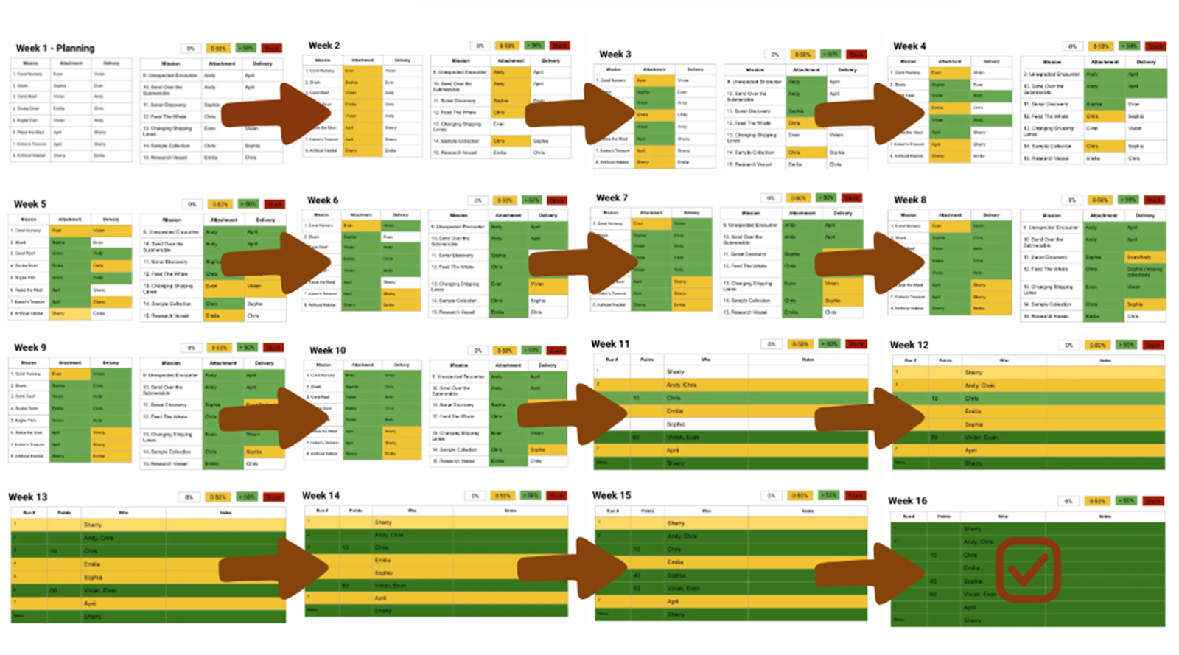
Plan/Schedule

Slide 27
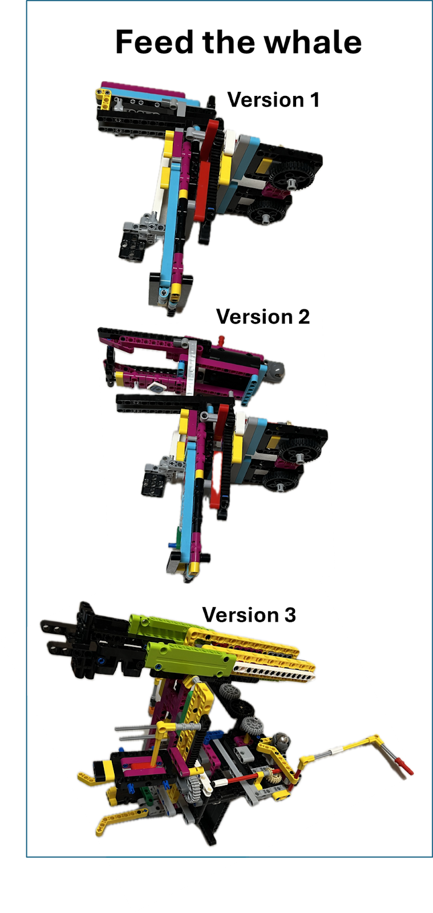
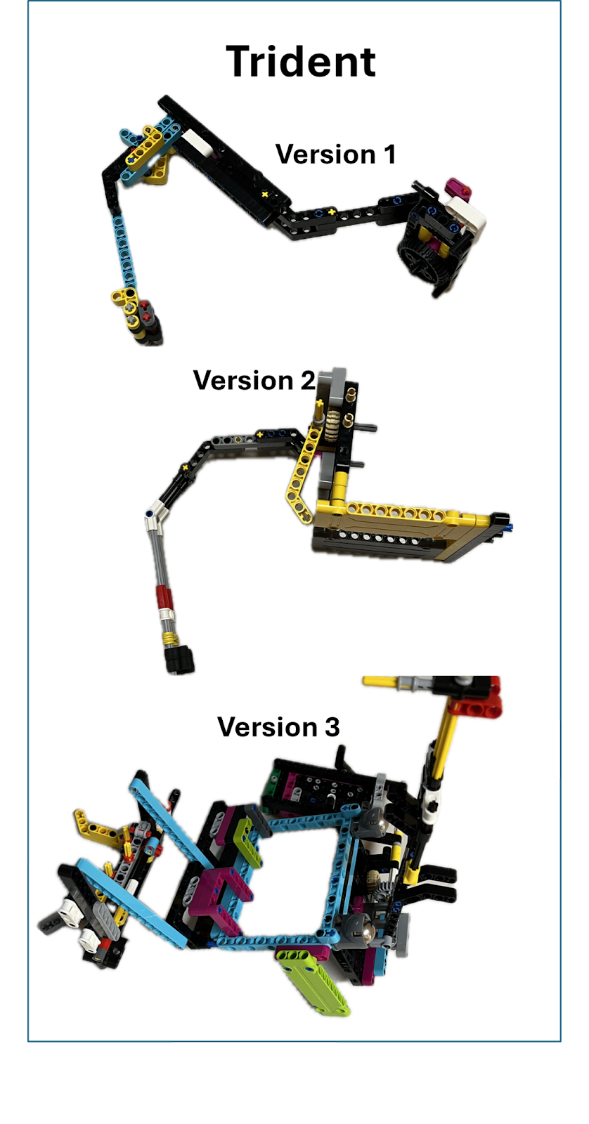
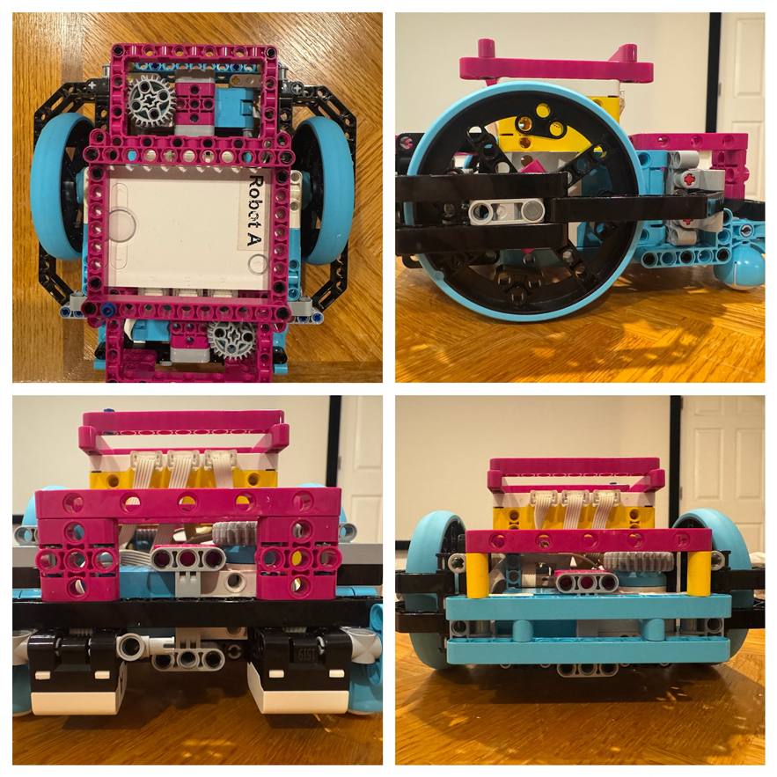
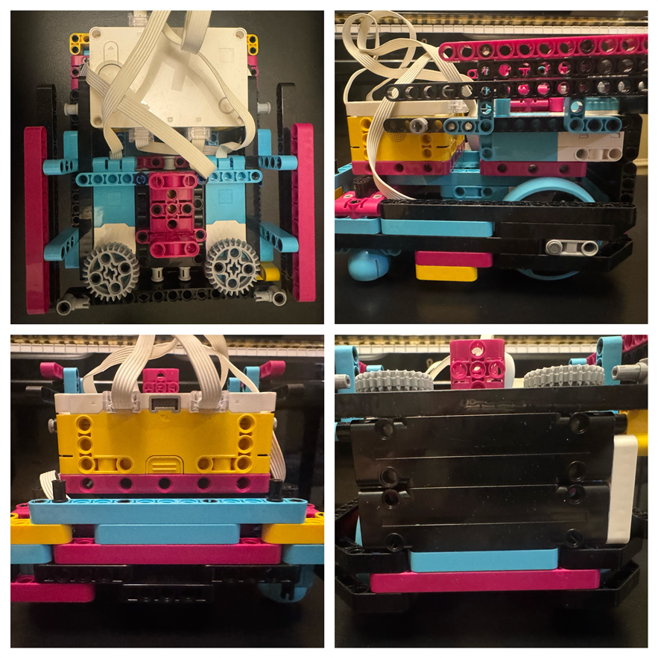
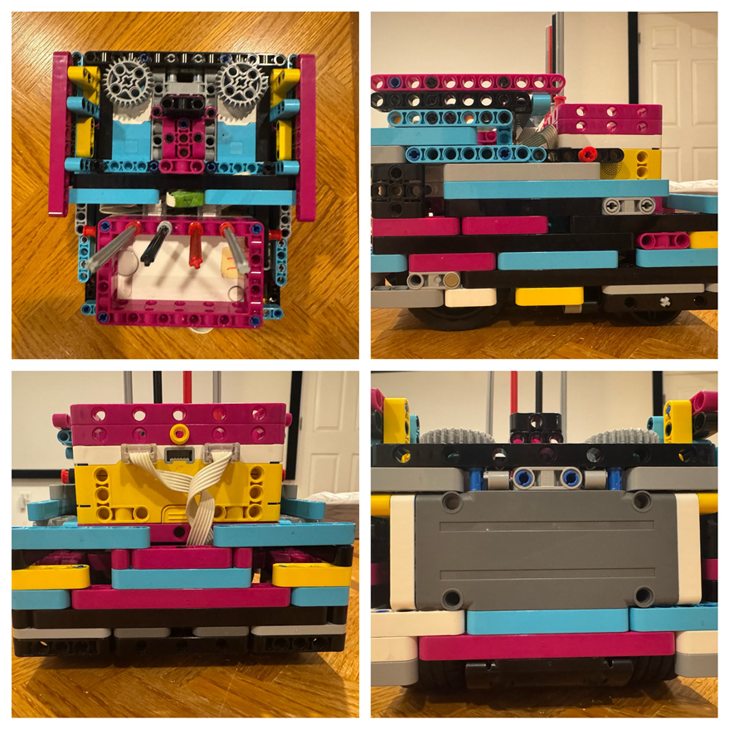
Iteration

Slide 28
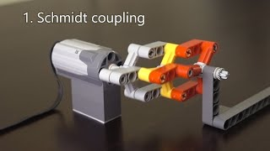
Mechanical Couplings

Slide 29
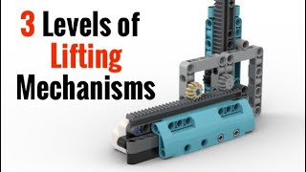
Lifting Mechanism

